Slide 1
Enterprise Resource Planning (ERP) Project Update
August 8, 2024
Notes:
Good morning Commission.
I’m Dana Reed, Director of ES and PM for this project.
With me today (virtually) is Brianna Pardon from BerryDunn. BD was awarded the contract to manage this project in March.
ERP is a large business project to replace our existing software WAM – which is at end-of-life – but to also modernize our financial process, controls and systems. This will create efficiencies, provide single-source of data for decision-making, and…

Slide 2
Today’s Presentation
Q2 Progress
Employee survey
Fact-finding sessions
Needs Assessment Report
Next Steps
Questions
Notes:
Today’s presentation is an overview of Q2 progress including:
Change readiness survey sent to all staff
Fact-finding sessions with subject matter experts
Deliverable of the Needs Assessment Report
Finally, Next steps and any questions you have.

Slide 3
Project Phases
Plan
Select project management firm
Define
Needs assessment
Implement
Select
Select software and services
Requirements gathering
Data migration
Training
Install software
RFP
Draft RFP
Release to vendors
Notes:
We are currently in Phase I – assessing our current environment and defining future needs.
We closed out Phase 0, the planning phase in April.
THIS project is on-schedule.

Slide 4
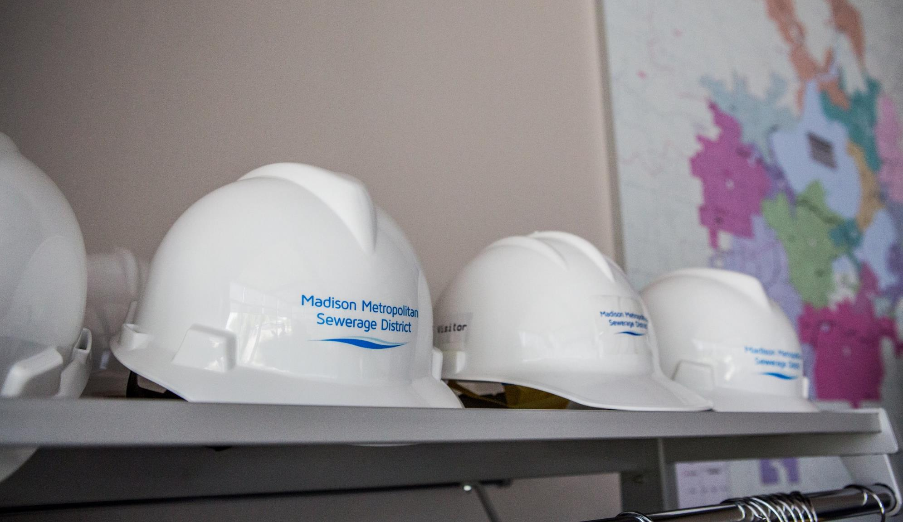
Q2 Progress
69 responses to employee survey
100+ documents collected
43 Staff attending kickoff
18 Fact-finding sessions
System Needs Assessment Report
Notes:
These metrics and activities supported our goal of assessing where we’re at - what’s our current functional and technical environment and our readiness for this project.
-

Slide 5
Employee Survey
Anonymous
7 questions
1 to 5 ranking (1 being strongly disagree and 5 being strongly agree)
Included open-ended comments
Notes:
Goal of the survey…
collect information to understand challenges in the current environment and evaluate the organization’s capacity to manage the process of implementing a new system
OE questions gave us additional insight into needs from a new system and information on how to involve staff in change activities

Slide 6
I believe we’re committed to making this change
Notes:
A majority of respondents (68%) believe the District is committed to making this change. This suggests the District’s actions and communications have conveyed a sense of commitment to the change initiative among respondents. Working to help ensure all employees perceive a strong commitment can help build trust and alignment, foster a more positive attitude toward the change, and contribute to a higher likelihood of cooperation, engagement, and successful implementation overall.
Open-ended

Slide 7
I understand the business reasons for ERP project
Notes:
In general, a significant portion of respondents perceive the project positively, and there is an understanding among most participants regarding the reason behind the software transition. This response suggests leadership’s communication and explanation about why the change is necessary has been effective. This understanding can contribute to smoother adoption, reduced resistance, and more engaged staff during the implementation process.

Slide 8
In the past training has been adequate to prepare me
Strongly disagree 3%
Notes:
A majority of respondents (79%) disagree or feel neutral that past training activities have adequately prepared them for change

Slide 9
Does WAM prevent you from making changes to current business processes
Notes:
A majority of respondents (79%) disagree or feel neutral that past training activities have adequately prepared them for change

Slide 10
Open-ended Comments Summary
Excitement and support
Desire for continued involvement in the ERP project
Access to data and reporting is critical
Inefficient and inconsistent processes are a frustration
We work in different ways than 20 years ago

Slide 11
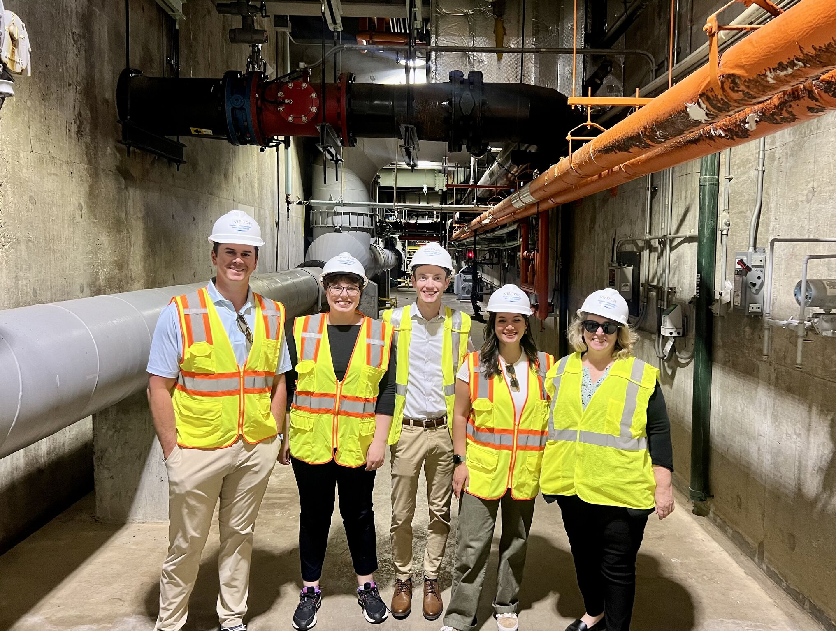
BerryDunn Consultant – Brianna Padron

Slide 12
18 Fact-Finding Sessions
General Ledger (GL) and Financial Reporting |  | Human Resources (HR) and Personnel Management
Project Accounting and Grant Management |  | Applicant Tracking
Budgeting: Operating, Capital, and Debt |  | Benefit Administration
Purchasing, Bid, and Contact Management |  | Compensation
Accounts Payable (AP) |  | Performance Reviews and Management
Accounts Receivable (AR) and Cash Receipts |  | Time and Attendance
Fixed Assets and Inventory |  | Payroll
O&M Training and Certifications |  | Document Management
Technical Environment |  | RFP Procurement Process

Slide 13
System Needs Assessment Report
Detailed survey data
Current functional area environment
Current technical environment
Opportunities for improvement
Key decision points
Steering Committee finalized July 24

Slide 14
Next Steps
August 13 Request for Information (RFI) released
October Vendor outreach sessions
November Finalize requirements for RFP
December Release RFP for ERP software and services
Notes:
As part of this phase of the project, we are contacting the vendor community to understand the availability of modules, functionality, and the related timeline and cost with implementing a new system(s). Information collected from this RFI will inform the District’s future planning process.

Slide 15
Questions?

