Slide 1
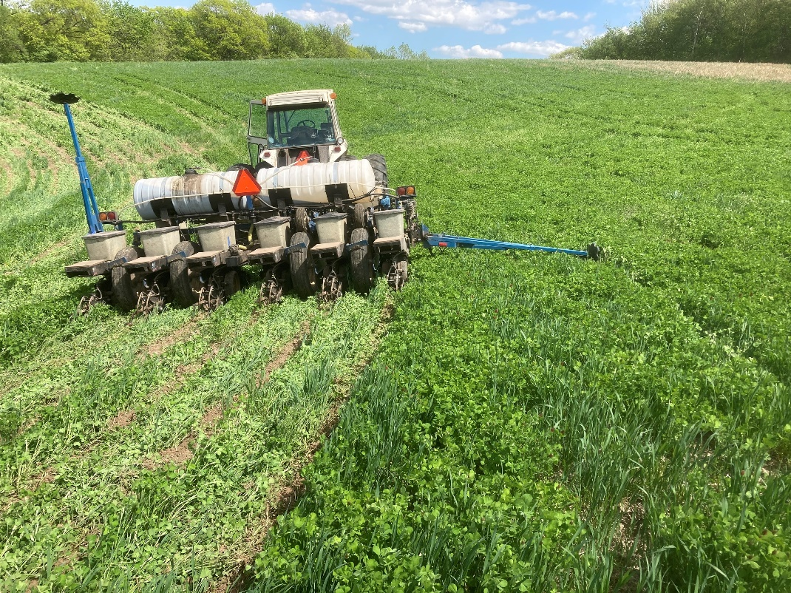


District Adaptive Management Project
Yahara WINS 2023 Annual Report
August 8, 2024

Slide 2
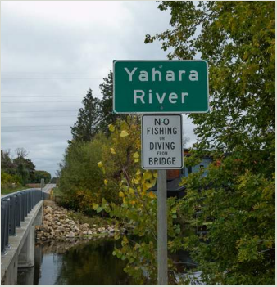
Agenda
YWINS Review
2023 Annual Report
Final Adapative Management Report for 1st Permit Term
Adaptively Managing Forward
Close

Slide 3


Phosphorus is an Essential Element
For Plant & Animal Growth
…but Excess Phosphorus
Can be a water resource concern.

Slide 4

Rock River Basin TMDL
96,000 lb/yr required reduction
Developed after 2010 phosphorus rule.
P reductions from all sources
  Nonpoint, Urban Stormwater, Point Sources
540 square miles
Rock River Basin

Slide 5


Point Sources
Nonpoint Sources
Treatment Plants
Urban Stormwater
Agricultural Runoff
20%
30%
50%
Permits
Permits
No Permits
Phosphorus Reductions From All Sources
Notes:
Have to remind ourselves that without every source working together to mee the goals of the TMDL, we will fail in meeting our permit requirements. In other words, if only point sources are working on it because of their permit, only half of the reduction goals will be met.

Slide 6
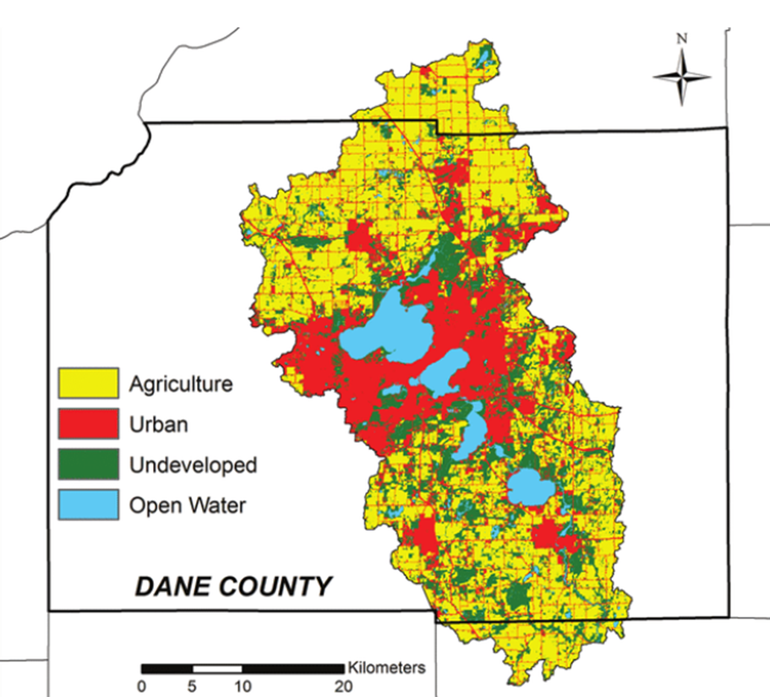
Cost of Additional Treatment
Minimal water quality benefit downstream.
High cost, low public benefit.
Missed opportunity to be a partner in Yahara chain of lakes improvements.
27%
Urban
47%
Cropland
19%
Natural Vegetation
Notes:
If we decided to achieve permit compliance on our own, there’s significant cost to the additional treatment.

Slide 7
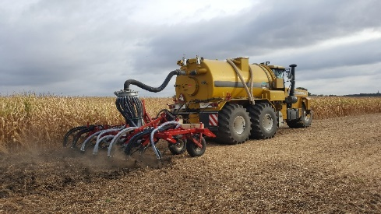
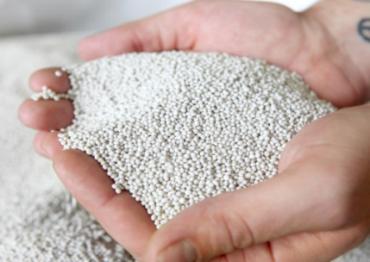

Cost of Additional Treatment
$140M (NPV)
$240M (actual)
Very expensive for point sources and MS4s.
95%
70%
Notes:
The actual cost of building tertiary treatment at the plant was estimated around $200 million to remove a very small amount of P.

Slide 8
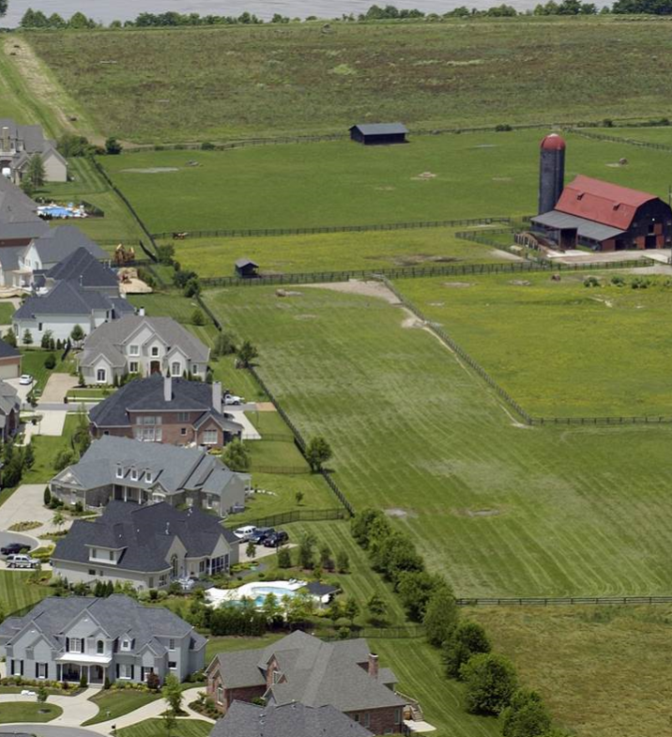

Adaptive Management
Regulatory Compliance Strategy
Yahara Watershed Phosphorus and Sediment
Watershed based approach
All sources work together
Fund affordable mix of Phosphorus reduction practices
Allows for creativity and flexibility
Lower $$ Regulatory Compliance

Slide 9
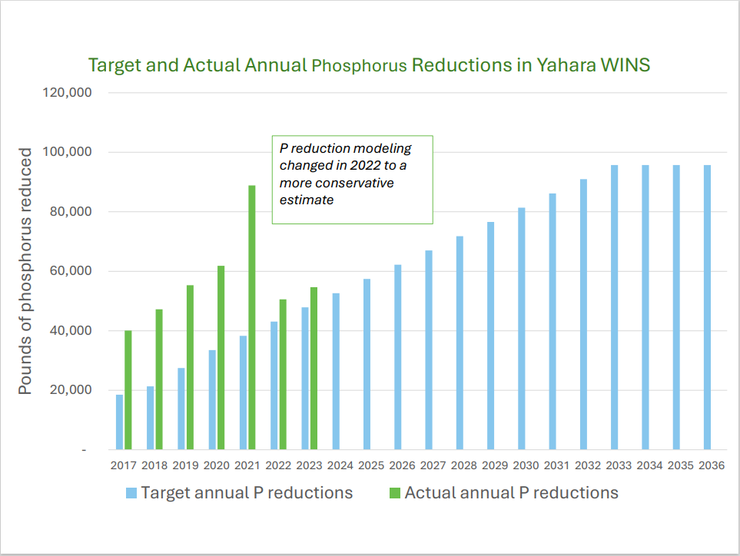

2023 Phosphorus Reductions
Watershed reduction total 54,541 lbs.
Exceeds 2023 goals, looking good for 2024!
Expanding conservation practices in lower reaches of the watershed.
Majority of implementation from Dane County and Yahara Pride Farms.

Slide 10
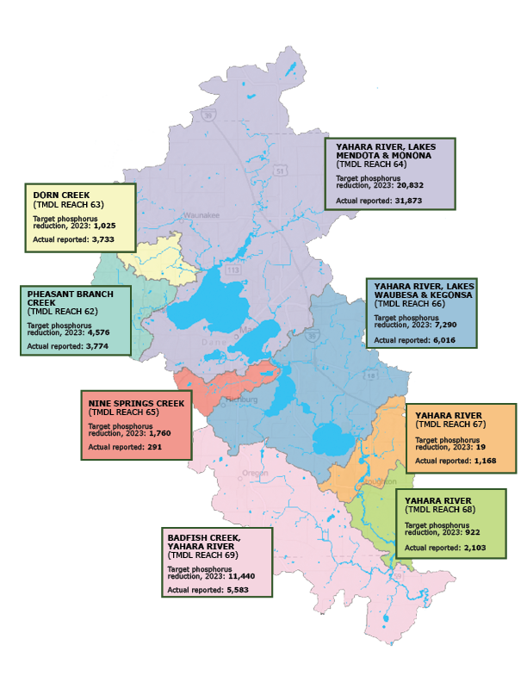
Reach Specific Goals
Majority of reductions still in Reach 64.
Exceeding goals in half of the reaches, closing the gaps in other reaches.
Challenges of Reach 65
More work needed to meet reach specific goals in all reaches.

Slide 11


“Ramp Up” Phosphorus Reduction Goals
TMDL Reach
5%
 |  | 62 | 63 | 64 | 65 | 66 | 67 | 68 | 69 | Total (lbs)
Year
2023 |  | 4576 | 1025 | 20832 | 1760 | 7290 | 19 | 922 | 11440 | 47,862
2024 |  | 5034 | 1128 | 22915 | 1936 | 8019 | 20 | 1014 | 12583 | 52,648
2025 |  | 5491 | 1230 | 24998 | 2112 | 8748 | 22 | 1106 | 13727 | 57,434
2026 |  | 5949 | 1333 | 27081 | 2288 | 9477 | 24 | 1198 | 14871 | 62,221
2027 |  | 6406 | 1435 | 29164 | 2464 | 10206 | 26 | 1290 | 16015 | 67,007
2028 |  | 6864 | 1538 | 31247 | 2640 | 10935 | 28 | 1382 | 17159 | 71,793
2029 |  | 7322 | 1640 | 33330 | 2816 | 11664 | 30 | 1474 | 18303 | 76,579
2030 |  | 7779 | 1743 | 35414 | 2992 | 12393 | 31 | 1567 | 19447 | 81,365
2036 |  | 9152 | 2050 | 41663 | 3520 | 14580 | 37 | 1843 | 22879 | 95,724
16%
5%
12%
10%
Notes:
A few points I want to make when we look within specific reaches:
We will have increases and decreases every year. What’s important is we exceed our goals within each reach watershed at year 2036.
We review each reach annually to make strategic decisions with our implementing partners to meet future reduction goals.

Slide 12




Implementing Partner Highlights
31,217 lbs. of P reduction
29,034 acres in cropland conservation
78 farmers in their cost share program.
Leveraged additional $583,216 for implementation
23,218 lbs. of P reduction
Over 60,000 ac. in Nutrient Management
Assisted 237 landowners/producers
Allocated over $600,000 in cost sharing.
Small area of the watershed (8%)
Grassed waterways, harvestable buffers, perennial forage conversion
Effective partner with fewer opportunities
Notes:
This slide speaks for itself. Our three partners currently putting conservation practices on the ground.

Slide 13

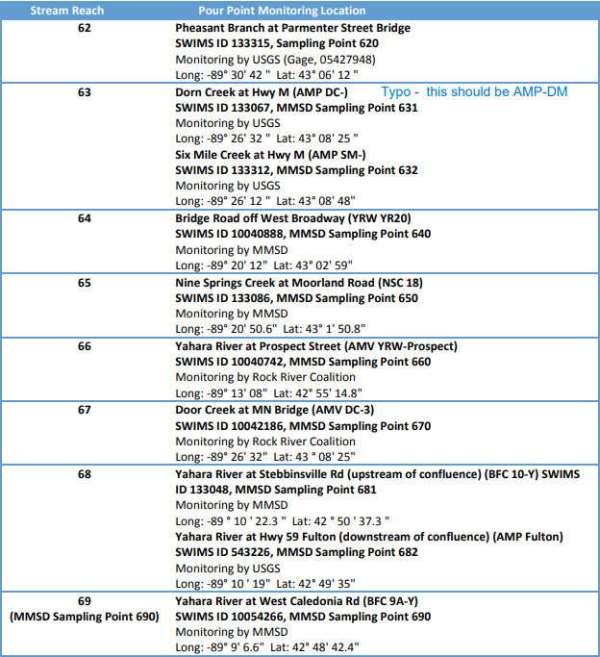
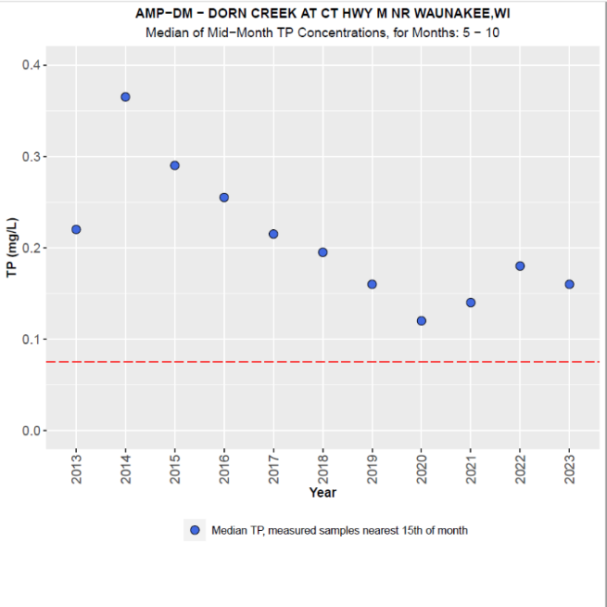
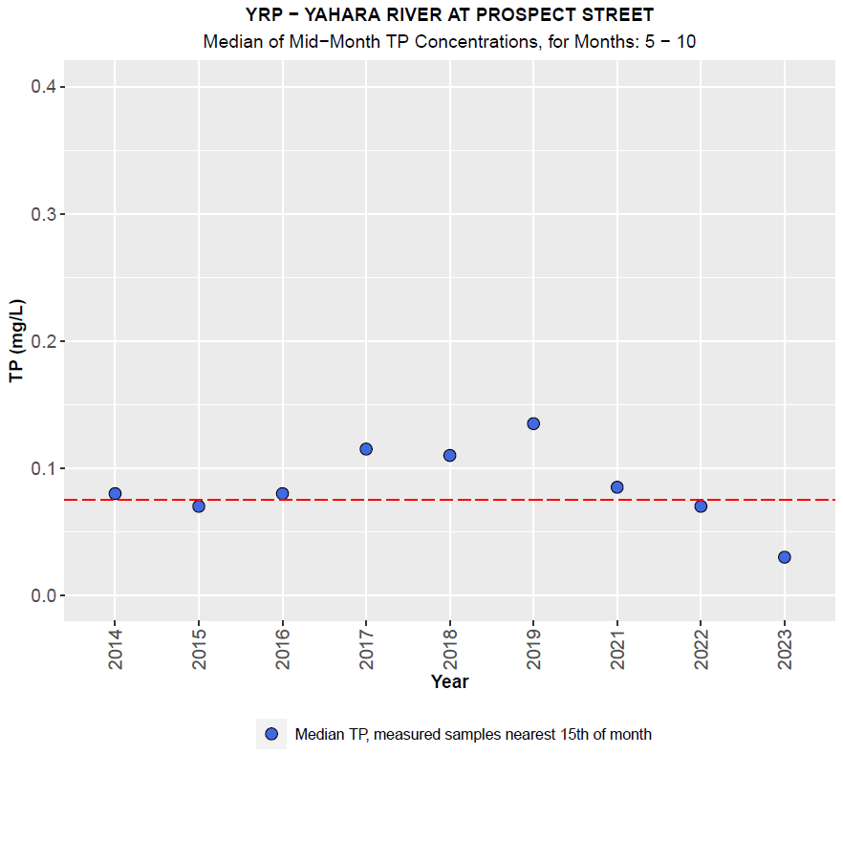
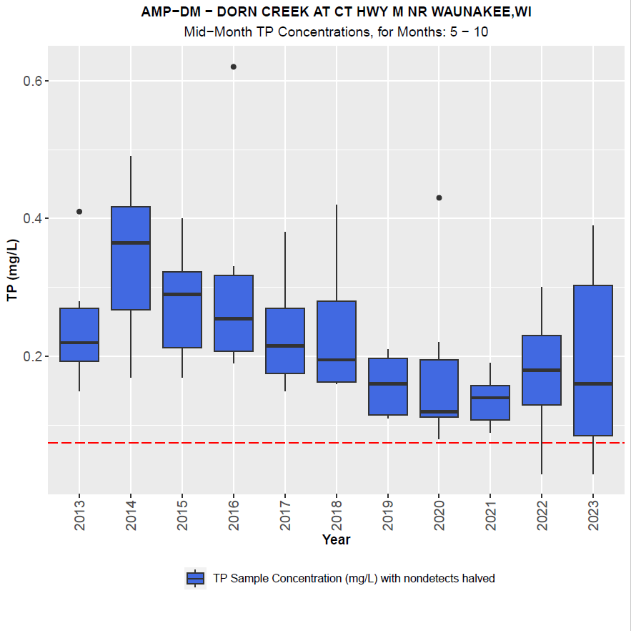
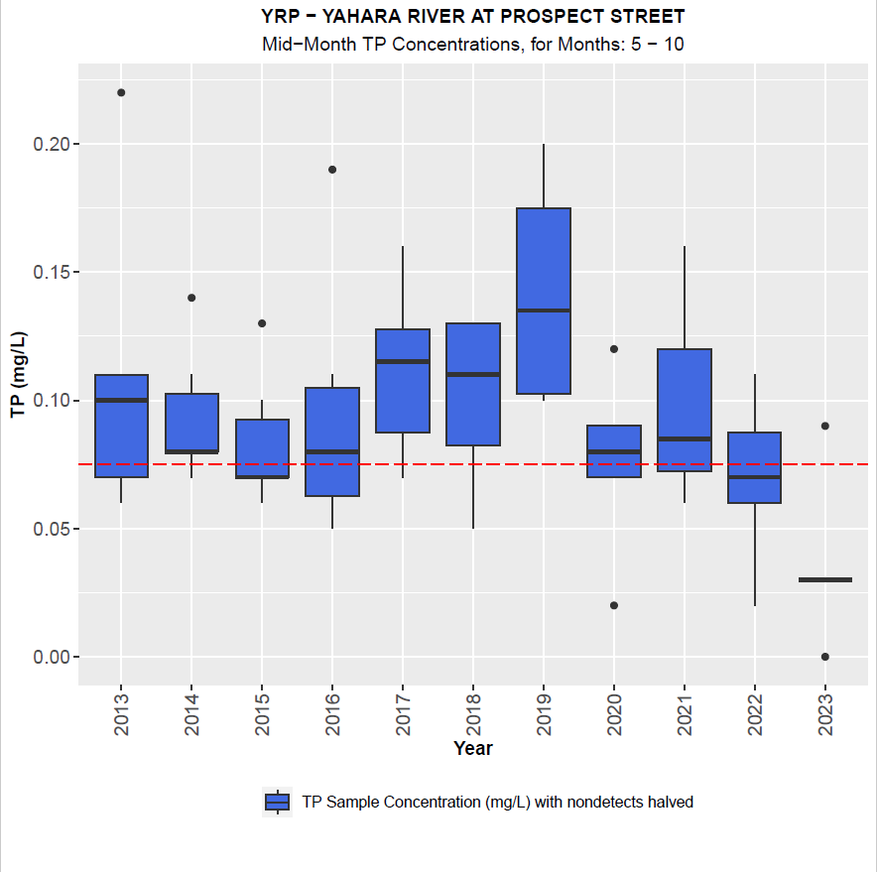
USGS Water Quality Monitoring
Notes:
USGS is another that leads our monitoring program and develops water quality analyses for us.
The takeway from the graphs is P concentrations are trending down…that’s a good thing. We have this type of information for all 10 monitoring sites. I’m only showing an upstream and downstream example.

Slide 14

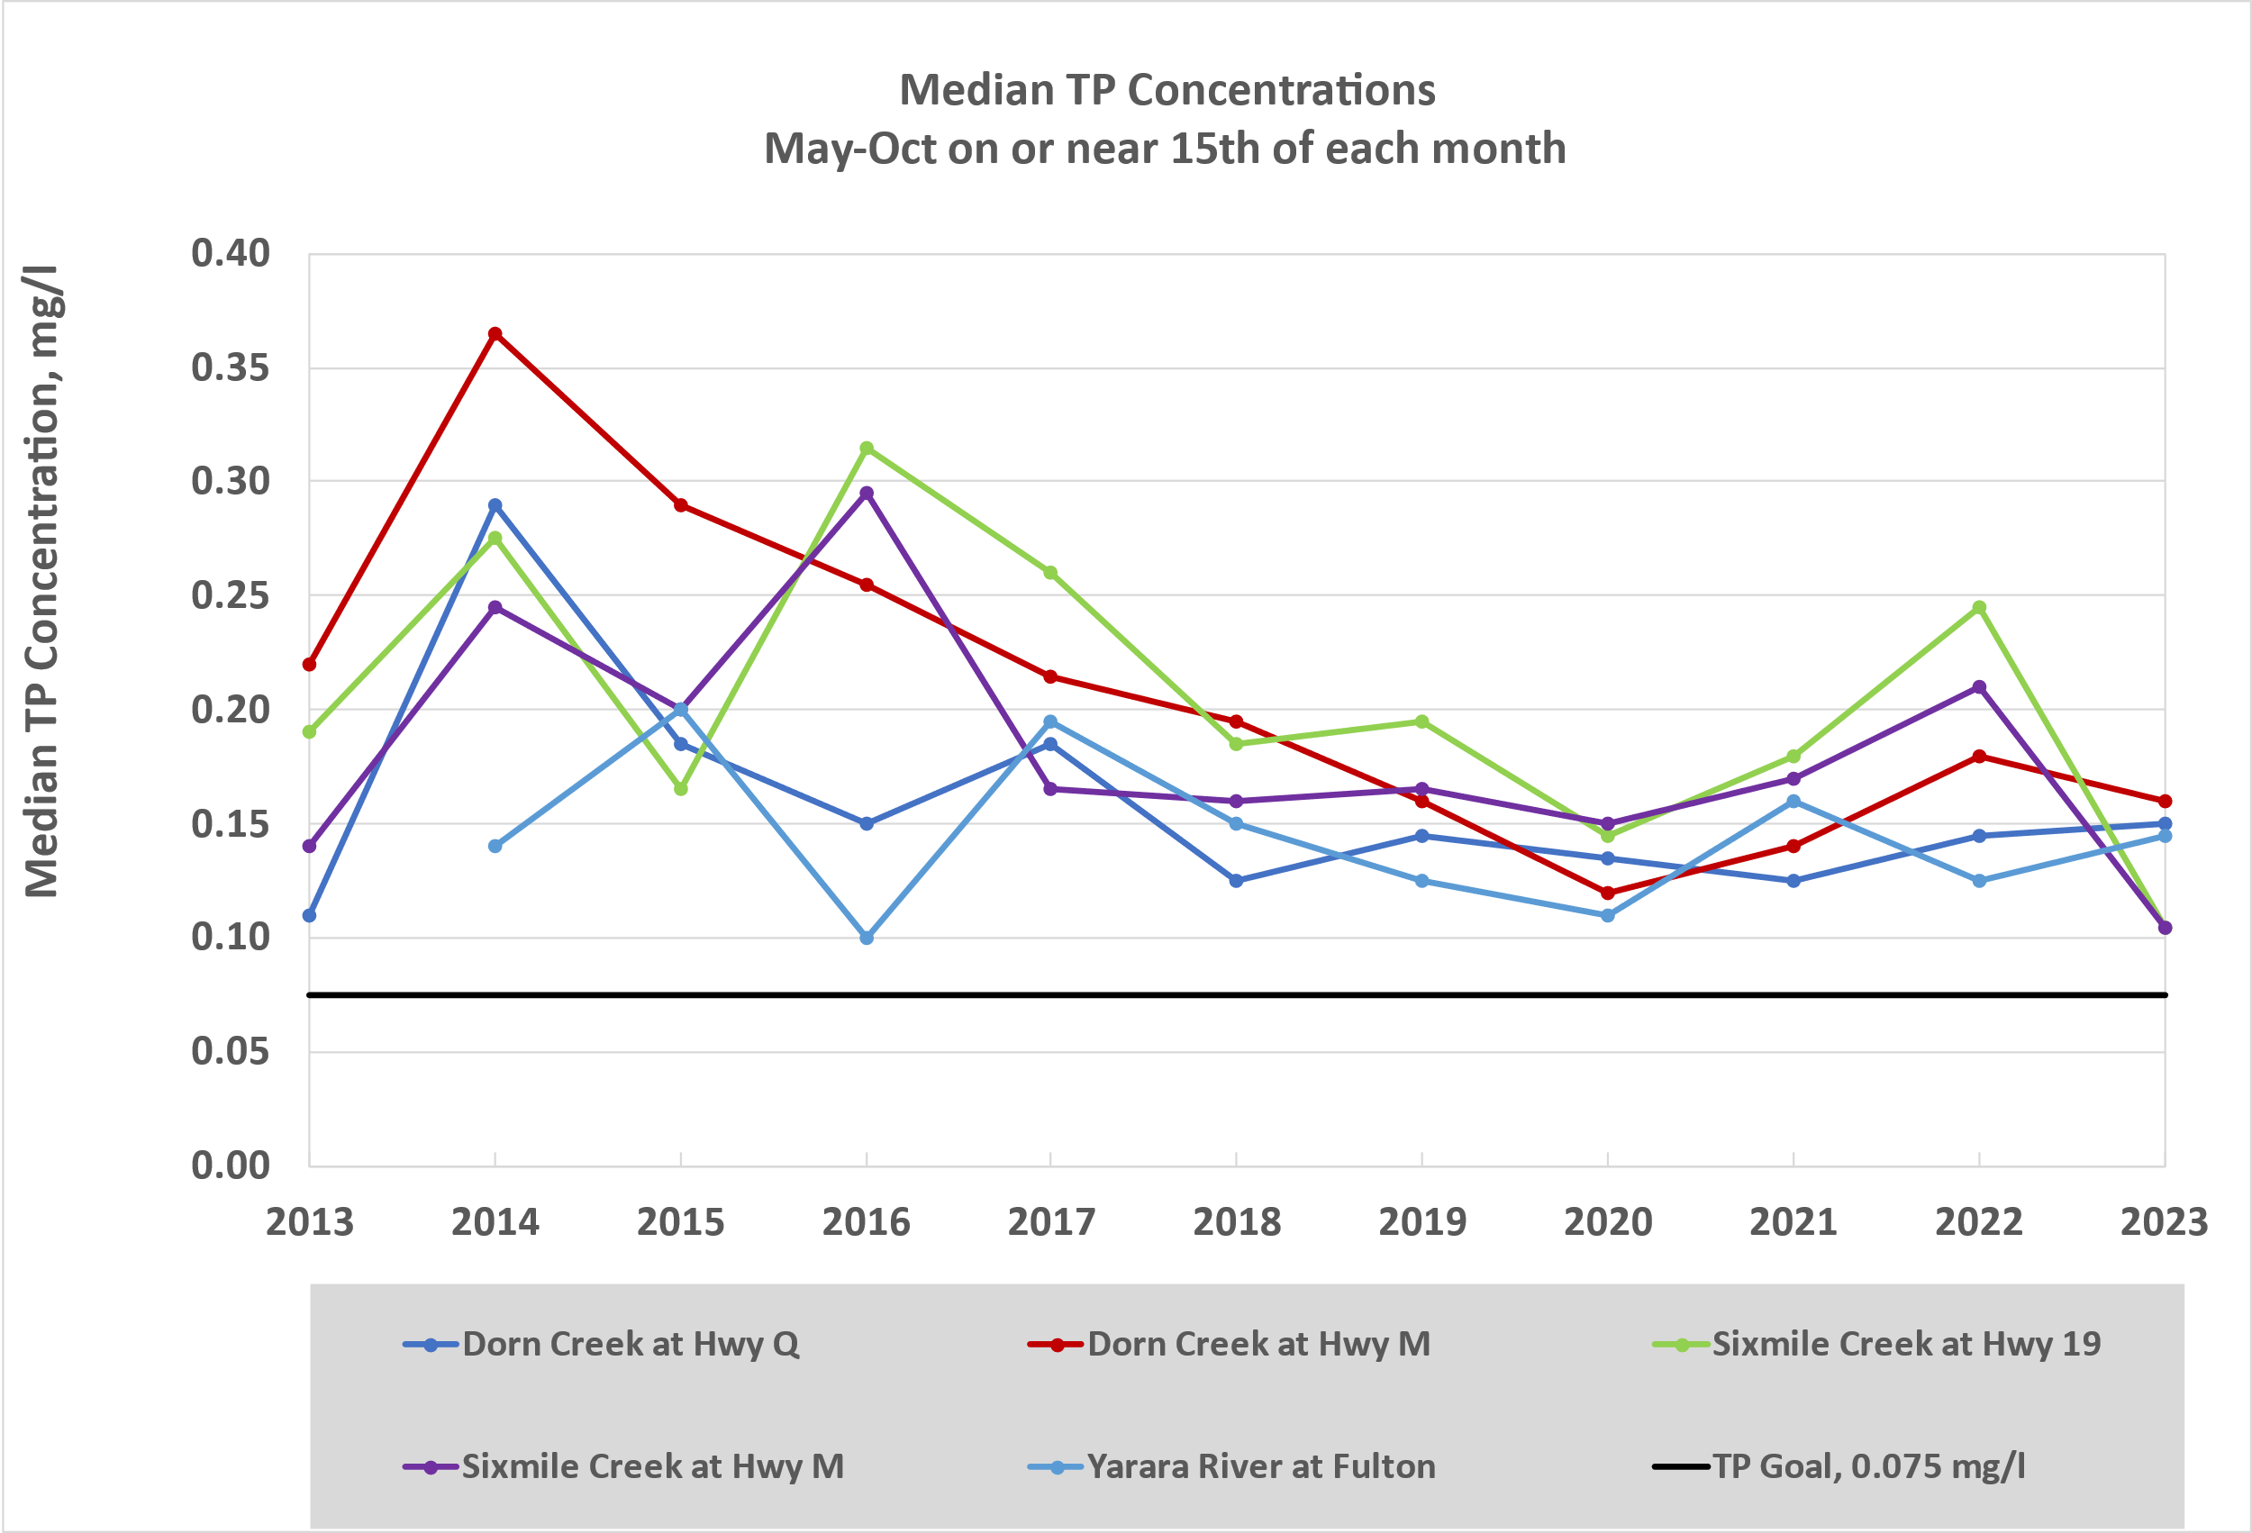
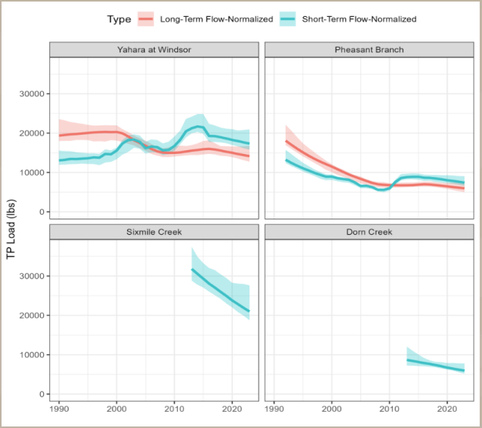

Which way is P trending?
Notes:
Left side graph is showing P concentrations from a subset of sites. We will always have peaks and valleys due to weather and impacts of climate change, but the goal is to smoot out the lines over time.
Right side graph is an assessment of P loads in lbs. from similar sites in the upstream area that also show P trending down…that’s a good thing!

Slide 15


Final AM Report for First Permit Term
DNR audit of Yahara WINS
Permit requirement, due every 5yr permit term.
Verify implemented practices.
Recognize efforts of implementing partners.
Navigated unknowns as the first one in the state!
Notes:
Think of this as an audit of Yahara WINS adaptive management program which assesses our methods for quantifying P reductions. More importantly it validates the success of Yahara WINS. It validates the annual P reductions that we report out are real, and it validates our status as a national model for reducing P runoff to surface waters.

Slide 16
Cost Model Update
Review/Modify Monitoring Strategy
Increase Program Resiliency
  Metrogro
  USDA Grant
Targeted Implementation
Committed to meeting program goals in the years ahead.
Notes:
Finally, a look ahead at some things we are working on to ensure we are meeting our goals into the future.
Working with a consultant to review and recommend adjustments to the cost model to meet the financial demands of future P reductions.
Working with USGS to make the necessary adjustments to our monitoring strategy so we collect the appropriate data to meet reach specific goals.
Increase our implementing partners to find more areas of P reductions.
Up to this point its been about finding as many lbs. of P as possible, and we have proven that we can. Now we need to strategize for reductions in specific areas…like Reach 65.

Slide 17
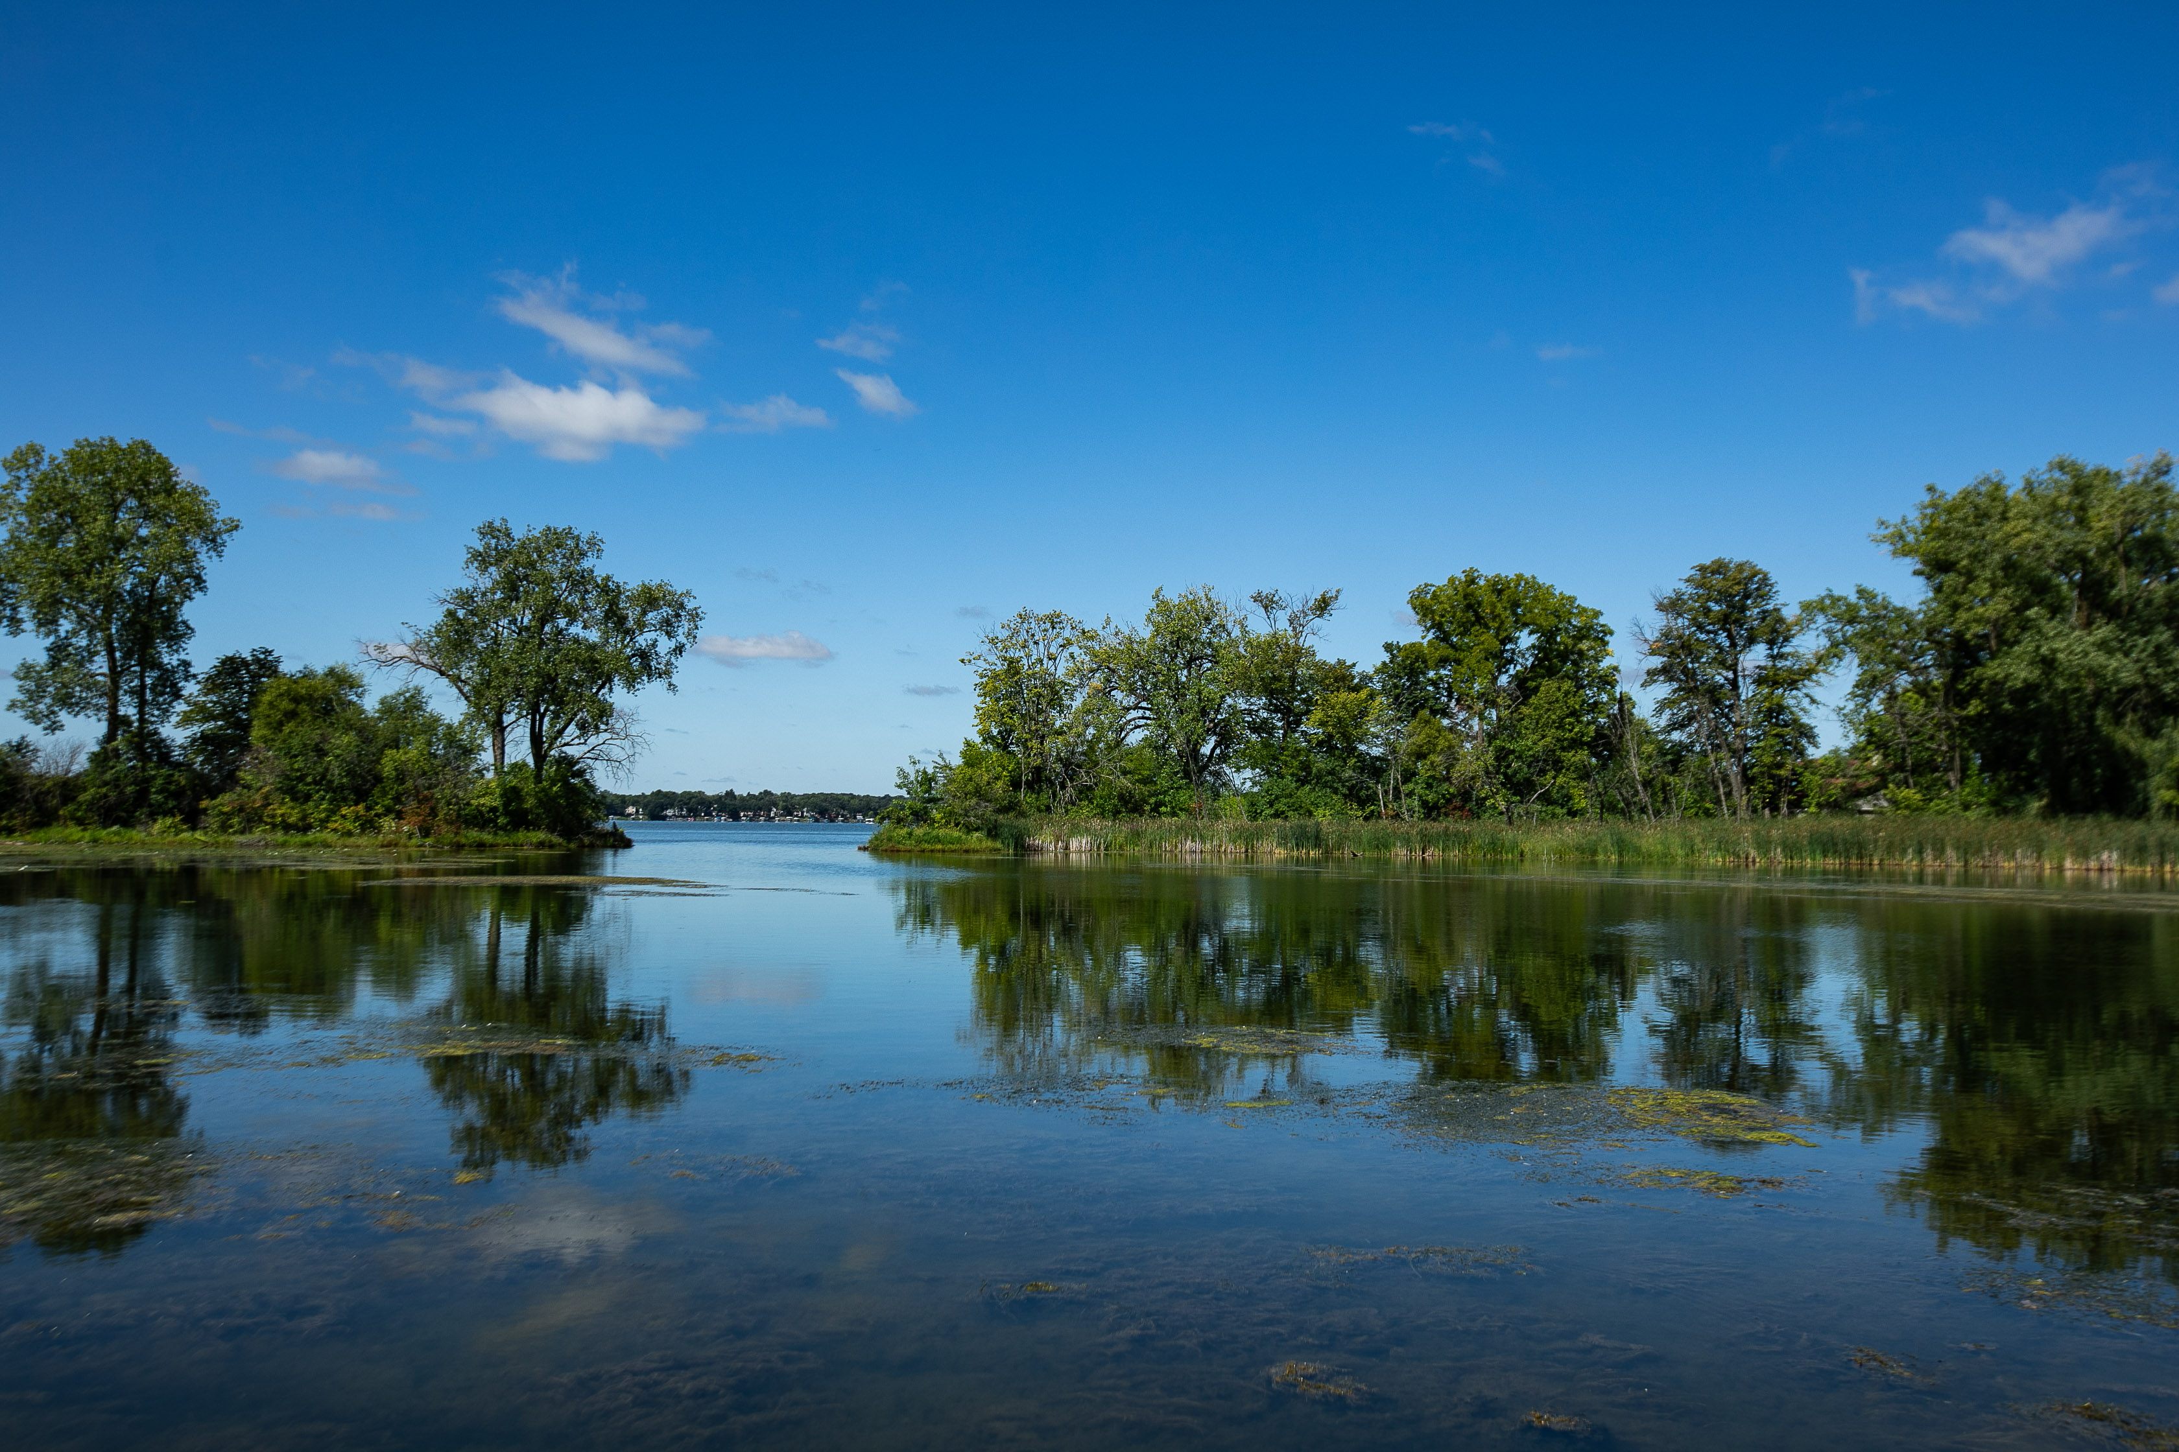
Thank you

