Slide 1
Madison Metropolitan Sewerage District
  Introduction to Public Finance
  July 25, 2024
PFM Financial
Advisors LLC
115 South 84th Street
Suite 315
Milwaukee, WI 53214
414-771-2700
pfm.com

Slide 2
Firm Overview

Slide 3
Firm Overview
Founded in 1975,¹ PFM’s financial advisory business started with the belief that governments and public entities need independent advice from professionals who understand institutional financial needs and challenges inside and out, advice from people who respect the amazing work they do every day for the benefit of others. With this insight, we serve as a fiduciary to our clients, guided by our bedrock principles of Ingenuity, Sustainability and Resourcefulness.
Today, our financial advisors and consultants work across a broad range of traditional and specialized sectors in every region of the country. Thanks to an unwavering commitment to serving our clients’ interests above all else, PFM has grown into one of the nation’s leading independent financial advisors.
Services l Entities
Financial advisory services | PFM Financial Advisors LLC
Investor relations powered by Munite® | PFM Financial Advisors LLC
Consulting services | PFM Group Consulting LLC
Swaps and Derivative advisory services | PFM Swap Advisors LLC
Financial planning powered by Synario™ | PFM Solutions LLC
¹PFM Financial Advisors LLC commenced operations on June 1, 2016; all transactions prior to such date were effected through former affiliate, Public Financial Management Inc., which was founded in 1975 on the principle of providing sound independent and fiduciary advice to public entities.
Notes:
Matt Schnackenberg

Slide 4

What PFM Does
FINANCIAL
PLANNING
FINANCIAL
ADVISORY
Synopsis powered by SynarioTM
transaction management & bond pricing | credit strategies | capital planning
ALTERNATIVE
FINANCE
public private partnerships & economic development | developer selection & negotiation | asset & real estate portfolio analysis & monetization | environmental finance | tax credit & incentive policies
INVESTOR RELATIONS
powered by Munite®
investor intelligence & outreach | analytics
| customized dashboards
SPECIALIZED
SERVICES
CONSULTING
fiscal planning & budgeting | organizational efficiency & effectiveness | policy & program analysis | workforce strategy & negotiation support
derivatives advisory | treasury management consulting | retirement finance
Notes:
Option 1

Slide 5
Role of an Independent Financial Advisor
An Independent Financial Advisor/Registered Municipal Advisor:
The only outside financial expert with fiduciary responsibility solely to you, the issuer. We work for you and protect your interests.
Represents your interests and advises you in the fast-changing markets.
Doesn’t the Underwriter Do This?
Federal regulations prohibit an underwriter from representing that it is offering you independent advice if it is also a purchaser of your bonds, certificates or notes.
The underwriter must represent itself and bond purchasers, as well as you, the issuer. Such a representation can present a conflict of interest.
What about PFM?
PFM is an independent full-time financial advisory firm with a fiduciary responsibility to its clients.
PFM does not underwrite bonds, which eliminates any conflict of interest.
PFM’s only interest is that of the issuer in providing the optimal financing at the lowest possible cost.

Slide 6

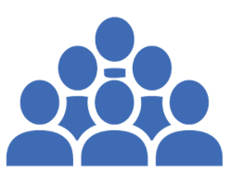

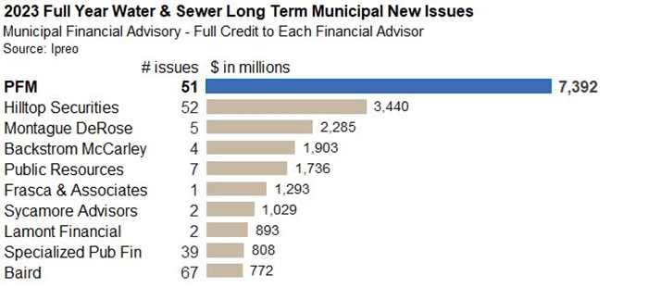
National Footprint with Deep Local and National Knowledge and Expertise
300
EMPLOYEES
Estimated according to PFM internal resources as of December 31, 2023
According to PFM Internal Resources as of December 31, 2023
¹ Source: PFM internal data.
Notes:
Matt Schnackenberg
Stearns has a big large upcoming jail project ($250 to $300 million in the next year or so)

Slide 7
Representative Sample of PFM’s Water and Wastewater Client
Representative List of PFM's Water and Wastewater Clients
Austin Water and Wastewater Utility | TX | Madison Metropolitan Sewerage District | WI
Baltimore Water and Wastewater | MD | Maryland Water Quality Administration | MD
City of New Orleans, Water & Sewerage Board | LA | New Water (Green Bay Metropolitan Sewerage District) | WI
Clark County Water Reclamation District | NV | Metropolitan Sewer District of Greater Cincinnati | OH
Clayton County Water Authority | GA | Metropolitan St. Louis Sewer District | MO
Contra Costa Water District | CA | Nassau Sewer and Storm Water Finance Authority | NY
DC Water and Sewer Authority | DC | New Jersey Water Supply Authority | NJ
Erie County Water Authority | NY | Oklahoma City Water Utility Trust | OK
Fairfax County Integrated Sewer System | VA | Passaic Valley Sewerage Commission | NJ
Fairfax County Water Authority | VA | Portland, Bureau of Environmental Services | OR
Great Lakes Water Authority | NI | Philadelphia Water Department | PA
Hampton Roads Sanitation District | MI | San Antonio Water System | TX
Kansas City Water Department | MO | San Diego County Water Authority | CA
Las Vegas Valley Water District | NV | Washington Suburban Sanitary Commission | MD
Los Angeles Department of Water & Power | CA
¹ Source: PFM internal data.
Notes:
Matt Schnackenberg
Stearns has a big large upcoming jail project ($250 to $300 million in the next year or so)

Slide 8
Why Issue Bonds?
New Money Bonds
Issued to fund Capital projects such as treatment plants, roads, bridges, stadiums, schools, power plants, etc.
Refunding Bonds
Issued to pay off existing bonds, where the old debt service payments are replaced with new debt service payments

Slide 9
Laws and Regulations
Federal Laws and Regulations
  Internal Revenue Service (IRS)
    Tax compliance
    Qualified use of proceeds
    Arbitrage yield restriction and rebate
    Records retention
  Securities and Exchange Commission (SEC)
    Initial Disclosure
    Continuing Disclosure
    Material Events
    Voluntary Disclosure
State Statutes
  Debt Limit
  Legal Authority for Issuing Debt
  Required Actions Needed

Slide 10
Debt Limit
The District has the power to incur indebtedness for District purposes specified by statute (Article 11 Section 3 of the Wisconsin Constitution and Chapter 67, Wisconsin Statutes) in an aggregate amount, not exceeding five percent of the equalized value of taxable property in the District, as last determined by the State of Wisconsin Department of Revenue. In general, such indebtedness may be in the form of bonds and promissory notes, including Clean Water Fund Loans, for various public purposes.

Slide 11
Debt Issuances: Clean Water Fund Loans (“CWFLs”)
PROS
Loans funded with debt issued by the State of Wisconsin (Aa1/AA+/AA+) at a subsidized rate (currently 2.365% for up to 20 years and 2.475% for 21 to 30 years as of July 1, 2024).
Funds are drawn down as needed, so there is no negative cost of carry (only pay interest on what has been borrowed).
CONS
Current limitations on available funding due to historically high requests for loans
Debt service repayment schedule is not customizable (level annual payments are required).
Federal requirements – BABA, Davis-Bacon, etc.
Term of loan is limited to 30 years in length.
Every draw requires additional paperwork and staff time.

Slide 12
Debt Issuances: Allowable Types of Market Debt
General obligation notes or bonds
  Can typically be issued for up to 20 years, however bonds can be issued up to 50 years for sewerage purposes (Wisconsin Statutes 67.07*)
  Lower interest rates than revenue bonds
Sewerage system revenue bonds
  Can be issued up to 40 years
  Principal must be paid not later than three years after the date of issue or two years after the estimated date construction will be completed (whichever is later)
*67.07 Maturity and place of payment
“….. every installment, whether of principal or interest, shall be made payable not later than 20 years .…or for the permanent improvement thereof, by a sewerage district or county having a population of 150,000 or over for sewerage purposes and by any city for sewerage purposes, all installments of principal and interest shall be made payable within a period not exceeding 50 years (effect added) from the original date of the bonds.

Slide 13
Debt Issuances: General Obligation Bonds
General obligation bonds (or notes if less than 10 years)
PROS
Length of the borrowing can exceed 30 years
Flexibility in structuring the principal payments
Lower interest rates than revenue bonds
CONS
Higher interest rates than CWFLs
Additional costs of issuance, e.g. underwriting costs, rating agency fee(s), etc. than a CWFL
The entire value of the debt issue is received up front, may result in a negative cost of carry depending on investment rates (interest is paid on what has been borrowed).

Slide 14
Debt Issuances: Revenue Bonds
PROS
Length of the borrowing can exceed 30 years, up to 40 years
More flexibility in structuring principal payments than CWFLs
CONS
Higher interest rates than CWFLs and general obligation debt
Less flexibility in structuring principal payments than general obligation debt
Additional costs of issuance, e.g. underwriting costs, rating agency fee(s), etc. than a CWFL
Debt service coverage requirements
May required a debt service reserve
The entire value of the debt issue is received up front, may result in a negative cost of carry depending on investment rates (interest is paid on what has been borrowed).

Slide 15
The Bond Sale Process

Slide 16
Structures the Bonds
Facilitates sale and closing of Bonds
Prepares Official Statement
Prepares Resolution
Delivers Tax Opinion
Reviews Documents
Municipal Advisor
Bond Counsel/
Tax Counsel
Prepares Bond Purchase Agreement
Prepares Agreement Among
Underwriters
Reviews Documents
Escrow Agent
Registrar/
Paying Agent/
Trustee
Pays Bondholders
Moves Money
Underwriter’s
Counsel
Madison MSD
Underwriter
Verification
Agent/
Accountant
Verifies Refunding
Escrow Sufficiency
Purchases Bonds
and Sells to Investors
Advises on Marketability
Rating Agencies
Moody’s, S&P,
Fitch
Credit
Enhancers
Every issue
As needed
Reviews Credit
Assigns Rating
Issues Report for Investors
Insures Debt Repayment
Premium Reflects Risk
Notes:
This chart shows who the participants are if your are issuing any debt – the grey circles represent those who will be involved in the transaction every time, the green represents those who will be involved as needed
In the next slides, we will talk in more detail about each of the participants and the role they play

Slide 17
Expenses Associated with a Bond Transaction
Cost of Issuance
(gets included in the sizing of the debt issue)
Underwriter’s Discount (how the underwriter(s) get paid)
  Bond Rating(s)
  Bond/Tax Counsel
  Financial Advisor
  Registrar/Paying Agent/Trustee
  Printer (posting of the official statement)
  Disclosure Counsel
  Trustee Counsel
  Marketing
  Verification Agent
  Escrow Agent
  Escrow Bidding Agent SLGS
  Miscellaneous
  Management Fee
  Takedown
  Underwriting Risk
  Expenses
  Underwriter’s Counsel
  Bond Desk
  CUSIP
  Day Loan
  DTC (Depository Trust Company)
  PSA
  Marketing
  Investor Roadshow
  Out-of-Pocket
** Costs in italics are not paid on every issue
Notes:
PFM was founded in 1975 on the principle of providing sound independent financial advice to state and local governments. Today PFM is the nation’s leading advisory firm with 21 offices strategically located throughout the United States.

Slide 18
Types of Bond Sales
  Issuers typically utilize one of two bond sale processes to access the Primary Market:
  Competitive Sales: An Issuer and their Financial Advisor procure bids from a variety of Underwriters on the obligations they are planning to issue and select one bid (i.e., the lowest costing bid)
  Negotiated Solicitation: An Issuer selects an Underwriter or a group of underwriting firms and works with the selected Underwriter(s) to price obligations through negotiation with the Underwriter(s) and Investors
  An issuer could also privately place their obligations by procuring an investor, group of investors, or local bank interested in purchasing their obligations and negotiating a price for their obligations directly with the investor(s). (Usually more expensive as the universe of potential investors is reduced.)
  Factors such as security type and transaction size typically help determine the best method of sale to utilize
Notes:
PFM was founded in 1975 on the principle of providing sound independent financial advice to state and local governments. Today PFM is the nation’s leading advisory firm with 21 offices strategically located throughout the United States.

Slide 19
Transaction Management

Slide 20
Bond Sale Process
Pre-Sale
  Finalize bond structure and term of bonds
  Preparation of disclosure document (“preliminary official statement” or “POS”)
  Rating agency call/meeting
  Calls typically exercised to achieve savings or restructure debt
Day of Sale
  Take bids or price the bonds
  Verify the bids
  Award the sale of the bonds/sign bond purchase agreement
Post-Sale
  Finalize document including the offering document
  Close on the bond and receipt of funds

Slide 21
Credit Ratings

Slide 22

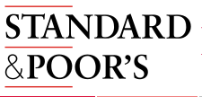

Ratings and Rating Agencies
  Rating Agencies (Moody’s, Standard & Poor’s and Fitch) rate both G.O. and Revenue bond credits on a scale in order to rank or categorize the credit worthiness and proximity to default of an Issuer and their obligations
  While many sophisticated Investors do their own credit research, ratings play a critical role in the minds of most market participants and are perceived by the market as a guide of an Issuer’s credit worthiness
  Ultimately, credit ratings play a significant role in broadening the investor base for an issuer and usually having a strong rating enhances an Issuer’s access to Investors, helping to lower their cost of capital
  Rating agencies have different rating scales
Investment Grade Rating Scales
Moody's | Aaa | Aa1 | Aa2 | Aa3 | A1 | A2 | A3 | Baa1 | Baa2 | Baa3
S&P/Fitch | AAA | AA+ | AA | AA- | A+ | A | A- | BBB+ | BBB | BBB-
Ratings below Baa3/BBB-/BBB- (Moody’s/S&P/Fitch, respectively) are considered “below investment grade”
and are generally Issuers with such ratings are not considered credit worthy enough for most municipal investors

Slide 23
Appendix

Slide 24
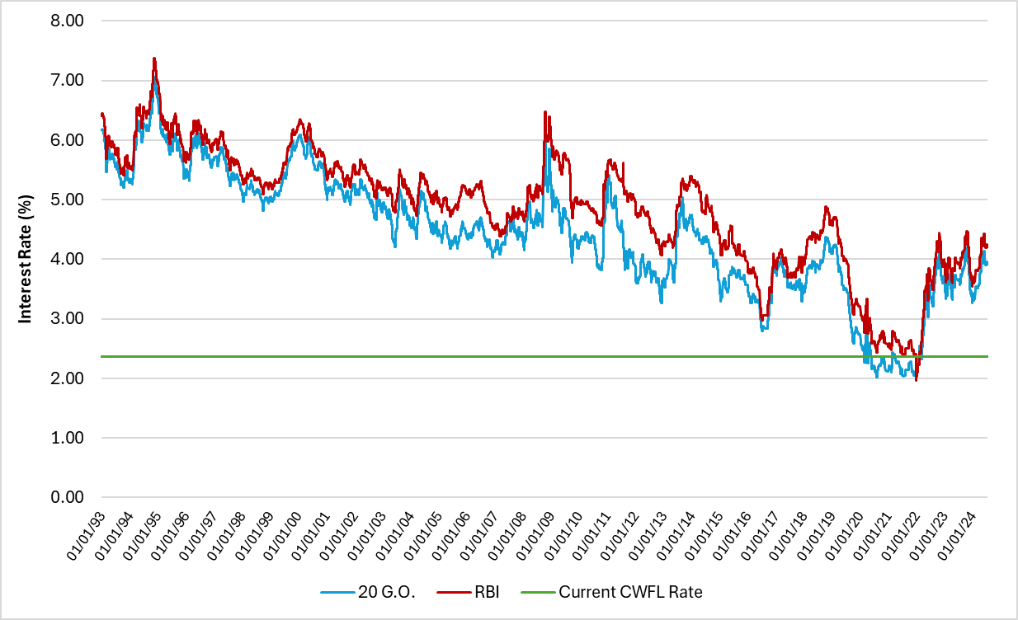
Historical Tax-Exempt Interest Rates
 | 20 G.O. | RBI
Max | 7.060 | 7.370
Min | 2.020 | 1.970
Average | 4.438 | 4.850
5yr Avg. | 2.936 | 3.272
10yr Avg. | 3.318 | 3.694
Current | 3.920 | 4.210
*Bond Buyer 20-Bond GO Index (“20 G.O.”)
*Bond Buyer 25-Bond Revenue Index (“RBI”)
*Present as of 7/19/2024
Notes:
PFM was founded in 1975 on the principle of providing sound independent financial advice to state and local governments. Today PFM is the nation’s leading advisory firm with 21 offices strategically located throughout the United States.

Slide 25
Determination of Type of Bond Sale—Competitive vs. Negotiated
Attributes
Competitive Sale
Negotiated Sale
Attributes
Competitive Sale
Negotiated Sale
Issuer
Marketing
Type of Organization
Broad-based, general-
Special-purpose,
Ability to select “best
purpose government
independent authority
Use of Underwriters
Broad market participation
qualified” banker and
Frequency of Issuance
Regular borrower in public
New or infrequent issuer of
direct business to local
market
debt
or regional firms
Active secondary market
Little or no institutional
Process blind to ultimate
Sale can be managed to
Market Awareness
with wide investor base
base, but growing dealer
Investors
investors
achieve wide distribution
Credit Quality
interest
or targeted allotments
Rating
“A” or better
Below single “A”
Pre-marketing
Limited need for pre-
Specific pre-sale activity to
marketing – commodity,
generate demand
Pledged Revenues
General obligation
Project supported revenues
market pricing
Conventional resolution
Unusual or weak
Flexibility in Timing
Limited flexibility
Greatest flexibility in timing
Security Structure
and cashflow; rate
covenants; subordinated
Fine Tuning Structure
Limited options given to
Unlimited ability to fine tune
covenant and coverage
debt
bidders
Trend
Stable
Improving or under stress
Cost
Market Conditions
Historically, spreads have
Recent data shows
Gross Spread
been lower for competitive
negotiated deals to have
Interest Rates
Stable, predictable market
Volatile or declining
sales
equal or higher spreads
market
than competitive sales
Strong investor demand,
Highest market price for
Best match of product with
Demand
good liquidity, light forward
Oversold market, heavy
Interest Rate
commodity offered on day
specific investor demand
calendar
supply
Preparation
of sale
Debt Structure
Professional banking
Tax Status
Tax-exempt*, no concerns
Taxable
Issuer determines own
support and more direct
Resolution/Structure
preference for managing
marketing input in
balancing security for
Aggressive use of
investor vs. flexibility for
Traditional serial and term,
innovative bond structuring,
issuer
Debt Instrument
full-coupon bonds
derivative products, swaps,
Issuer relies on own
Underwriters’ counsel
or variable-rate debt
Disclosure
program disclosure
assists in the preparation of
instruments
official statement

Slide 26
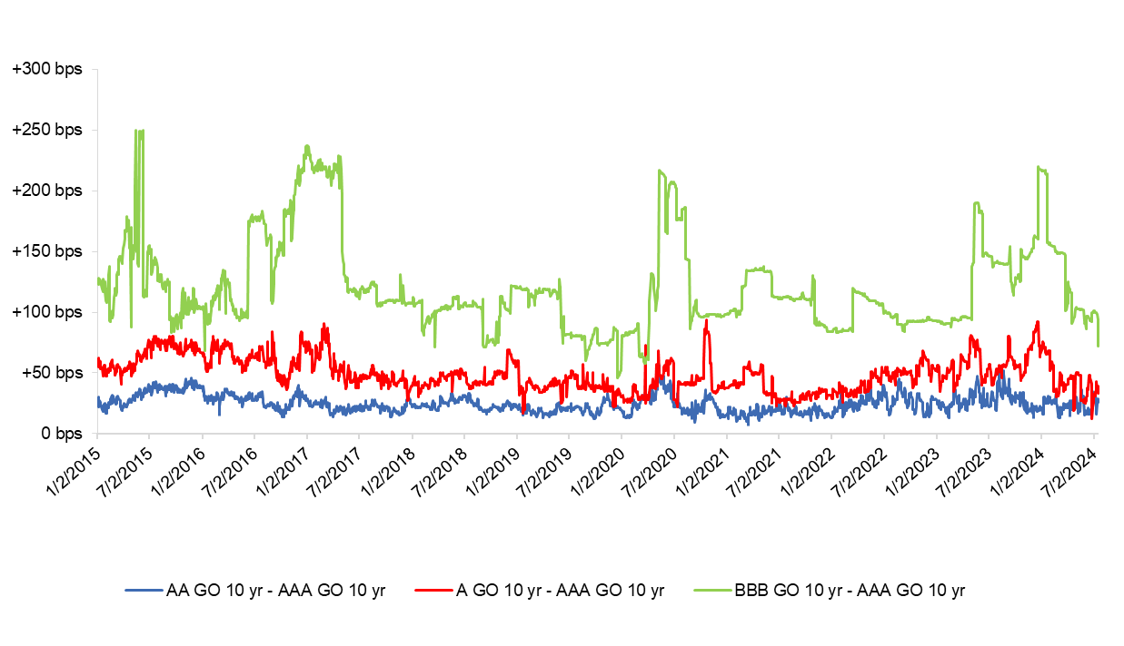
Credit Ratings and Cost of Borrowing—Credit Spreads
Present as of 7/19/24
Ten Year Maturity
BVAL Indices
Notes:
PFM was founded in 1975 on the principle of providing sound independent financial advice to state and local governments. Today PFM is the nation’s leading advisory firm with 21 offices strategically located throughout the United States.

Slide 27
Basic Terminology
  Bond
  Evidence of a loan
  Buyer of the Bond is the lender or investor
  Seller of the Bond is the borrower or the issuer or the obligor
  Principal or Face Amount or Par Amount
  Amount of loan
  Maturity date
  Repayment date of loan – may be spread across multiple years
  Nominal or Coupon rate
  Interest rate paid periodically on the loan
  Usually expressed as a percentage of par amount
  Price
  Amount a lender will lend in consideration of future receipt of principal and interest payments
  Yield
  Single rate that sets the PV of the future principal and interest payments equal to the initial price

Slide 28
Resources and Links
Internal Revenue Service
(https://www.irs.gov/tax-exempt-bonds/teb-post-issuance-compliance-some-basic-concepts)
Municipal Securities Rulemaking Board
(http://www.msrb.org/msrb1/pdfs/secrule15c2-12.pdf)
(https://www.msrb.org/sites/default/files/2022-08/MSRB-Glossary-of-Municipal-Securities- Terms-Third_Edition-August-2013.pdf)
GFOA Best Practices
(https://www.gfoa.org/best-practices)

Slide 29
Thank You

