Slide 1
2024 Employee Engagement Survey
Commission Meeting- July 25, 2024

Slide 2

Second Annual Engagement Survey
Engagement Survey
Analyze & Share
Act
Reflect
Discuss & Plan
Notes:
Talk about how this is the second year. We’ve completed the cycle once and are now back around, able to have comparison data.

Slide 3
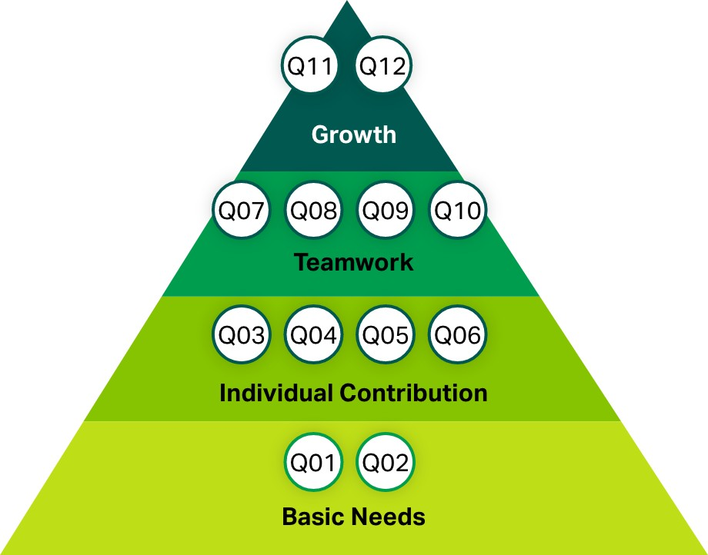
Gallup’s Q12
Data-backed
Widely-used
Actionable
Conducted online
Completely Confidential
Notes:
For Commissioners.

Slide 4



Gallup definitions
Engaged
Not engaged
Actively disengaged
Highly involved in and enthusiastic about work and workplace.
Psychological "owners“ who drive performance and innovation
Psychologically unattached to
work and workplace
Putting time—but not energy or passion—into their work
Unhappy and potentially resentful that needs are not being met

Slide 5
Employee Engagement Index

Slide 6
District vs. National Engagement Index
District Engagement
National Statistics (as of April 2024)

Slide 7


Engagement Index Ratio
District Engagement Index
National Engagement Index
5.71:1
1.8:1
:
:
5.71 engaged employees for every
actively disengaged employee.
1.8 engaged employees for every
actively disengaged employee.

Slide 8
Overall Snapshot
ENGAGEMENT MEAN
MEAN PERCENTILE RANK
3.92
30
Database: Industry - Utilities
TRENDED MEAN
RESPONDENTS
Change From Last Mean: +.13
107 / 86% response rate
3.79 | 3.92
Notes:
Mention change in comparison database. Last year it was Utilities- First administration.

Slide 9
Two Highest Q12 Items (weighted)
Mean Percentile Rank - Industry - Utilities
Change from 2023
Questions
Current Mean
Q08: The mission or purpose of my company makes me feel my job is important.
4.28
+.13
53
Q09: My coworkers are committed to doing quality work.
4.24
+.24
40
Notes:
Mention Gallup’s determination of “high”/ “Low” involves more than just taking highest/lowest mean.

Slide 10
Two Lowest Q12 Items (weighted)
Mean Percentile Rank - Industry - Utilities
Questions
Current Mean
Change
Q01: I know what is expected of me at work.
4.04
-.09
20
Q03: At work, I have the opportunity to do what I do best every day.
3.75
-.06
22

Slide 11
Notable Changes- Q12 questions
Change | Question | Current Mean
⬆ .25 | Q04: In the last seven days, I have received recognition or praise for doing good work. | 3.57
⬆ .27 | Q06: There is someone at work who encourages my development. | 3.91
⬆ .20 | Q07: At work, my opinions seem to count. | 3.75
⬆ .24 | Q09: My coworkers are committed to doing quality work. | 4.24
⬆ .20 | Q11: In the last six months, someone at work has talked to me about my progress. | 3.96

Slide 12
Notable Changes- Additional Questions
Change | Question | Current Mean
⬆ .23 | My coworkers report errors, near misses, and unsafe acts when they occur. | 3.98
⬆ .23 | I have the same opportunities for advancement as other coworkers in my organization. | 3.47
⬆ .42 | I trust the leadership of my organization. | 3.23
⬆ .26 | Leaders help me see how changes made today will affect my organization's future. | 3.30

Slide 13
Work group minimum/ maximum scores

Slide 14
Percent engaged, by gender

Slide 15
Changes from 2023, gender comparison

Slide 16
Changes from 2023; race/ethnicity comparison

Slide 17
Key Takeaways
Our percentage of engaged employees far surpasses national averages
Overall trend is slightly positive compared to last year
There are some variations in engagement trends when comparing work and demographic groups
There are opportunities to improve engagement at both the team and organizational level

Slide 18
Next steps
Team conversations and action planning July-September
Team Action Plans submitted by September 30
District leadership will also undertake its own state of the team and state of the District work

Slide 19
Questions?

