Slide 1
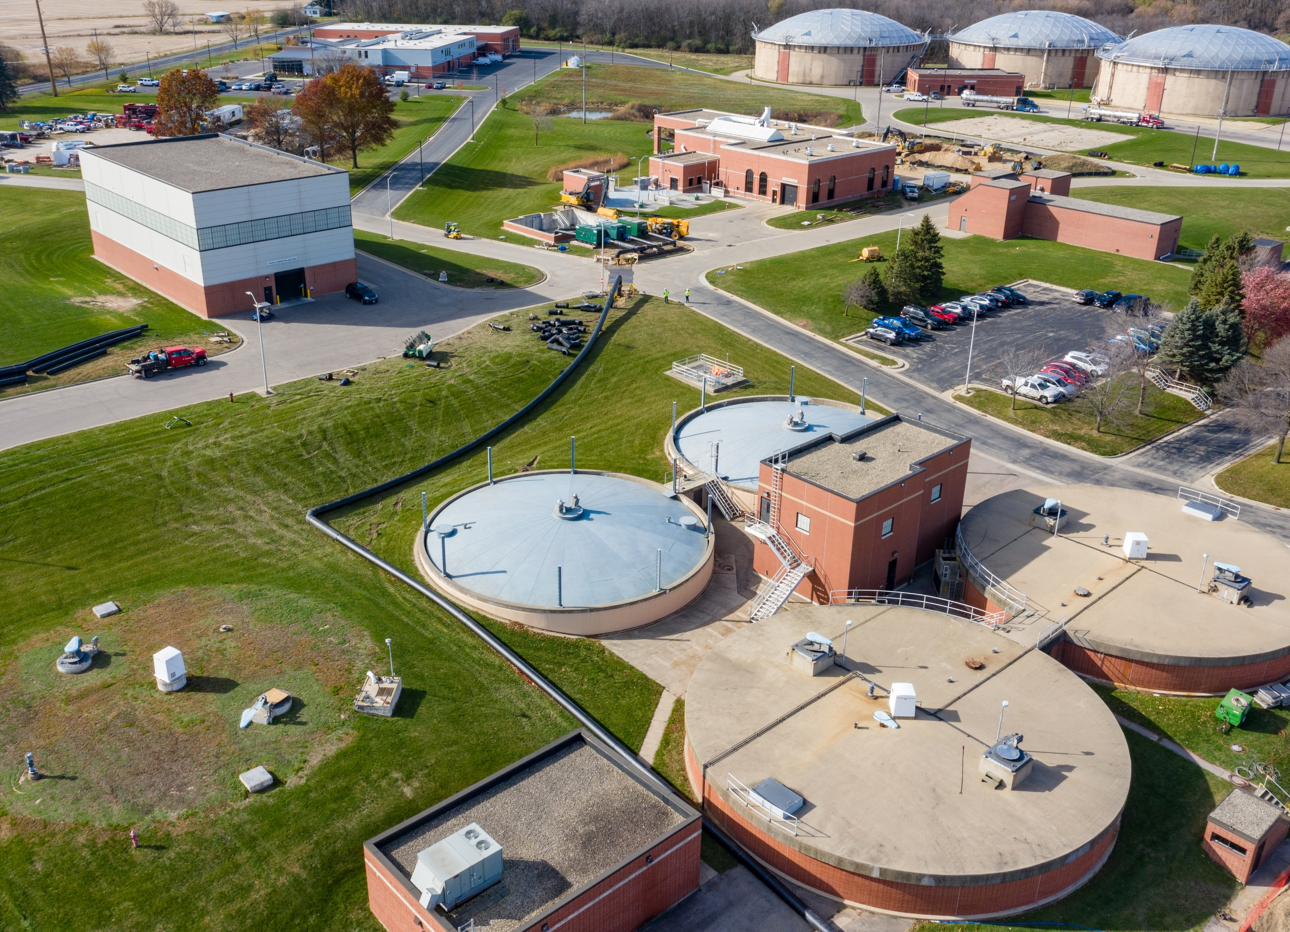

June Operations Report

Slide 2
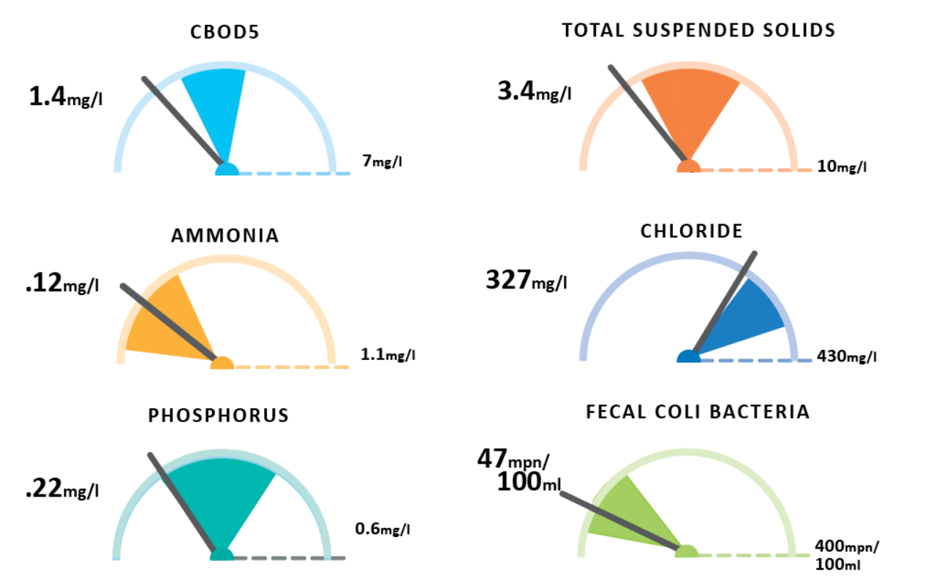
June Plant Performance

Slide 3

Thank you

