Slide 1

Nine Spring Valley Interceptor – Mineral Point Extension:
Pipe Investigation
Commission Meeting
July 25, 2024

Slide 2
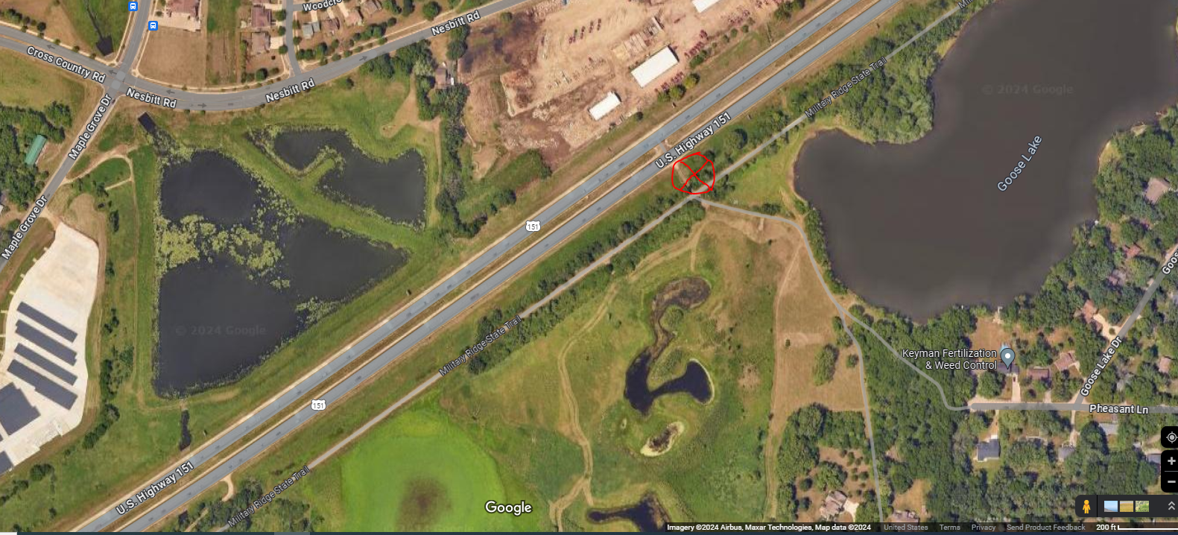

Agenda Location Map
Staff introduction
Location
Investigation
Action Items
Questions
To Fitchburg / Madison
To Verona
Pipe investigation location

Slide 3
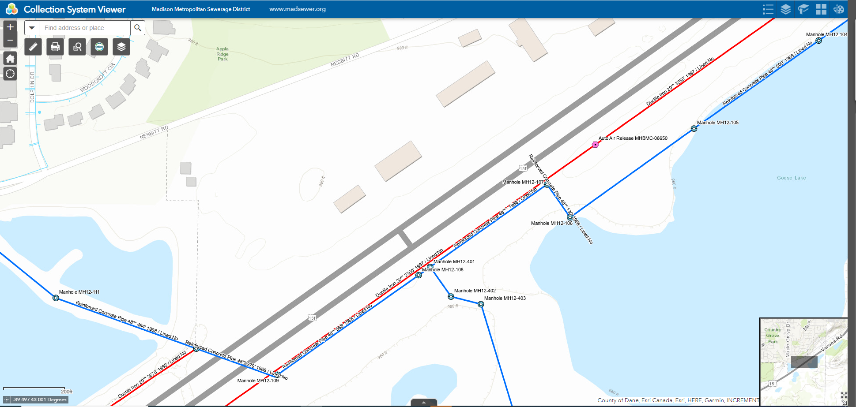
Collection System Map
BMC Effluent Line
To Fitchburg / Madison
Pipe investigation location
Flow to PS 12
To Verona
PS 17 relief is in active construction project
NSVI
Flow from PS 17
PS 17 Relief

Slide 4
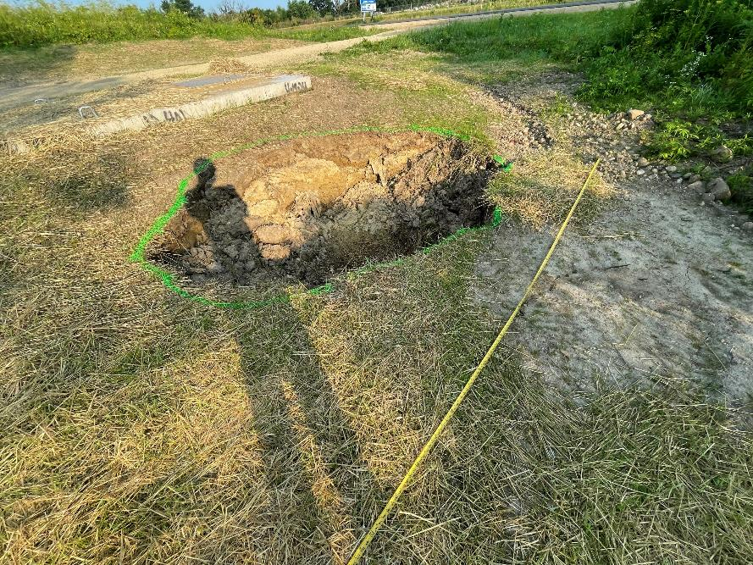
Investigation
Photo: Friday 7/12/2024
Reason for Investigation – Collapse of grade over existing pipe adjacent to new manhole installed during PS 17 FMR P2 construction project.

Slide 5
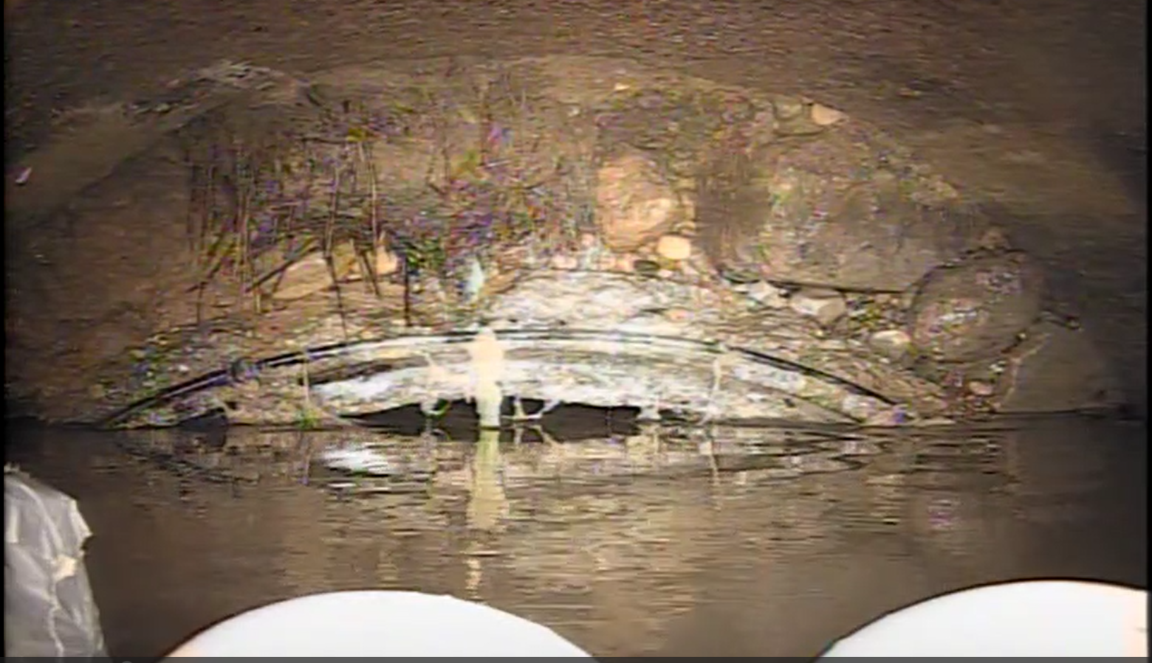
Investigation
Photo: Friday 7/19/2024
Televising of Pipe 04:09 am
Top of Pipe, inside
Findings – Joint failure of pipe
Top of Pipe, outside
Joint Failure
Top of Pipe, inside
Looking downstream from MH12-401 to MH12-107.

Slide 6
Action items Completed
Televising investigations
Contractor obtaining by-pass flow equipment
Daily flow monitoring and surface observations
Daily updates

Slide 7
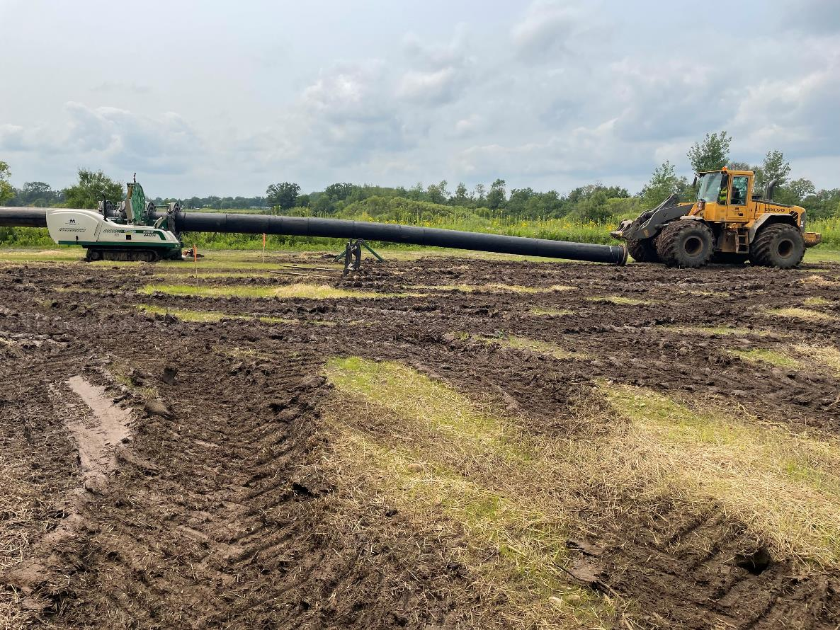
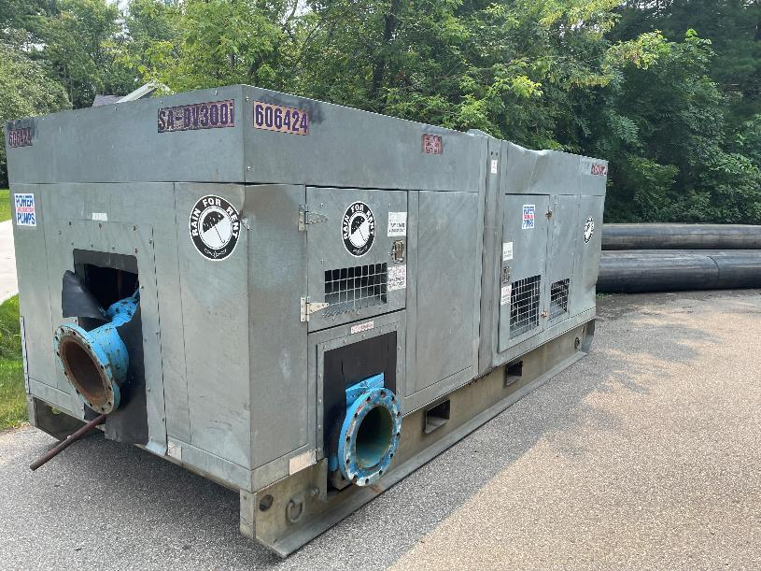
Action items in process
Photo: Tuesday 7/23/2024
By-pass pipe preparation
Photo: Tuesday 7/23/2024
By-pass pump
Install by-pass pumping system
Perform further pipe investigation beyond known failure
Perform joint / pipe section replacement
Clean and inspect pipe
Restoration

Slide 8
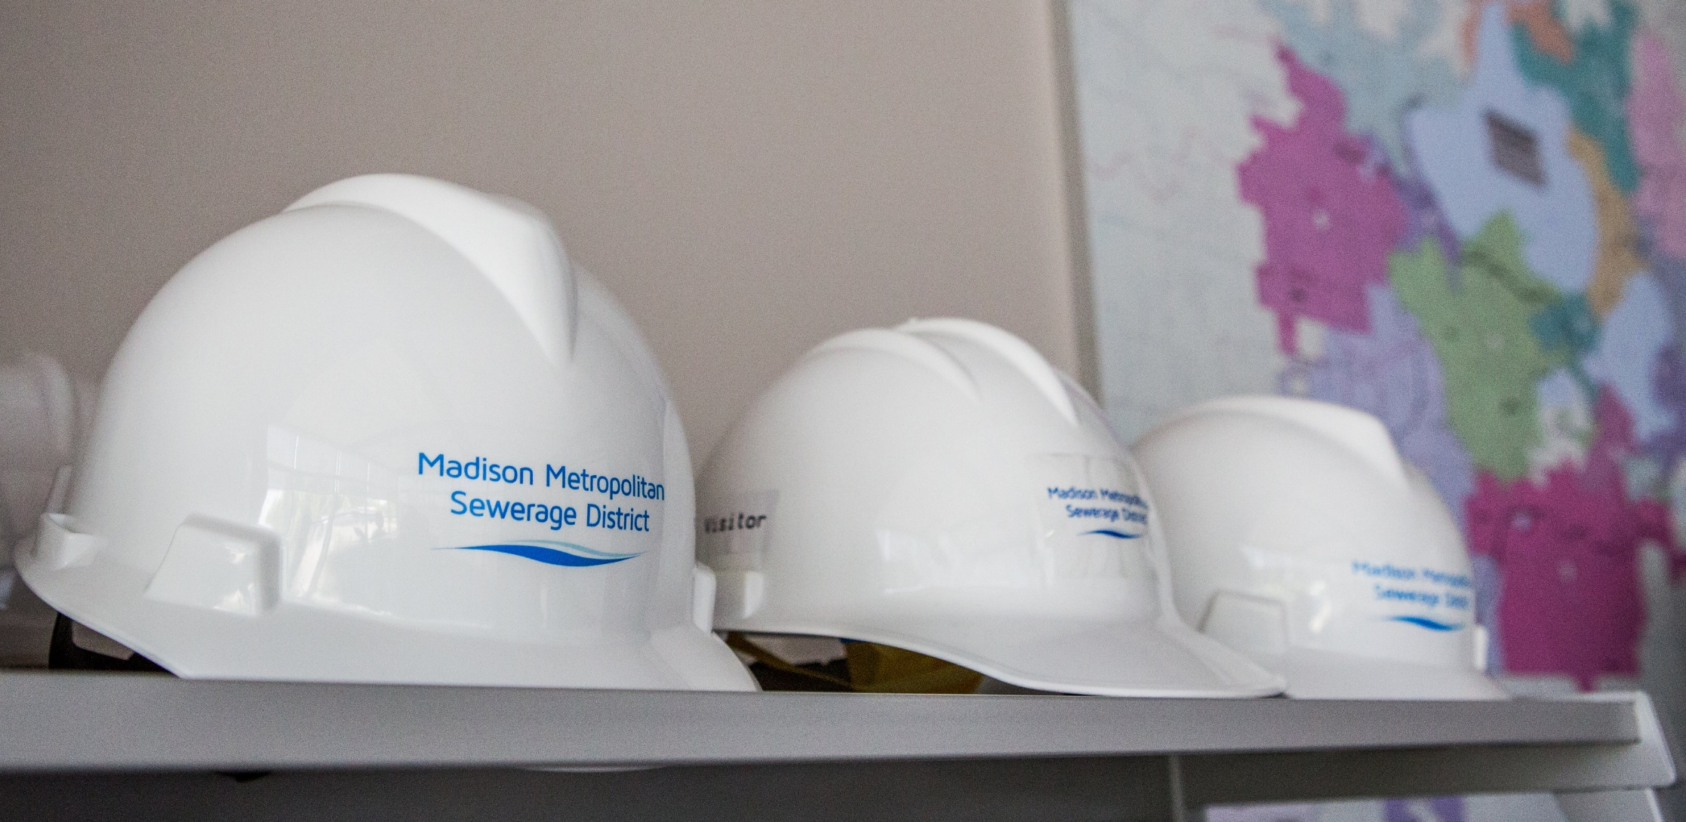

Questions?

