Slide 1
Overview of the 2025 Draft Capital Improvements Plan
July 25, 2024

Slide 2
Topics
Comparison of 2024 CIP & 2025 CIP
Spending for 2025 Capital Budget
Project drivers and costs
Project summaries

Slide 3
Total Six-Year Expenditures
2024 CIP = $275 million
Notes:
CIP is broken down into four cost categories.
Projected spending in treatment plant category is up significantly in 2025 Plan due to three large projects.
Spending in Pumping Station category is done slightly as we complete major rehab projects.

Slide 4
Project Highlights
Project | Total Spending in 2024 CIP | Total Spending in 2025 CIP | Difference
Access to Interceptors | - | $3.9 M | $3.9 M
Pumping Station Bar Screens | - | $3.8 M | $3.8 M
PS 5 & PS 15 Force Main Isolation Valve Replacements | - | $0.9 M | $0.9 M
Emergency Power Generation at District Pump Stations | $9.8 M | $1.7 M | ($8.1 M)
Liquid Processing Improvements – Phase 2 | $50.4 M | $65.3 M | $14.9 M
Heat & Power Improvements | $29.3 M | $0.5 M | ($28.8 M)
Biosolids Processing Improvements | $24.1 M | $48.8 M | $24.7 M
Notes:
This slide highlights the major project changes in the 2025 CIP.
Total spending represents the six-year planning horizon of the documents and does not include current year or prior year costs.
The first three projects are new to the 2025 CIP.
Spending in Emergency Power Generation has decreased due to delaying the project three years.
LPI
Part of increase due to increase in scope.
Total cost expected to decrease based on cost estimate received from consultant on Monday.
Heat & Power
Costs in 2025 CIP reflect only facility planning costs.
Infrastructure costs were removed to allow focus on Biosolids project.
Biosolids Processing
2024 Plan included costs to increase loadout capacity for current product, Class B liquid.
2025 Plan takes a step to consider:
Class A options that address capacity through volume reduction
PFAS

Slide 5
Notes:
These three projects have been in the District’s CIP since 2014 in one form or another.
District staff conducted a number of workshops over the last several months that prioritized these three projects.
Aeration System Projects has been incorporated into LPI and is well underway.
Heat & Power and Biosolids are both at facility planning level.
We feel it is important to keep moving the H&P and Biosolids projects forward as they inform each other and are needed to address challenging problems in the years ahead.
The implementation plan for infrastructure for both projects is likely to change as facility planning progresses.

Slide 6
Annual Expenditures
Notes:
This slide shows annual expenditures looking back 10 years and forward for the next six years.
Blue bars represent actual spending.
We have tried to balance annual spending to approximately $45 million/year.
2027 is the highest year due to Liquid Processing – Phase 2.
While still below budget, actual spending in 2024 has increased due to a number of projects which have entered the construction phase in the past year.

Slide 7
Recent Project Awards
 |  | Total Project Cost ($ in millions)
 | Date of Bid |  |  |  | CWF
Project | Opening | 2024 CIP | 2025 CIP | Difference | Funding
PS 17 Force Main (Phase 2) | 8/10/2023 | $10.4 | $10.5 | $0.1 | Yes
PS 17 Firm Capacity Improvements | 1/10/2024 | $8.1 | $5.7 | -$2.4 | Yes
NEI-Waunakee Ext Capacity (Phase 1) | 6/13/2024 | $11.9 | $10.7 | -$1.1 | Yes
NSWWTP Electrical Service Replacement | 6/26/2024 | $13.6 | $11.6 | -$2.0 | Yes
West Int - Shorewood Relief (Phase 3) | 5/22/2024 | $7.3 | $8.5 | $1.2 | Pending
Flow Splitter Improvements | 6/25/2024 | $5.0 | $7.5 | $2.6 | Pending
TOTAL |  | $56.2 | $54.5 | -$1.7
Notes:
Six large projects have been awarded since Aug. of last year and four within the last two months.
The costs of the projects in the 2024 CIP were estimated at $56.2 million.
Incorporating contractor bids, estimates in the 2025 CIP now total $54.5 million.
Note that West Interceptor and Flow Splitter projects were bid with Build America, Buy America provisions – bids came in higher than estimates.
This suggests that the financing plan developed in the 2024 CIP is sufficient. More on the 2025 financing plan at the next meeting.
Also shown on this slide is an update on CWF status, with loan applications broken down into three groups.
PS 17 projects
Submitted to DNR in Feb.
Funding is available and application is still being processed.
NEIWD and NSWWTP Electrical
These projects were granted waiver from Build America, Buy America requirements last year but funding was uncertain because of loan capacity problems in 2024 SFY and the waiver deadline of June 30.
We submitted loan application in June and it appears funding is available.
WI-Shorewood and Flow Splitter
Intend to submit in August.
Decision expected in Dec 2024.

Slide 8
Projected Capital Expenses – Year 2025
Total Proposed Budget = $44.2 million
Notes:
This slide breaks down projected expenditures in 2025 based on project status.
Active construction projects include six on “Recent Project Awards” + Metrogro Applicators, 2021 HVAC, and PS 4 Rehab.
Most of design money ($5m) is for LPI – Ph 2 ($2.5m) and Biosolids & H&P facilities plans.
Takeaway: most of the projects with 2025 expenditures are already underway.

Slide 9
Project Drivers for 2025 CIP
Notes:
Beginning in the 2024 CIP, we have identified the primary driver for each capital project.
Several large wastewater utilities that we have talked to do this to help communicate spending needs and priorities.
Not surprisingly, most of District’s spending is to address capacity and condition issues.
Two-thirds condition.
One-third capacity.
Allocation for resiliency projects has actually decreased in 2025 CIP
Emergency generators.

Slide 10
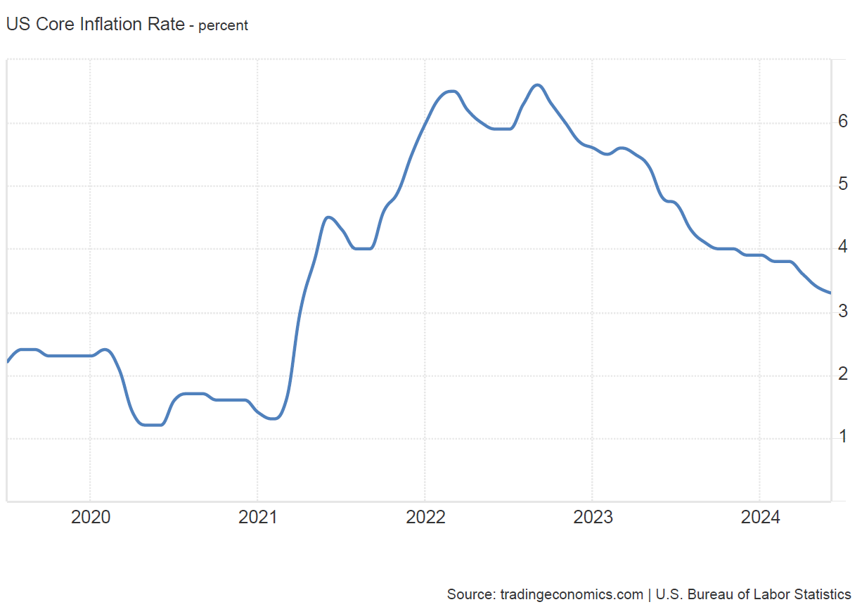
Annual Inflation
Year | Rate used in 2024 CIP | Rate used in 2025 CIP
2025 | 5.0% | 3.5%
2026 | 4.0% | 3.5%
2027 | 3.0% | 3.5%
2028-30 | 3.0% | 3.0%
Notes:
Core inflation rates for United States have dropped from about 5% to 3% over the last year. Core inflation omits volatile items such as food and energy costs.
Engineering News Record has gone up only about 2% in the last year.
As a result, we are lowering the annual rates in the 2025 CIP as shown in the table.

Slide 11
Build America Buy America (BABA) Contingencies
Project | Contingency
Liquid Processing Improvements – Phase 2 | 10%
Lagoon Dikes Improvements | 10%
Pumping Station Bar Screens | 10%
W4 System Improvements | 10%
NEI – Truax Extension Rehab | 5%
NEI – Far East Int to Southeast Int Rehab | 5%
Notes:
Inflation rates apply to all projects.
We have also applied an additional cost contingency to projects that may obtain CWF and be especially vulnerable to BABA requirements.
This involves projects with electronics, specialized equipment, and large amounts of steel/iron.

Slide 12
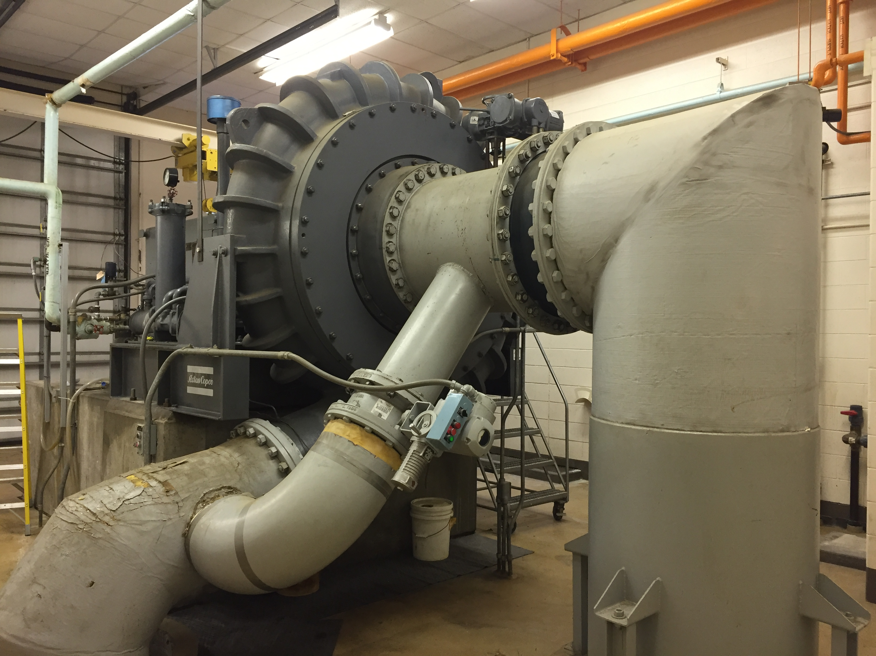
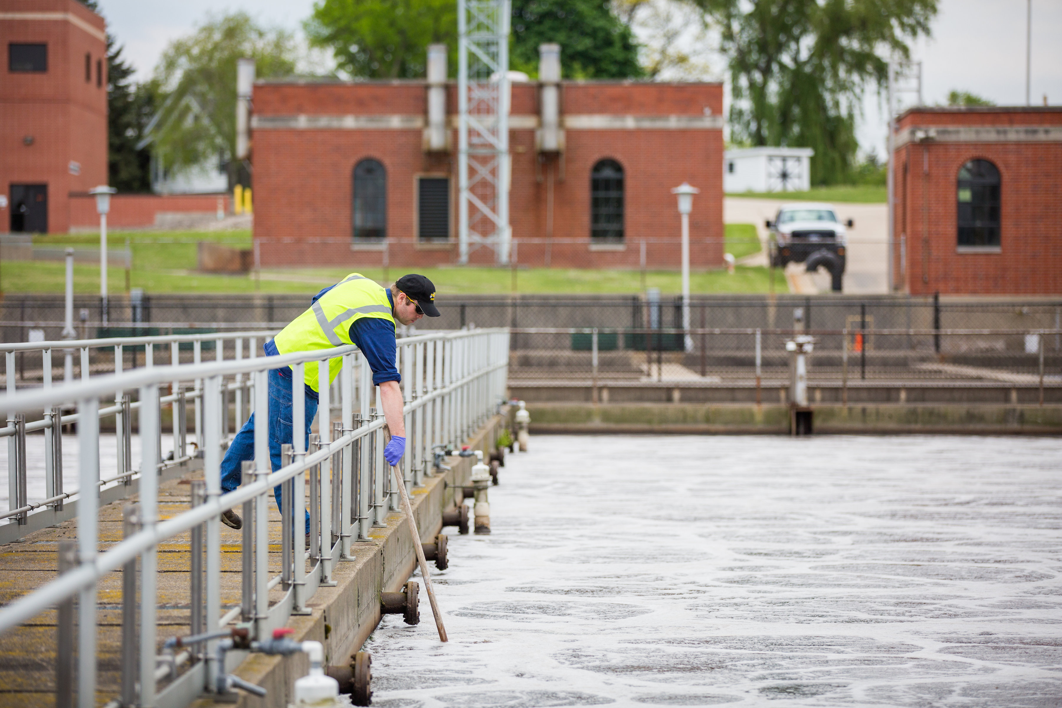
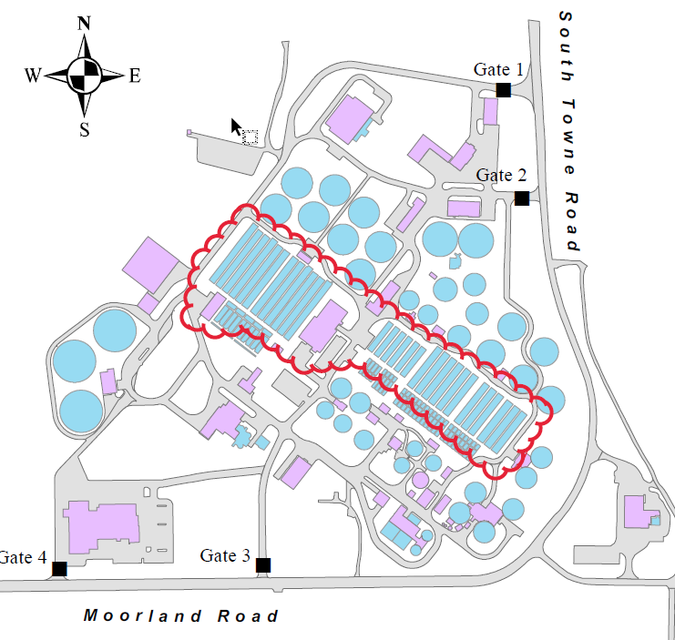
Liquid Processing Improvements – Phase 2
Project | Total Project Cost | Construction
East Primary Air Piping | $1.75 million | 2026-28
Low DO (Full Plant) | $40 million | 2026-28
West Blowers Replacement | $11.2 million | 2026-28
East Blowers Replacement | $11.4 million | 2026-28
East Primary Tank Rehab | $7.0 million | 2026-28
Notes:
I wanted to give you an update on Liquid Processing Ph 2 project, which as Todd noted, is a big part of our CIP spending plan.
You may recall- This system involves the long rectangular tanks located in the center of plant where biological nutrient removal takes place by supplying air to the bugs in the tanks.
Project aims first and foremost to replace aging equipment. In doing so, we hope to use energy more efficiently, and possibly to remove more nitrogen from effluent.
There are several “sub projects” – I won’t go into a lot of detail here except to note some differences from last year - we’ve taken the “partial plant” pilot project out of our 6-yr spending model as we no longer feel a “partial plant” pilot is necessary and we are confident we can just go to full scale right away, which helps keep the schedule moving on the project. Also, we have added in the East Primary tank rehabilitation. This is a project to replace the collector mechanisms in the east primary tanks (with the exception of one tank that’s already recently worked on). This is necessary work that we think makes sense to include in the project to coordinate with other shutdowns that will need to occur with the other components of the project.
Reaching end of prelim design. We are working with Strand + Brown and Caldwell on this. – We have made some important equipment selections - have selected high speed turbo blowers + and we have selected silicone tube diffusers for the aeration system. Nearing a decision on BNR process (stay with current process but more efficiently - Or move to “hybrid” plant with operational flexibility to run at lower or higher DO –which will have a higher capital cost but likely have modest energy savings over the long run. We expect to make that decision in the next month and then move into final design this fall, with construction anticipated to begin in 2026.

Slide 13
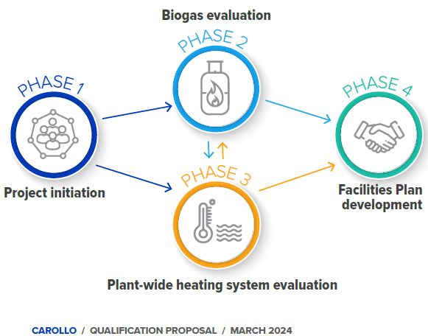
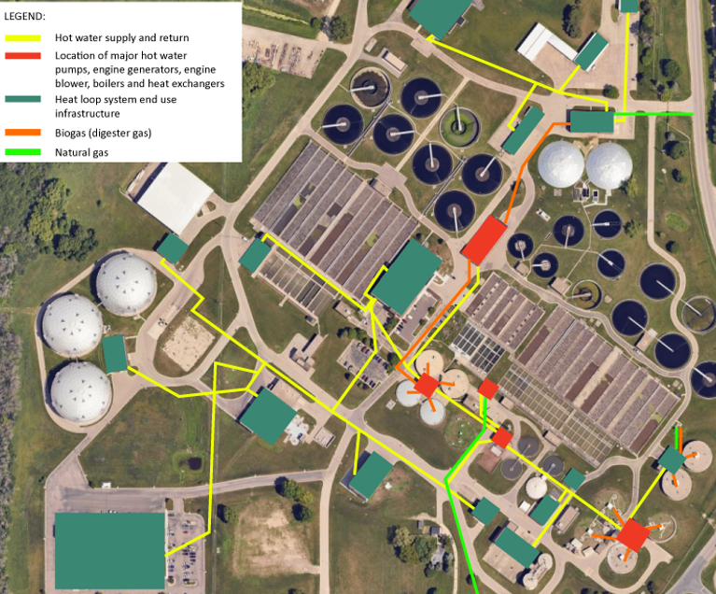
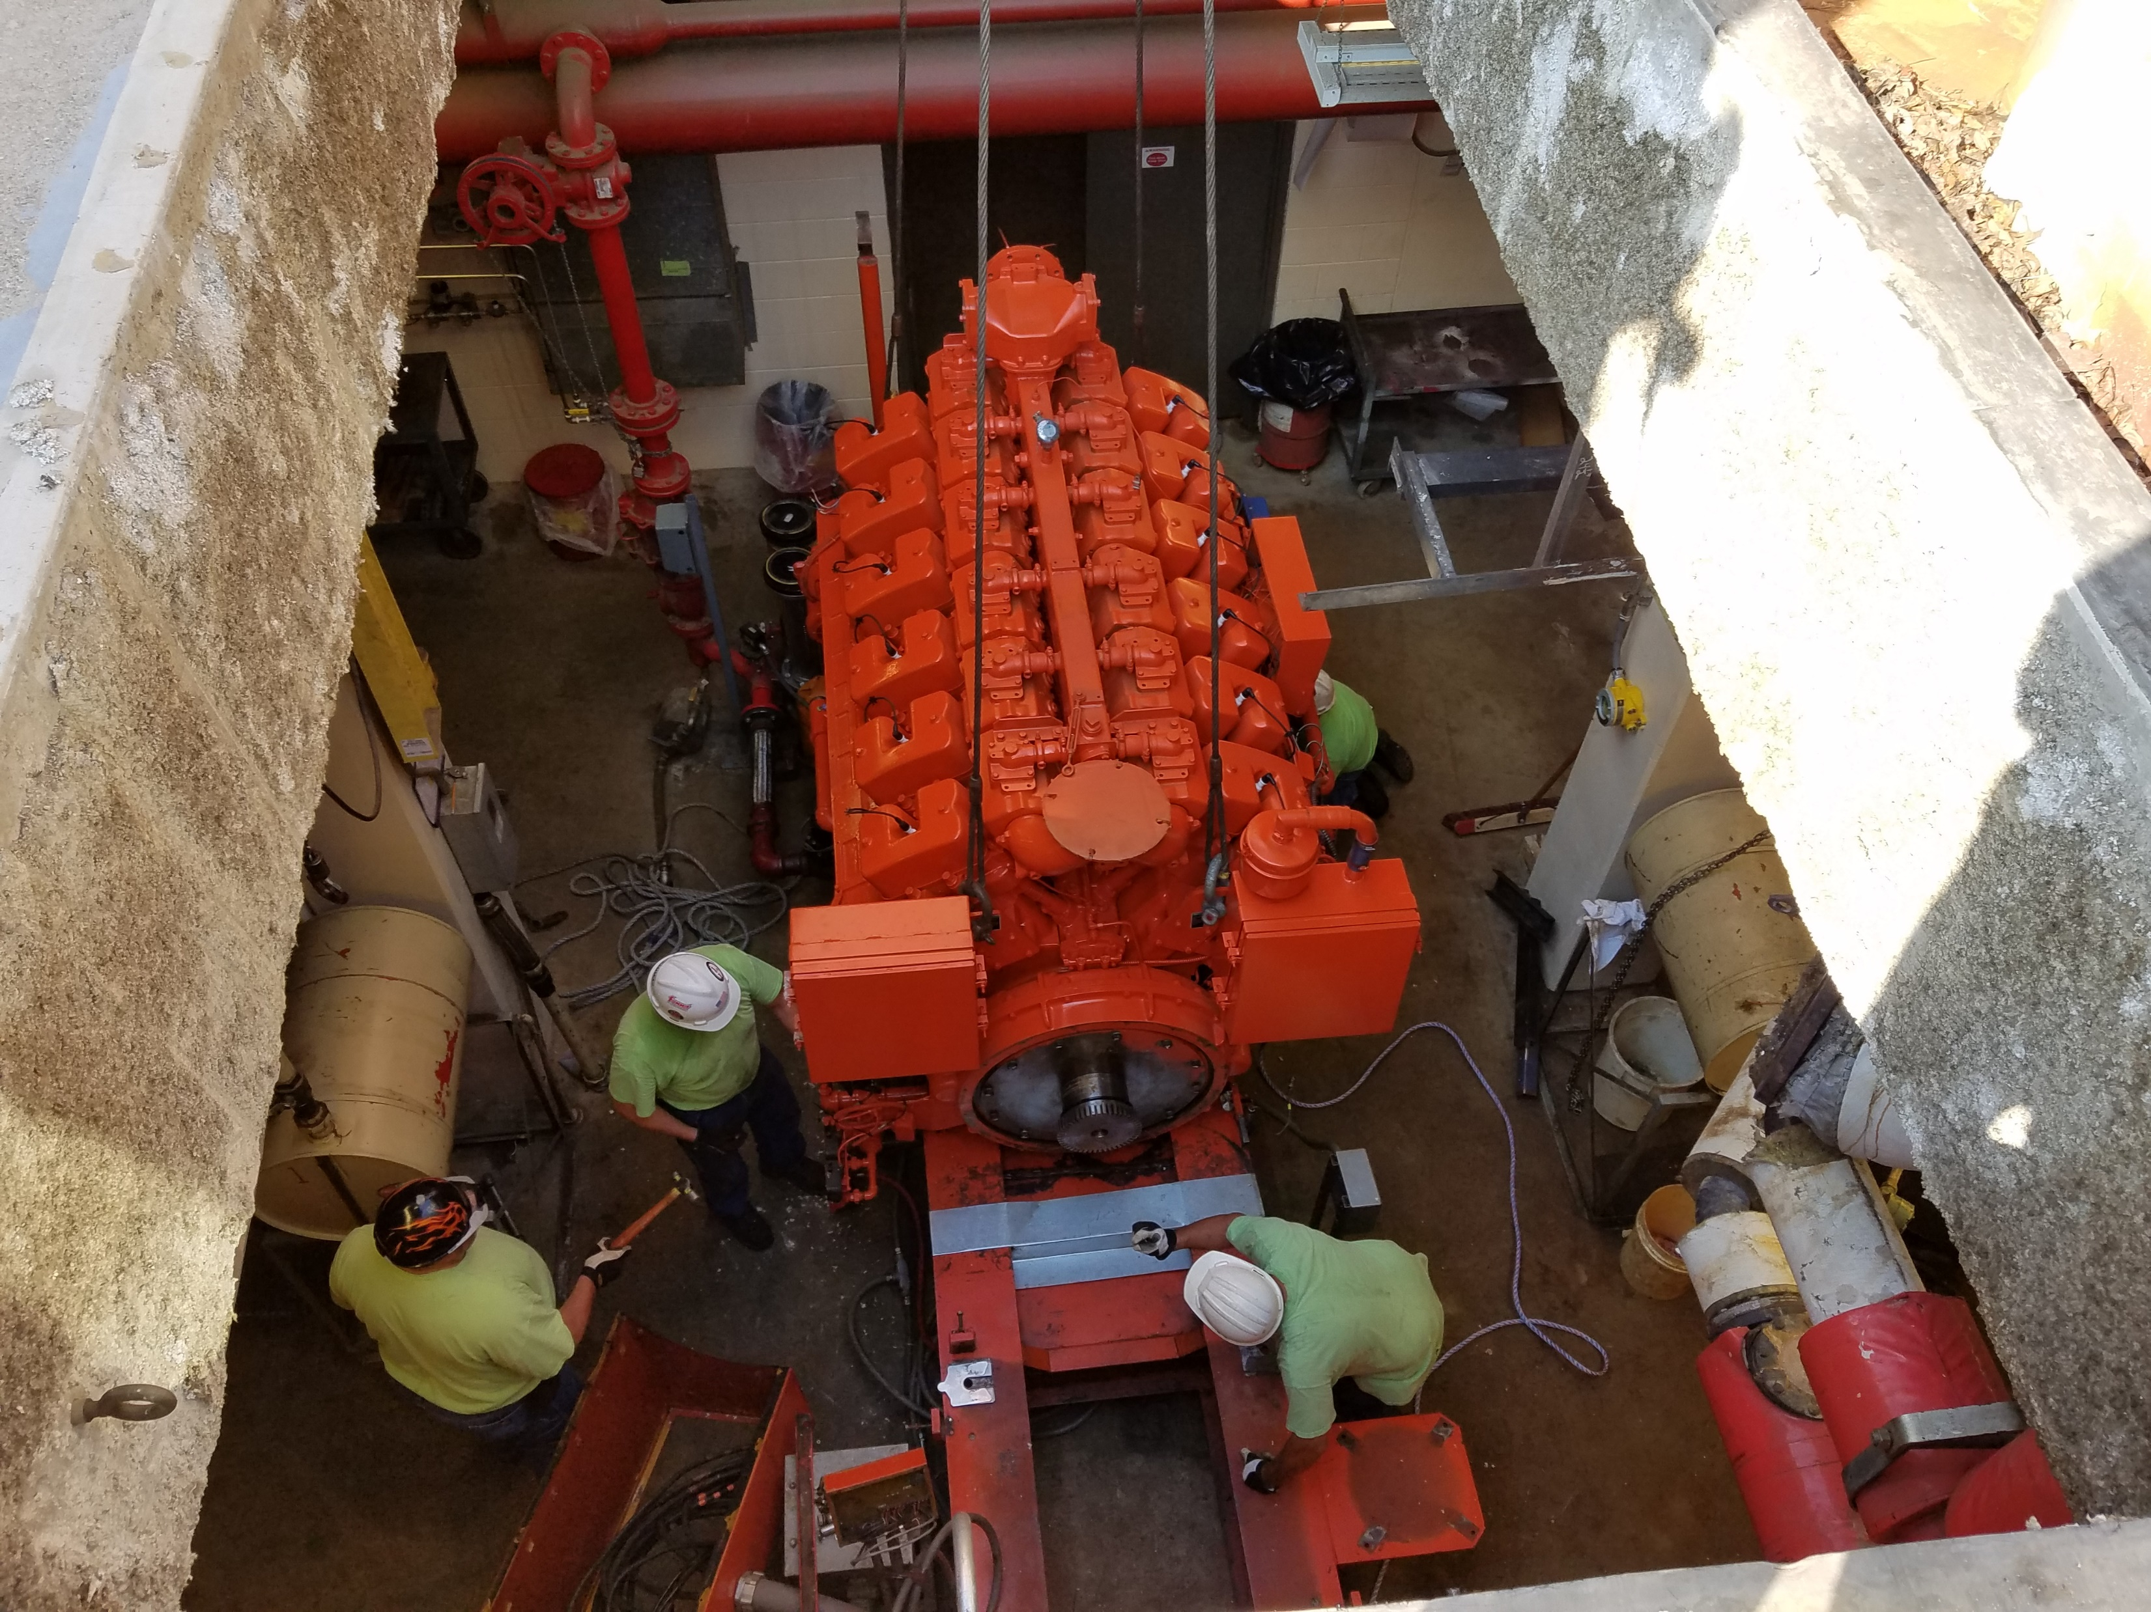
Heat & Power Improvements
Total Project Budget: $50.9 M
Facility Planning in 2023-25 - $930,000
Design/Construction delayed pending results + Biosolids facility plan
Notes:
Currently we are working on a Facility plan that continues the work begun with the 2020 Energy Management Master Plan.
We are looking at lots of interconnected infrastructure at the plant that involves 2 main areas – systems involving biogas & power generation, and heating systems. For biogas, our key question is which of 2 very different pathways we should follow:
Continue using biogas to generate our own electricity for plant. (Supplies about 25% - 30% of electrical needs.) OR
Clean gas to pipeline quality and sell for regional distribution, which could provide revenue under the current regulatory climate (RNG – renewable natural gas RIN- renewable identification number).
Because our hot water systems are so dependent on our our gas systems – we need to look at the heating system at the same time.
We need to go though this facility planning effort to better inform our infrastructure replacement related to these systems in coming years. It is important to note that this touches a lot of related systems at the plant.
We expect the facility plan to be completed in Fall of 2025. As Todd noted – one thing that’s changed from last year in our 6 year spending plan – we are not showing then going right into design + construction. Depending on the outcome of this facility plan + the biosolids facility plan we will need to decide what should happen next, recognizing that we probably can’t build everything at once.

Slide 14
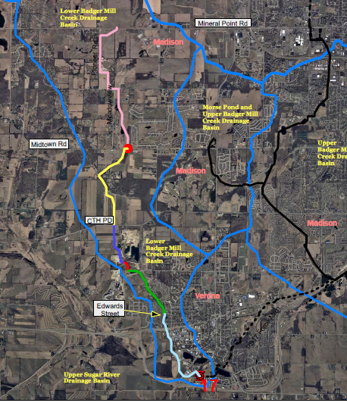
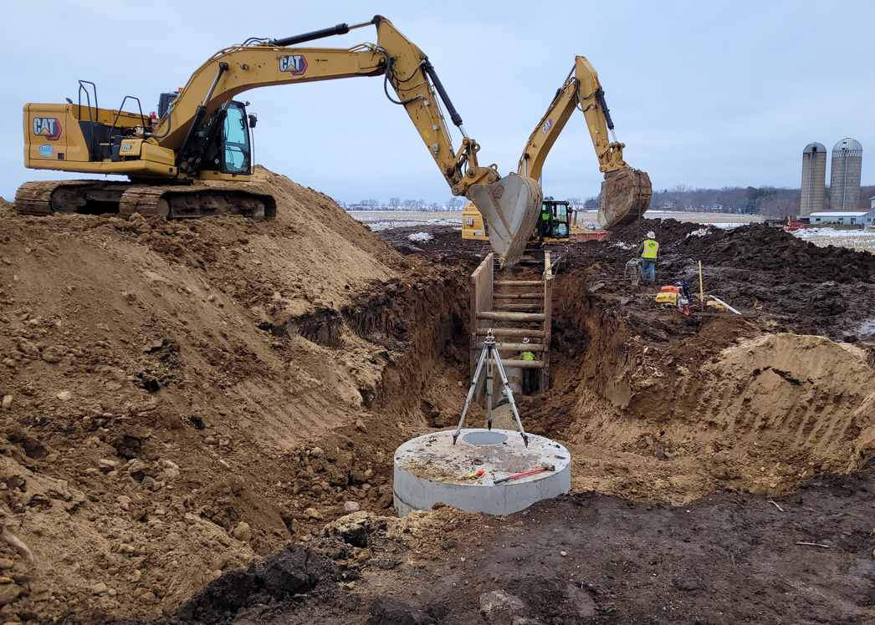
Lower Badger Mill Creek
Interceptor Projects
Project | Total Project Cost | Construction
LBMC Interceptor (Phase 5) | $1.9 M | 2023-24
LBMC Interceptor (Phase 6) | $5.1 M | 2025
Notes:
The last couple slides that I want to talk about are projects out in the collection system, related to ongoing capacity improvements to serve the Lower Badger Mill Creek basin. As you may recall we have been working on planning and building the Lower Badger Mill Creek Interceptor since the early 2000s. We last talked about the “missing link” which is shown here in yellow between PD and Midtown road.
About half of that yellow pipe is now completed – the piece between PD and Shady Oak lane, thru Veridian’s Ardent Glen Development - this is the Lower Badger Mill Creek Interceptor Phase 5. Bids were accepted about a year ago – on July 27, 2023, and construction started last fall and continued over the winter. Integrity Grading and Excavating is nearly complete with this work – they are just working on a few punch list items.
The last part of the interceptor – Phase 6 – is expected to go out for bid in early 2025, for construction through next year. Once that last pipe run from Shady Oak to Midtown Road is done, the entire interceptor will be complete, and the temporary Mid Town lift station will be able to be decommissioned.
We are working with ra Smith on the design and are working on real estate acquisition.
This is expected to involve challenging construction through a narrow ravine traversing private property.

Slide 15
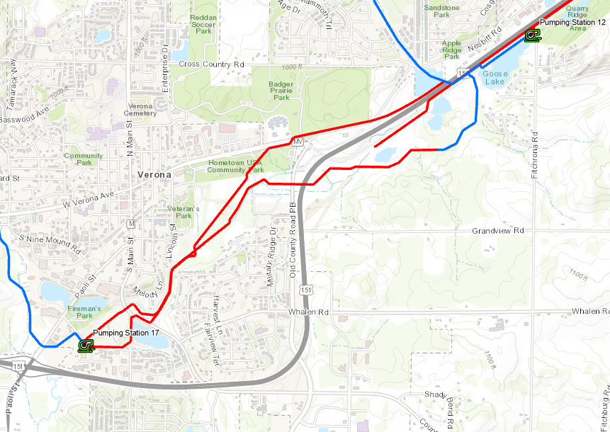
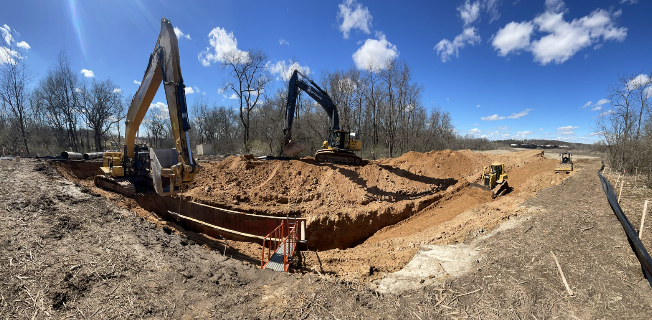
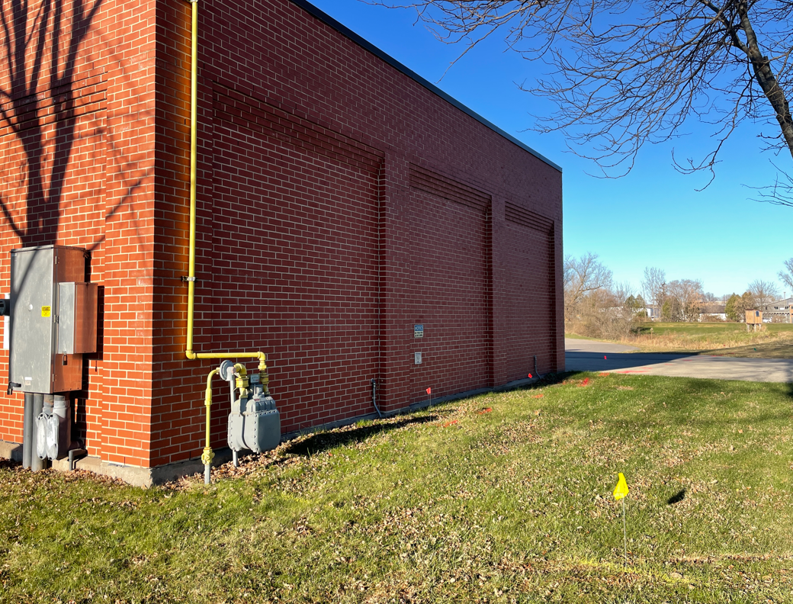
Pumping Station 17 Projects
Project | Total Project Cost | Construction
PS 17 Firm Capacity Improvements | $8.1 M | 2024-26
PS 17 Force Main Relief (Phase 2) | $12.0 M | 2024-26
Not yet installed
Notes:
And finally – once we get all that additional flow from the interceptor to Pumping station 17 – then we need to need to have adequate capacity there– thus another focus of the CIP, which are the 2 ongoing projects related to Pumping station 17 - .
The first of these is Pumping Station 17 Firm Capacity Improvements, which was awarded earlier this year, on January 25th. The scope of the project is to upgrade capacity and rehabilitate some other systems at the existing station.
We are currently under construction now by August Winter and Sons. Schedule for construction driven by equipment lead times. 68 week delivery time for MCC (Motor control center). 47 wk VFDs (variable frequency drives)
To date we’ve been mainly involved with submittal review. We expect to break ground at the station itself later this summer, to install a large valve vault outside the station.
All of the construction is expected to be complete hopefully in early 2026.
4. And - last but not least – to get that flow away from PS 17, we’ve been working on a second “relief” force main to carry additonal flow away from pumping station 17. The second phase of that project was awarded in August of 2023. Construction of that by Minger Construction was ongoing over this past winter + spring. That project is now over halfway complete, along with City of Verona’s bike path and bridge that was built with the project.. Pipe installation has paused for the summer to avoid wetland impacts. The last part, shown here, between the areas south of Veteran’s park in Verona and Old hwy PB – will be built starting up again in October, and expected to be complete by late May 2025.

Slide 16
Project Delays
Project | Delay
Liquid Processing Improvements – Phase 3 | Move project start from 2026 to 2027
Emergency Power Generation at Pumping Stations | Move project start from 2025 to 2028
Interceptor rehab projects (multiple) | Delay projects 1-2 years
Pumping Station 16 & Force Main Rehab | Move project start from 2024 to 2026
Notes:
LPI – Phase 3
Delay mitigated if Pumping Station bar screens are successful.
Emergency Generators
District stations still meet state codes for providing service during loss in power.
Interceptor Rehab
Acceptable delays but don’t want to fall behind.
PS 16 Projects
Capacity is adequate at station.
Main risk is complete failure of aging electrical system, which is unlikely.

Slide 17
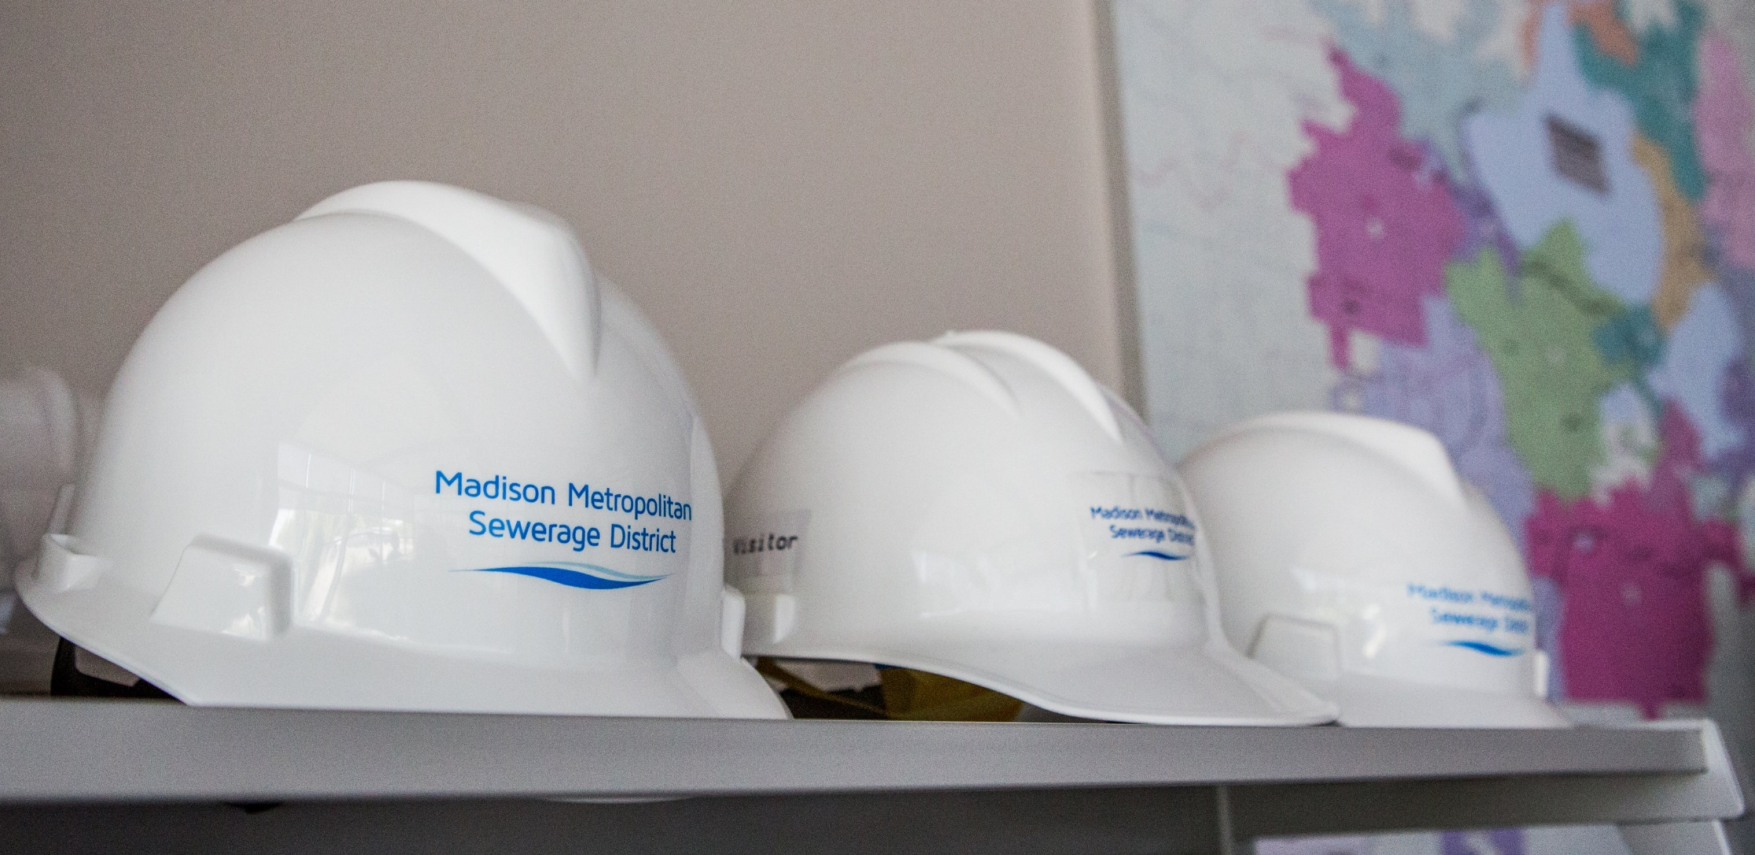
Questions?

Slide 18
Budget to Actual – 2024 Expenditures
Notes:
Beginning in the 2024 CIP, we have identified the primary driver for each capital project.
Several large wastewater utilities that we have talked to do this to help communicate spending needs and priorities.
Not surprisingly, most of District’s spending is to address capacity and condition issues.
Two-thirds condition.
One-third capacity.
Allocation for resiliency projects has actually decreased in 2025 CIP
Emergency generators.

