Slide 1
Nine Springs Wastewater Treatment Plant Electrical Service Equipment Replacement
Review Bids and Award Contract
Professional Service Agreement Amendment - Construction
Commission Meeting
July 11, 2024

Slide 2
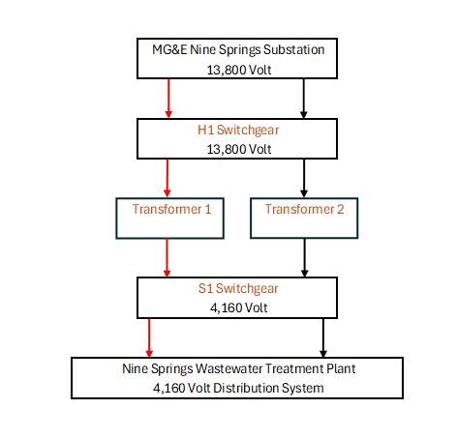
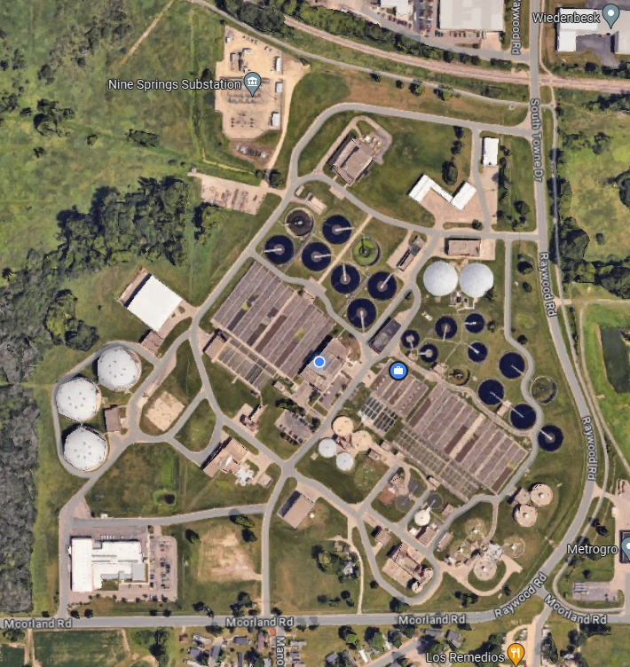
Project Location and Overview
Project Location

Slide 3
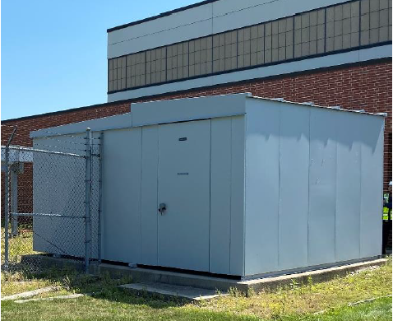
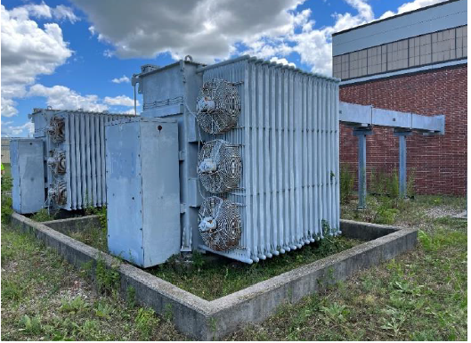
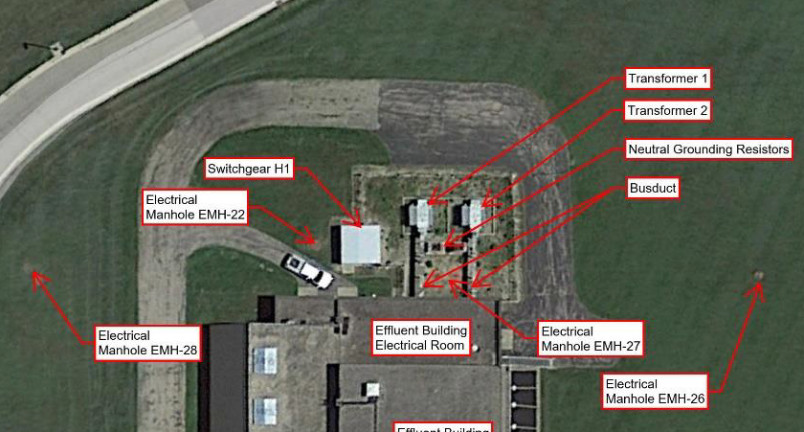
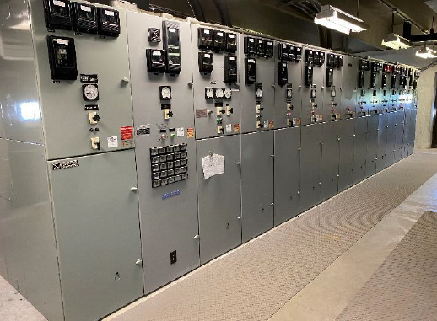
Electrical Service Equipment Replacement
Scope of Work
Replace 13.8kV H1 Switchgear
Replace Two 13.8kV to 4.16kV Transformers
Replace 4.16kV S1 Switchgear in New Building
Replace 4.16kV Cables
H1 Switchgear
Transformers
Existing Conditions
S1 Switchgear

Slide 4
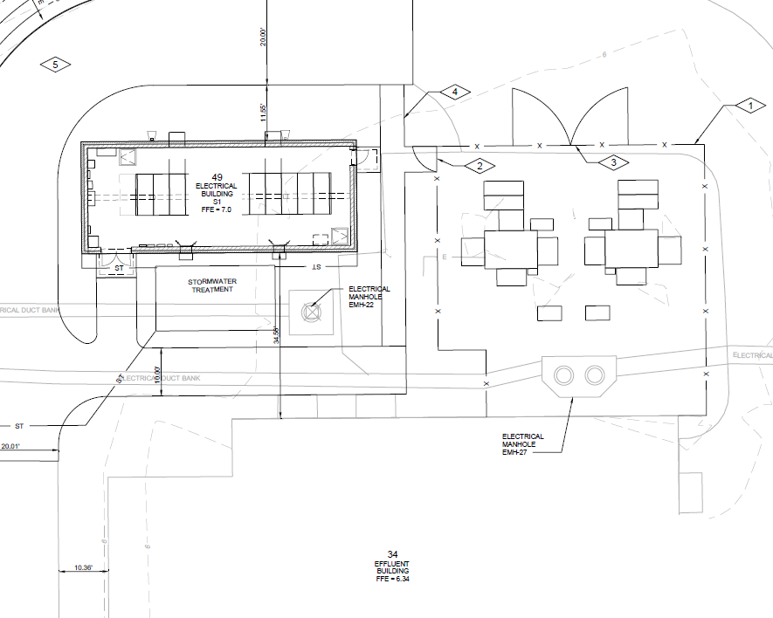
Electrical Service Equipment Replacement
Project will eliminate switchgear H1 building, replace switchgear S1 in new building, replace distribution cables and transformers.
New S1 Building
New H1 Circuit Breakers
New Transformers
Planned Layout

Slide 5
Advertisement for Bids
Advertised in June 2024
Approx. 17 plan holders
4 prequalified bidders
18 attendees at the pre-bid meeting
4 bids received
S1 Switchgear

Slide 6
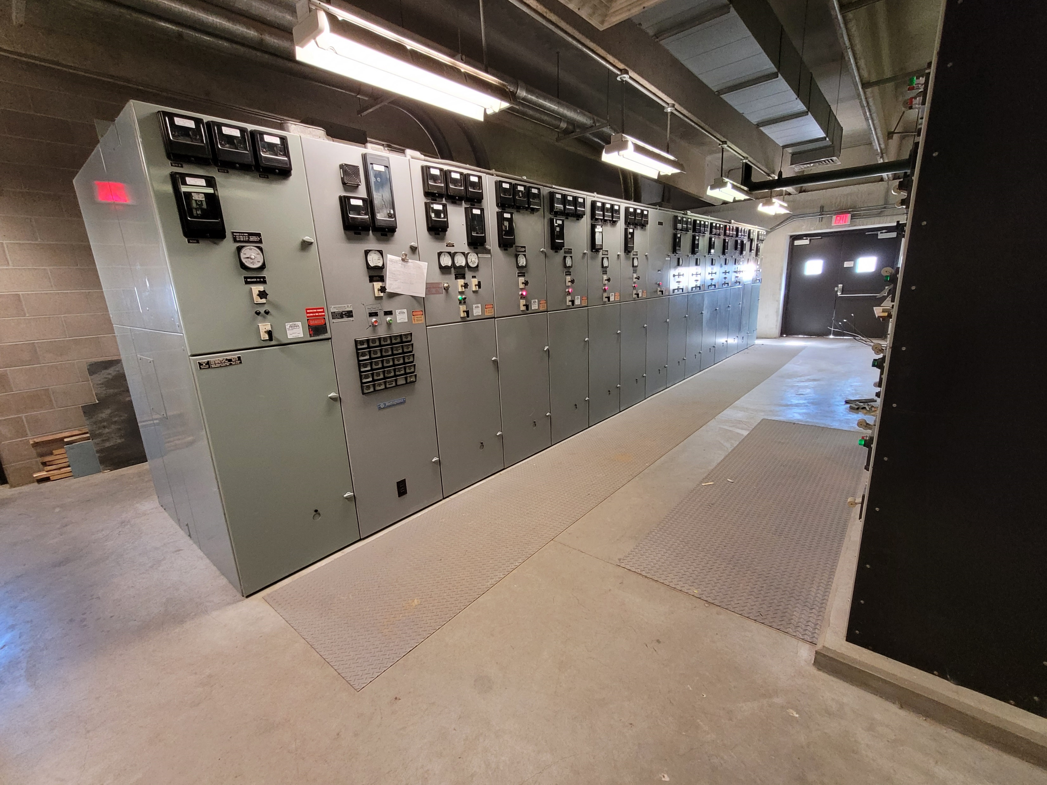
Bid Results
Bids accepted on June 26
Engineer’s Estimate $11,392,500
WIL-surge Electric, Inc.
Qualified, financially stable, prior experience and staff/equipment necessary to perform the work.
Contractor | Bid
WIL-surge Electric, Inc. | $ 9,235,730
Pieper Electric, Inc. | $ 9,637,973
NEXT Electric, LLC | $ 9,748,833
Forward Electric, Inc. | $ 11,382,000
S1 Switchgear

Slide 7
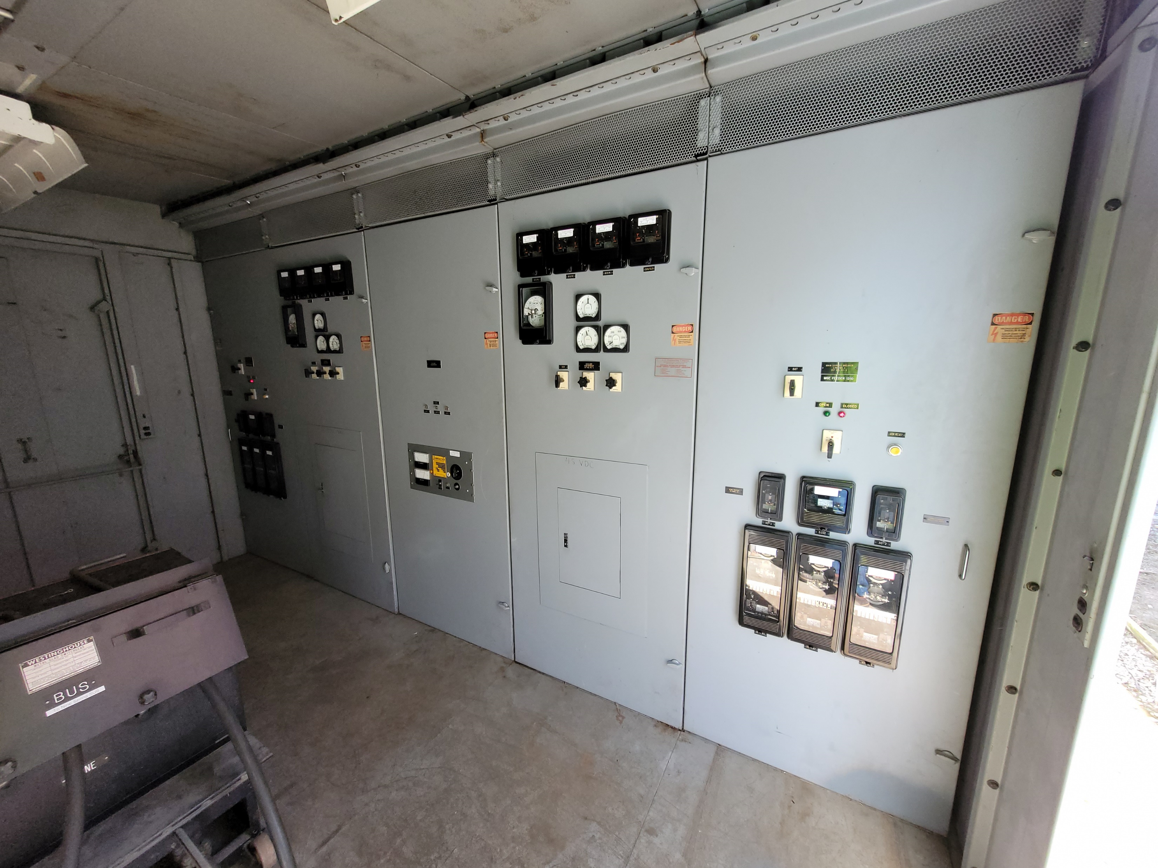
Project Budget
Budgeted 2024 CIP construction amount: $11,180,000
Current construction estimate: $9,710,000
Total budgeted 2024 CIP amount: $13,700,000
Current total project cost estimate: $11,630,000
H1 Switchgear

Slide 8
Professional Service Agreement Amendment
Amendment 2: Stage 4 Construction Services
Donohue & Associates, Inc. has performed well in previous stages and will be retained for construction services
Construction Services proposed to be $626,300

Slide 9
Recommendation and Next Steps
Approval of Resolution 2024-07-11-R4
Review of Bids & Award of Contract: Nine Springs Wastewater Treatment Plant Electrical Service Equipment Replacement
Approval of Resolution 2024-07-11-R5
- Approve Transaction Amount and Approve Professional Service Agreement Amendment: Nine Springs Wastewater Treatment Plant Electrical Service Replacement Construction Services
Construction to begin July 2024; Complete by February 2027

Slide 10
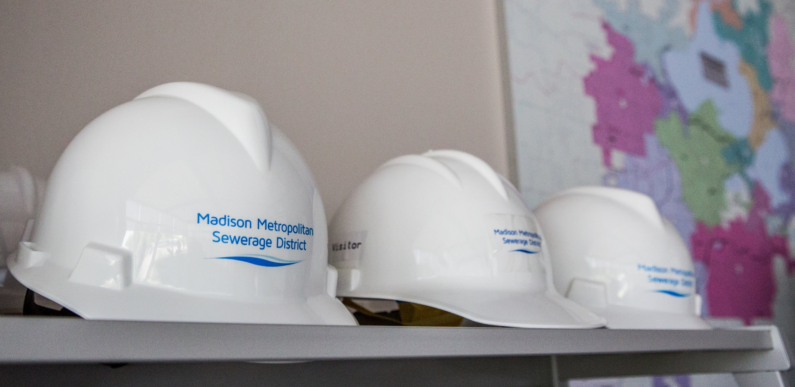
Questions?

