Slide 1
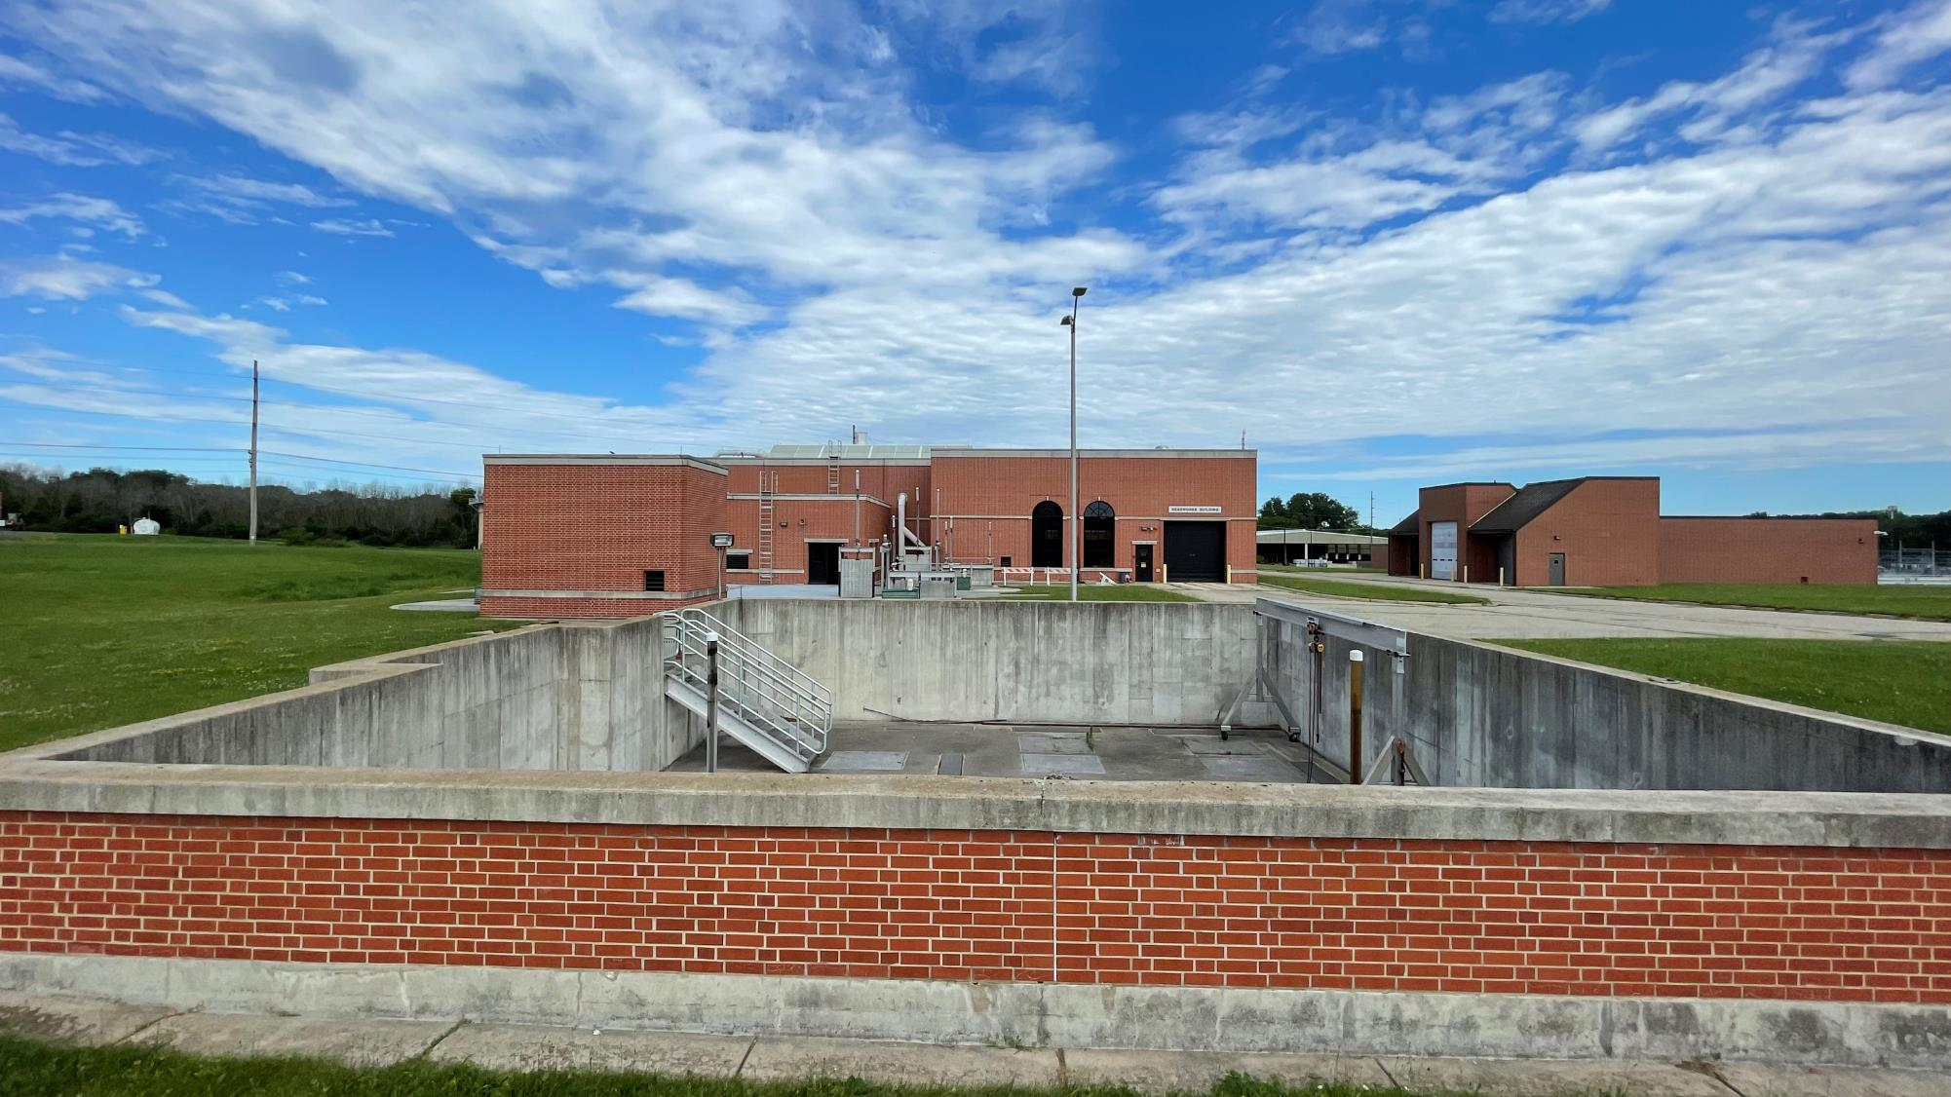
Flow Splitter Improvements
Approve Transaction Amount and Approve Professional Services Agreement Amendment
and
Review of Bids, Award of Contract, and Increase in Total Project Budget

Slide 2
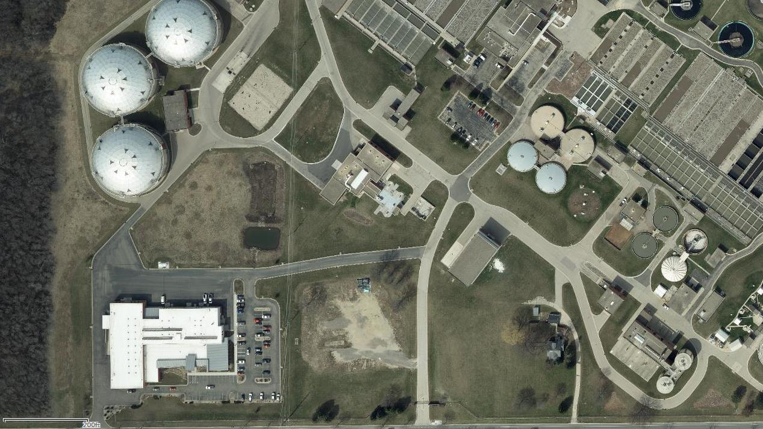
West Plant
Influent
Flow
Headworks Facility
East Plant
Flow Splitter

Slide 3
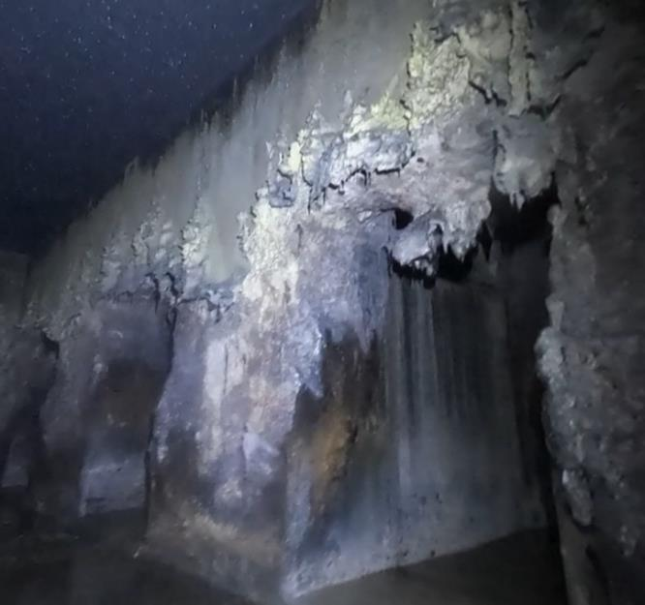
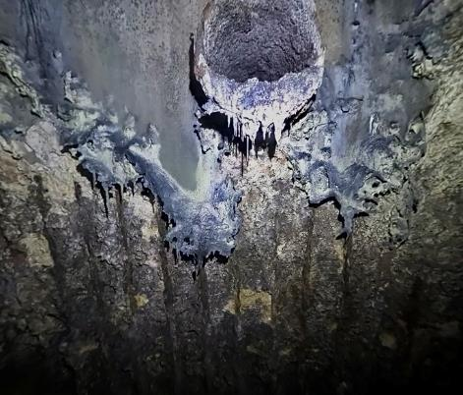
Condition of Flow Splitter Structure

Slide 4
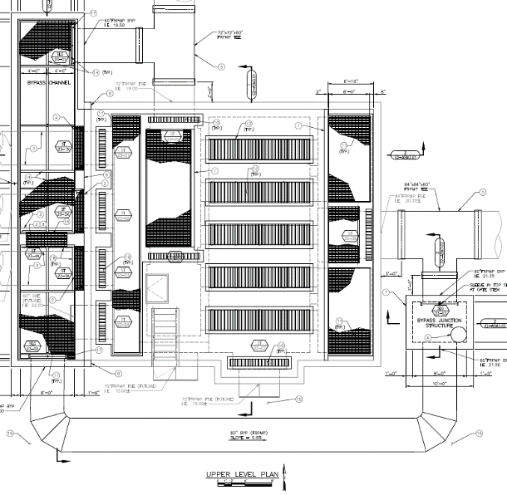
Scope and Schedule
Construct new permanent bypass channel
Repair concrete and rebar that had degraded
Remove and replace chemical resistant coating
Removal of sections of the top deck and replacement with grating for passive ventilation
Removal of concrete troughs and weirs with Fiber Reinforced Plastic (FRP)
Earliest construction start date in October 2024
Complete construction end of 2025

Slide 5
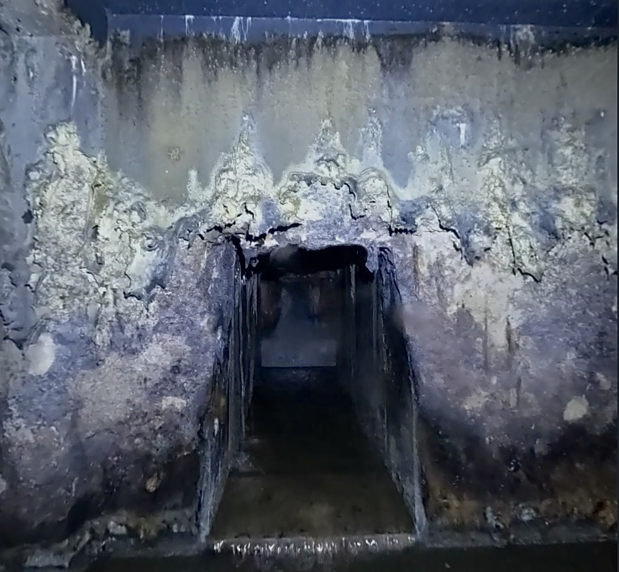
Advertising Published in the WSJ two times on May 28 and June 3.
Plan Holders Approx. 15 plan holders
Bidders Two pre-qualified prime bidders
Four pre-qualified subcontractors
Pre-bid Meeting 11 attendees
Bids Received Two bids received

Slide 6
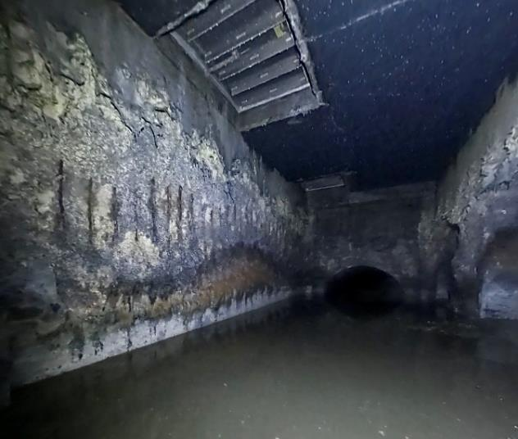
Bid Results
Bids accepted on June 25, 2024
August Winter & Sons, Inc.
Qualified, financially stable, prior experience and the equipment necessary to perform the work.
The engineer’s estimate was $5,125,000
Contractor | Bid
August Winter & Sons, Inc. | $ 6,435,000
Staab Construction Corporation | $ 7,443,000

Slide 7
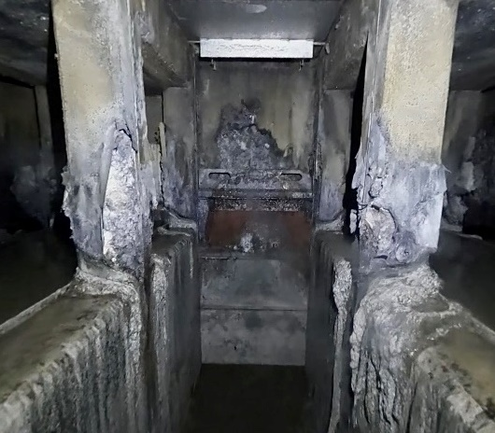
Project Budget
Project is anticipated to be funded with CWF, pending available funding. Contract documents comply with the CWF and BABA requirements.
Current construction estimate: $6,820,000
Budgeted construction amount: $4,495,000
Current total project cost estimate: $7,600,000
Total budgeted amount: $5,000,000

Slide 8
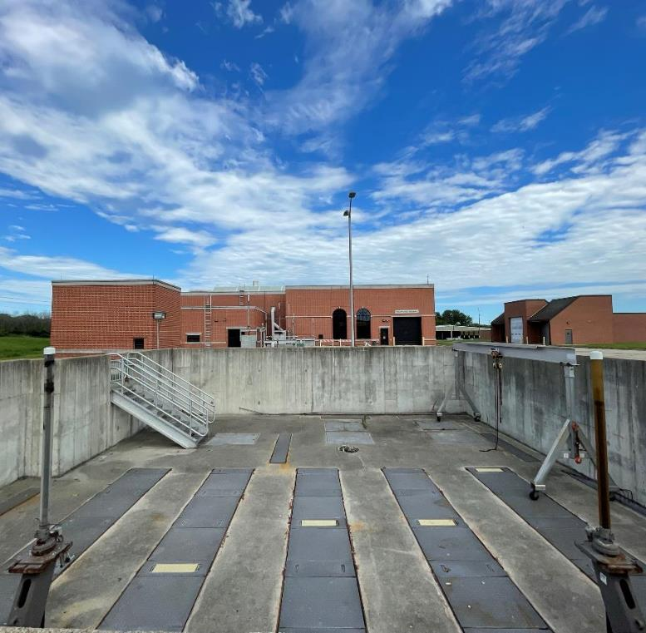
Approve Transaction Amount and Approve Professional Services Agreement Amendment: Flow Splitter Improvements Construction Services
Amendment 2: Stage 4 Construction Services
Strand Associates Inc has performed well in previous stages and will be retained for construction services.
Construction services proposed to be $252,000

Slide 9
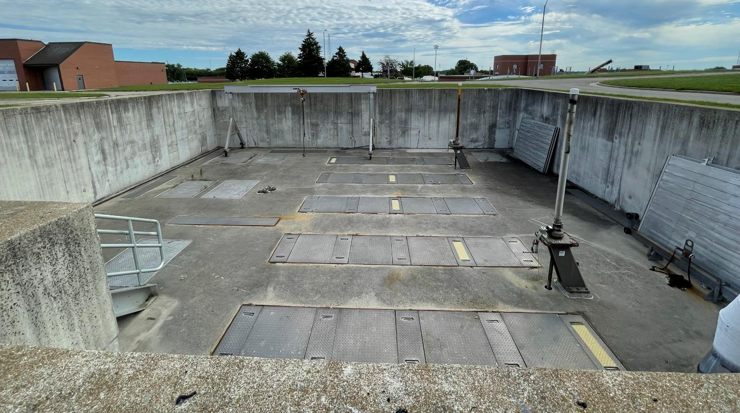
Recommendation and Next Steps
Approval of Resolution 2024-07-11-R6
Review of Bid, Award of Contract and Increase in Total Project Cost: Flow Splitter Improvements
Approval of Resolution 2024-07-11-R7
Approve Transaction Amount and Approve Professional Services Agreement Amendment: Flow Splitter Improvements Construction Services

Slide 10
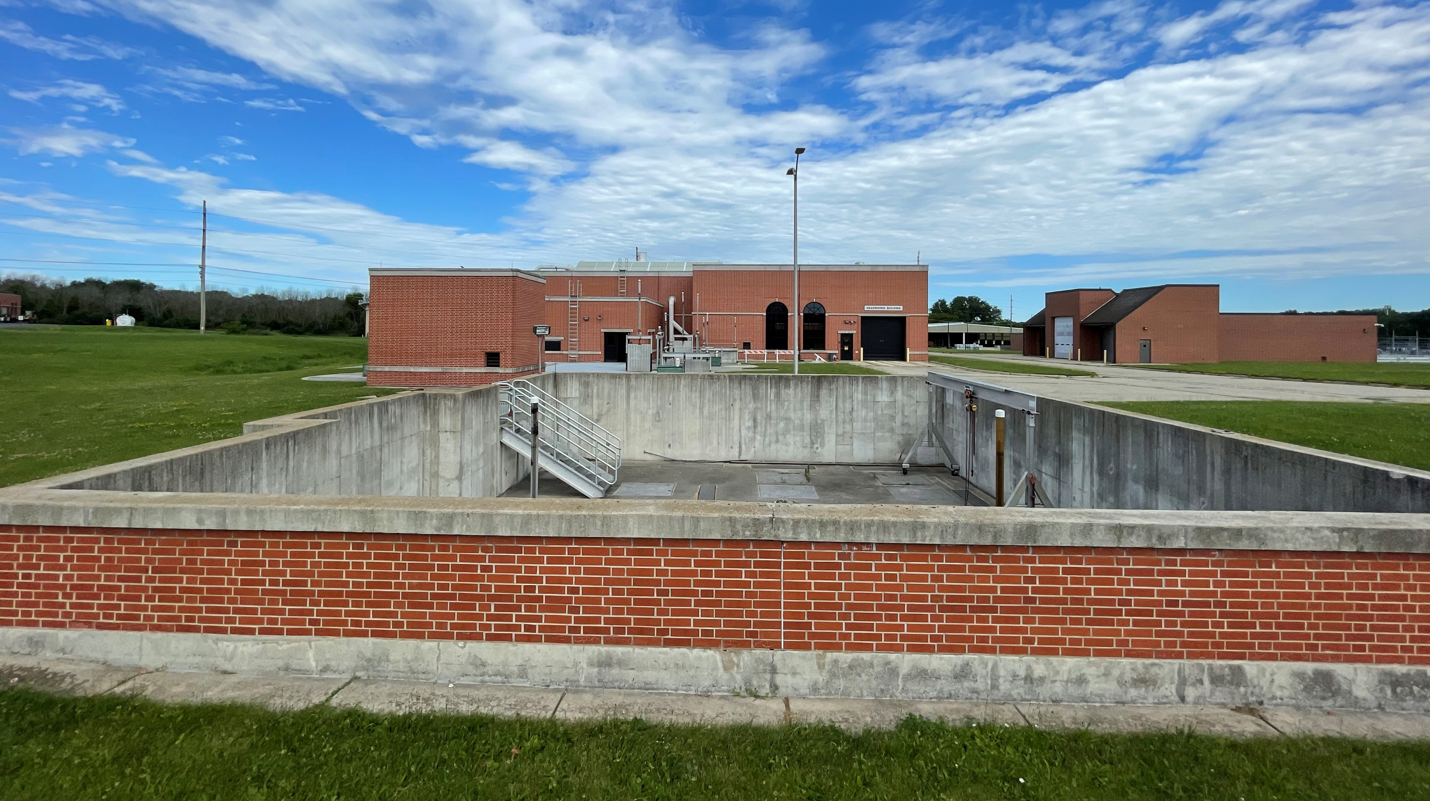
Thank you

