Slide 1
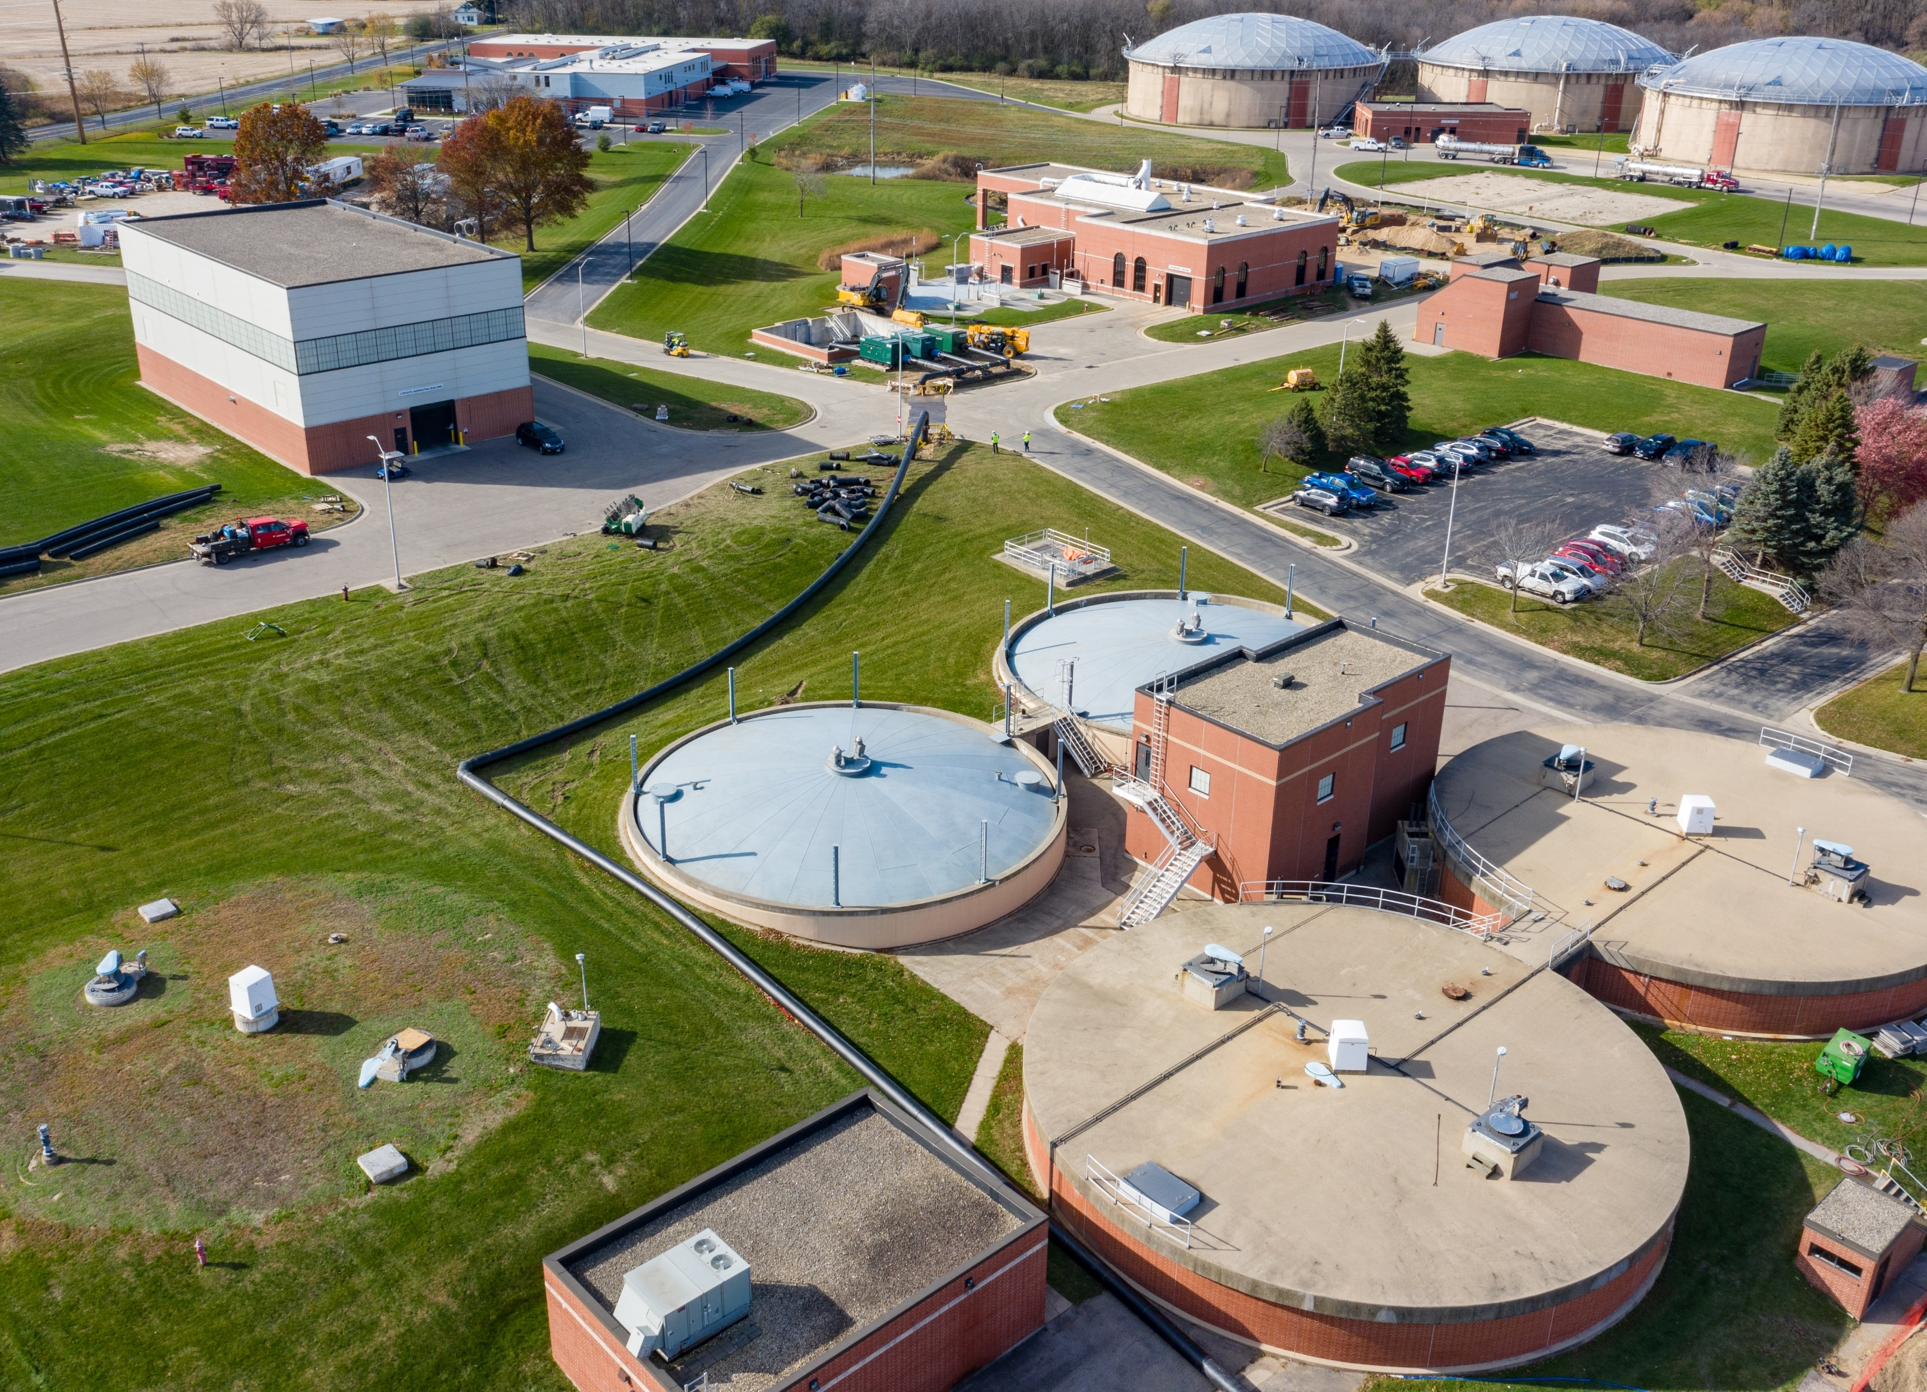
May Operations Report

Slide 2
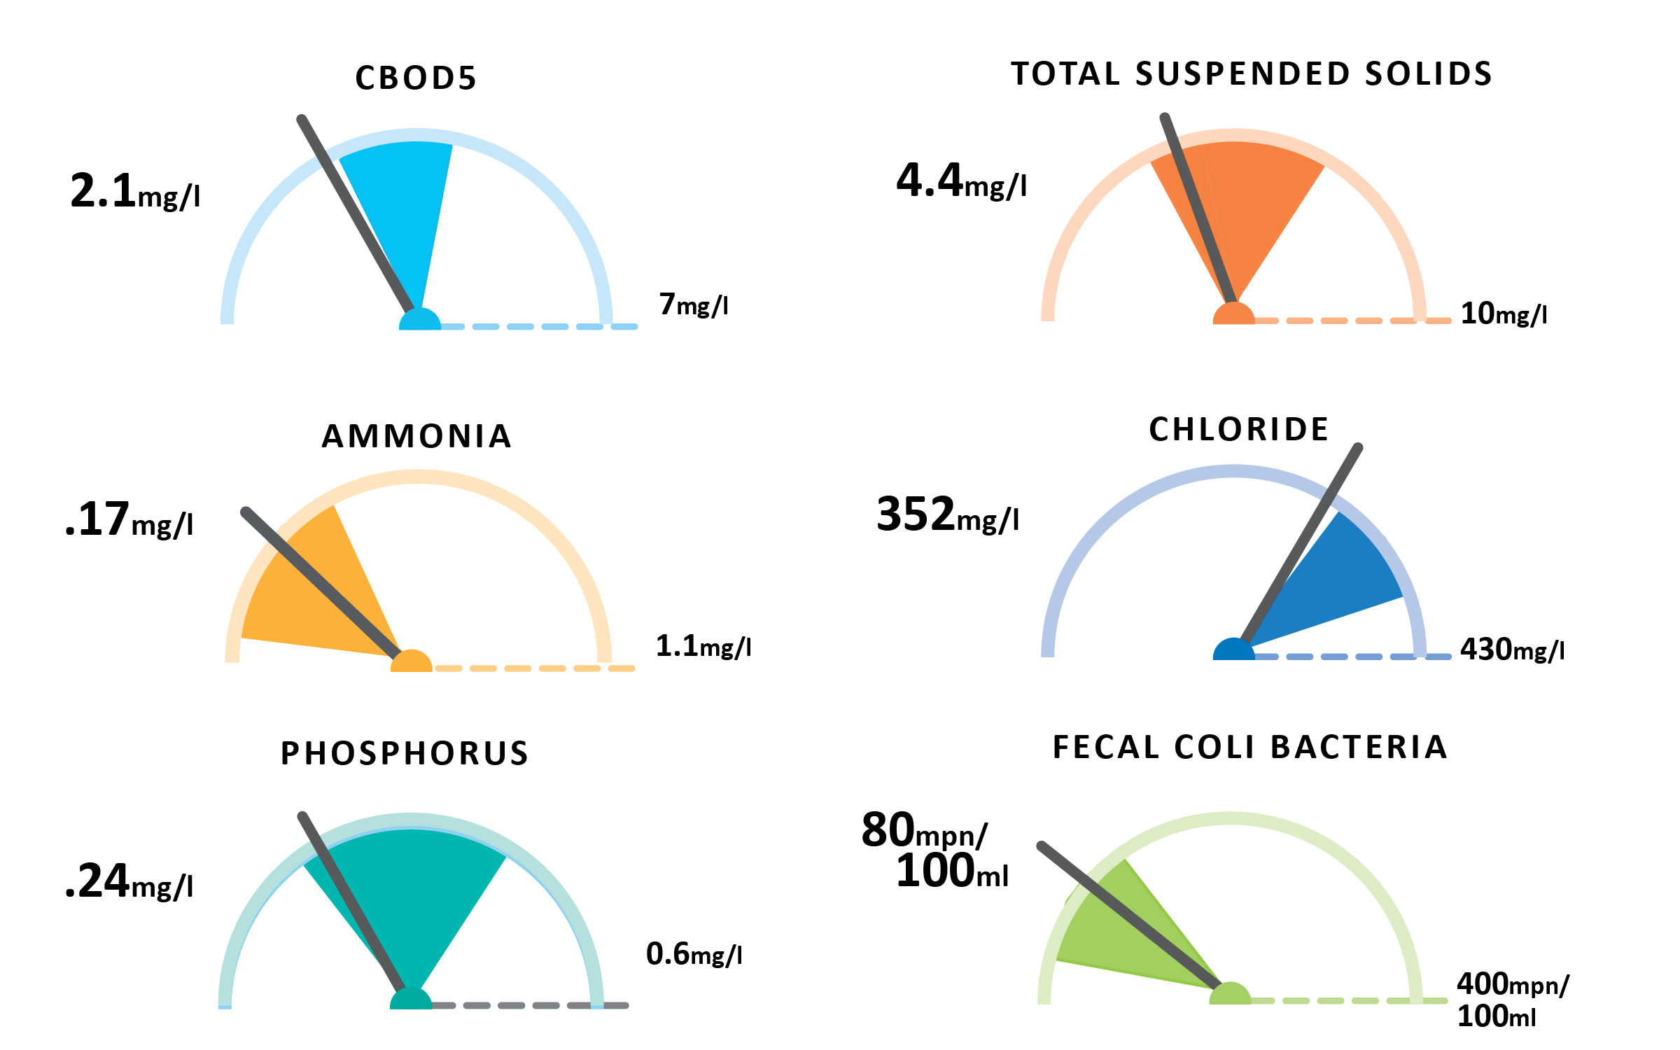
May Plant Performance

Slide 3
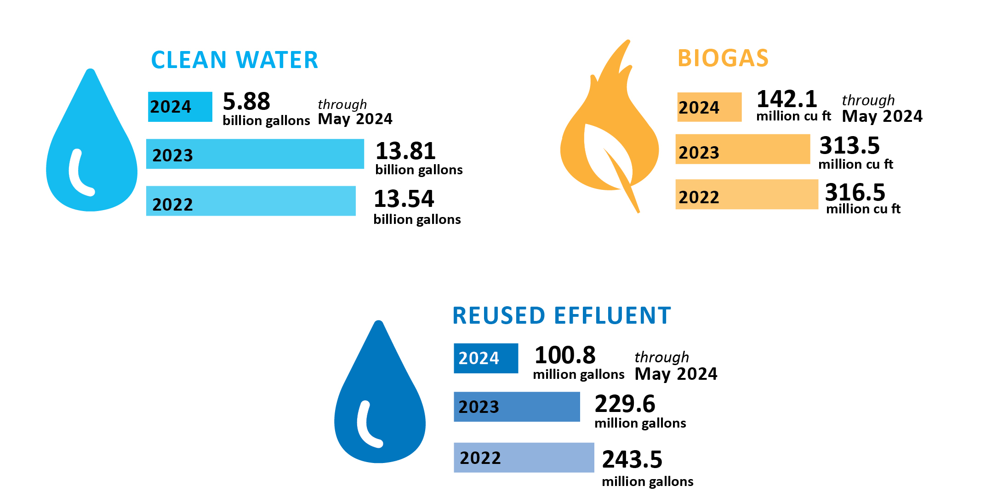
May Plant Performance

Slide 4
May Plant Performance

Slide 5
Thank you

