Slide 1


2023 Compliance Maintenance Annual Report
June 13th 2024

Slide 2

Legal Requirements
Slide title here
Department of Natural Resources (NR)
Statute Ch. 283- Pollution Discharge Elimination
Implemented by NR 208
Wisconsin Pollution Discharge Elimination System (WPDES) Permit Requirement
Approval of report and resolution by governing body
Wisconsin State Legislature
Notes:
Why do we do this?
The CMAR is required by the Department of Natural Resources through the Wisconsin State Legislature
This legislation describes the compliance maintenance requirements for wastewater treatment plants including Nine Springs and upholds our permit requirements
In addition to submitting an annual compliance maintenance report, a certified resolution statement by the governing body verifying the completion and accuracy of the document is also submitted
Chapter NR 208, which went into effect in January of 2005, describes the compliance maintenance requirements for wastewater treatment plants including Nine Springs
This chapter implements statute chapter 283 on pollution discharge elimination, which upholds our permit requirements
This legislation requires the submittal of the CMAR as well as the certification of a resolution statement by the governing body verifying the completion and accuracy of the documents submitted

Slide 3
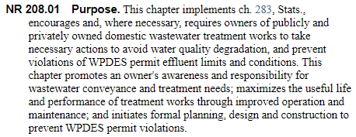

Purpose
Protects Public Health and the Environment
Initiates action to avoid water quality degradation
Serves as an Educational Tool
Promotes owner awareness and responsibility for
treatment needs
Identifies Improvement Areas
Maximizes useful life and performance through improved
operations and maintenance
Initiates New Projects
Promotes formal planning, design and construction
Notes:
The CMAR has the following purposes identified in NR 208:
The CMAR exists to protect public health and the environment. This document helps initiate action that will avoid water quality degradation and permit violations.
It also serves as an educational tool because it aids in facilitating discussions which promote owner awareness of treatment plant needs.
By identifying treatment areas that need improvement, the CMAR serves to maximize the useful life of the facility and improve performance through implementing better O&M practices.
Finally, the CMAR helps to promote the formal planning, design, and construction of new projects in the treatment facility and collection system.
Moving forward, it’s important to note that the CMAR is not WWTP specific and is not intended to be a punishment for poor scores. It is also not intended to report on new data or compliance issues, since it provides a review of the previous year. So even though we’re halfway done with 2024, this report will not touch on current treatment plant performance.

Slide 4
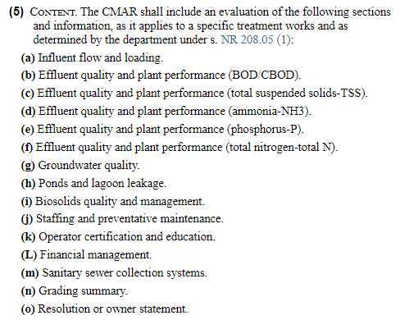

Report Content
*NSWWTP omits total nitrogen, groundwater quality, and ponds and lagoon leakage sections
Notes:
The questions on the CMAR aim to identify average performance throughout the previous year through reported values from monthly discharge monitoring reports, as well as broad facility goals and plans for upgrades.
Getting into the actual contents of the CMAR report, the District’s report contains sections for influent flows and loadings as well as effluent quality for biochemical oxygen demand (BOD), carbonaceous biochemical oxygen demand (CBOD), total suspended solids (TSS), ammonia, and phosphorus. It also includes sections for biosolids quality and management, staffing and preventative maintenance, operator certification and education, financial management, and sanitary sewer and collection systems.
Once each of these sections is completed, a grade is generated on the DNR’s website based on the responses submitted.
Overall, scores are assigned in a similar format to typical school report cards. However, certain violations are worth more than others and can have a disproportionate impact on the overall grade received.

Slide 5
2023 Grade Summary
Grade | Section
A | Influent Flow and Loadings
A | Effluent Quality: Biochemical Oxygen Demand
B | Effluent Quality: Total Suspended Solids
A | Effluent Quality: Ammonia
A | Effluent Quality: Phosphorus
D | Biosolids Quality and Management
A | Staffing and Preventative Maintenance
A | Operator Certification and Education
A | Financial Management
A | Collection Systems
GPA: 3.46
Notes:
The District scored 128 out of 148 total points on the 2023 CMAR, receiving a grade point average of 3.46.
8 out of 10 sections received an “A” grade. Only the total suspended solids and biosolids management section deviated from this, receiving a “B” and “D,” respectively.
In alignment with the purpose of the CMAR, sections that received a grade worse than a “B” along with any overflow instances must be explicitly addressed in the resolution document to improve performance in these areas. Because of this, we are going to spend the remainder of this presentation reviewing information from the sections where issues were identified.

Slide 6
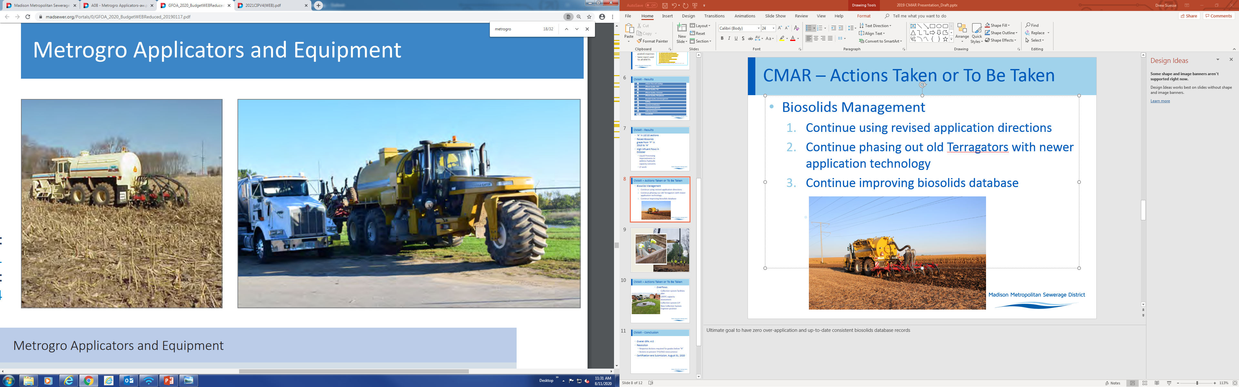
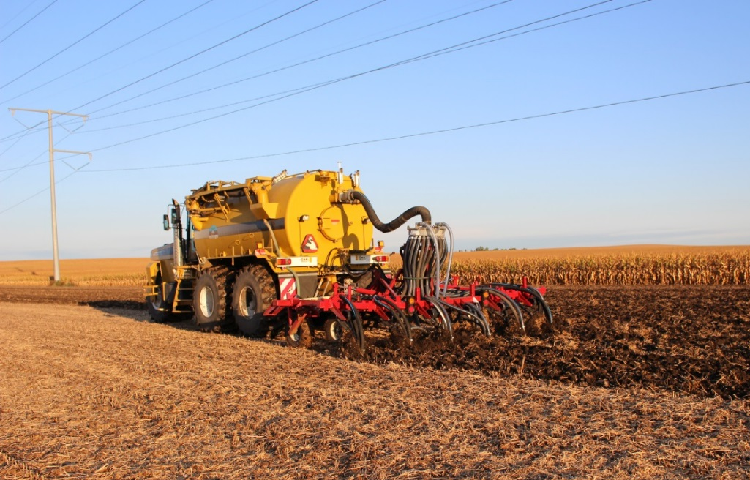
One Instance of Nitrogen Over Application
Lost 30 points, dropped score down to a D
Replacing Old Technology
New Terragators are equipped with GPS and Autosteer technology
Cause of Over Application
Not all sites are applied with new technology due to slow phase-out of old equipment
Switch to new methodology for generating application rate
New QA/QC Procedures
New QA/QC procedures have been adopted to properly calculate biosolids application rates
Biosolids
Management
Notes:
The main area where the District lost points on the CMAR is the biosolids management section. We lost 30 points for the over application of nitrogen, bringing the grade for this section down to a “D”.
The majority of 2023 over applications were due to higher than anticipated nitrogen test results. After the spring season staff were able to meet with DNR to discuss previous over applications that have occurred. It was during those conversations that the District and DNR were able to agree on a calculation method and process that provided clarity on application rates. This resulted in the District having to create a new way of calculating application rates: Instead of calculating application rates based off of the previous 12-month average, the District has now implemented a system that involves creating baseline application rates using the 3 most recent data points for nitrogen content at the time of application and then reporting the actual amount of nitrogen applied based on sample results from the week of application. This process doesn’t eliminate chances of over applications, but it allows us to report the most accurate information possible.
The District is also in the process of phasing out old equipment with newer application technology. Old applicators are not equipped with GPS or autosteer technology and are more subject to overlapping. Once old equipment has been effectively phased out, it is our hope that the District will be able to minimize over applications in the coming years.

Slide 7
Historical Overflows
Notes:
The next area which requires a response is the collection systems section. Despite the fact that it received an “A” grade, multiple overflows were reported on this section of the 2023 CMAR.
Treatment facility overflows, or TFO’s, are typically less severe than sanitary sewer overflows, or SSO’s. This is because TFO’s are overflows that occur from a location within the wastewater treatment plant, while SSO’s are overflows that occur from a collection system and have a greater chance of interacting with the environment.
On the screen is a graph of the number of the number of TFO’s and SSO’s reported by the District over the last 5 years. Last year, the District reported 5 TFO’s, and 3 SSO’s.

Slide 8
Sanitary Sewer Overflows
Date | Location | Response Action
5/23/23 | Carroll St. Pump Station | Careful monitoring and installation of level transducer
9/18/23 | BMC Force Main | Bled off air and planned force main shut down
10/6/23 | Force Main near Allen Boulevard and Marshall Park | Continue regular force main rehabilitation
Notes:
During each sanitary sewer over event, immediate corrective action was taken to mitigate the problem, and long term preventative actions were taken if possible.
The 5/23/23 SSO occurred as a result of conducting preventative maintenance at Carroll Street pump station while the pumps were being controlled manually. Typically, the pumps are set to turn on automatically once the well reaches a certain level which ensures the well does not get too high, but this feature was disabled due to maintenance. Immediate corrective action was taken to put the station back into automatic control once the issue was discovered. The District has discussed adding a level transducer to prevent reoccurrence.
The 9/18/23 SSO occurred as a result of air getting trapped in the Badger Mill Creek force main, obstructing flow. This situation was very unusual and the exact cause of the problem has not been identified. However, a similar overflow hasn’t reoccurred and the District plans to shut this force main down in the near future.
Finally, the 10/6/23 SSO occurred as a result of a force main break. Since the exact cause of the break has not been identified, the District's plan to prevent similar SSOs is to continue to replace other force main sections on a regular schedule.

Slide 9
Treatment Facility Overflows
Date | Location | Response Action
3/14/23 | Centrate Well | Control adjustments made
5/12/23 | RAS Well | Fixed level monitoring equipment
9/8/23 | DAF Pressure Vessel | Air to water ratio recalibrated
9/17/23 | Digester Relief Hatch | Fixed recirculation pump and added defoamant
10/5/23 | RAS Flow Meter | Planned replacement of RAS flow meters
Notes:
The remaining overflows that happened in 2023 were small, treatment facility overflows that occurred on site and did not pose a threat to human health or the environment.
The 3/14/23 TFO occurred due to the centrate well overflowing while the centrifuge was operating. The centrifuge is only operated intermittently and requires process tuning when it is restarted. To correct this, control adjustments were made including lowering polymer dosing.
The 5/12/23 TFO occurred due to a failure in the RAS well level monitoring equipment. The spill occurred when adjusting settings to take manual control of the well level during the equipment failure. The spill was cleaned up and the equipment was repaired which effectively prevented further TFOs.
The 9/8/23 TFO occurred as a result of the dissolved air flotation pressure vessel filling with water. To correct this, the amount of air being put into the system was recalibrated. Better monitoring of the system is necessary to prevent a similar TFO.
The 9/17/23 TFO occurred as a result of foaming that was caused by a recirculation pump failing. To prevent another overflow, defoamant was added and the District is awaiting installation of new digester covers that would permanently prevent this from happening again.
The 10/5/23 TFO occurred as a result of a small hole that spontaneously developed in the casing of a RAS flow meter. To prevent reoccurrence, the District plans to replace the other RAS flow meters during the liquids processing upgrade by approximately 2028.

Slide 10
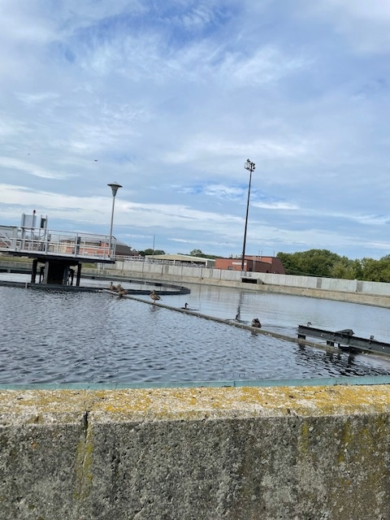
Grade
The District received a “B” on this section due to violating four effluent solids limits in July of 2023
Violations
Weekly average TSS limits at Badger Mill Creek (x2)
Monthly average TSS limit at Badger Mill Creek
Weekly average TSS limit at Badfish Creek
Corrective Actions
Increasing return activated sludge rates to reduce detention time in the clarifiers
Conversion back to typical wasting method
Worst performing clarifier from each plant taken out of service
Total Suspended Solids
Notes:
Besides the biosolids section, the only other area where the District lost points on the 2023 CMAR was the total suspended solids section.
The District received a “B” on the TSS section due to violating four effluent solids parameters during the month of July in 2023. These violations include the weekly average TSS limit during the first and second weeks of the month from July 1st through July 7th, and July 8th through the 14th at Badger Mill Creek. These weekly violations also contributed to a monthly violation at the Badger Mill Creek outfall during the month of July. Finally, the Bad Fish Creek outfall experienced one weekly violation during the second week of the month.
To mitigate these issue, operations staff were periodically increasing RAS return rates to reduce the solids detention time in the clarifiers to try to mitigate the effects of increased denitrification due to intense heat. Each plant was also converted back to a simplified wasting method to better control the sludge ages. Finally, the worst performing clarifier from each plant was removed from service to reduce detention times to mitigate the negative impacts from drought conditions.

Slide 11
Influent BOD Loading
Notes:
The final section I wanted to touch on is the influent loadings section. This score has improved since last year from a “C” to an “A” due to decreased BOD loadings and improvements in the lab instrumentation.
The current design was constructed as part of the liquids treatment project that was completed in 1998. The design BOD loading was planned to be 112,590 lbs BOD/day through 2018. Both the BOD design load and 90% design load are indicated on the graph.
As you can see from the graph, the average monthly BOD’s appear to be trending upward towards the design condition since the beginning of 2021. So far, the District has not exceeded the influent design load despite not undergoing a loadings upgrade since 1998.
In order to accommodate increased loadings, the District has undertaken a liquids processing phase 2 upgrade. One of the major focus areas for this project involves increasing the design BOD loading. Design for this project started this year in 2023, and construction is expected to be completed by 2028. Once construction is complete, the District will be able to accommodate the increased loads without risking exceedance of design parameters.

Slide 12

GPA: 3.46
Responses required for grades below “B”
Biosolids management: continued replacement of aging equipment
Actions to prevent overflow reoccurrence
Certification and submission due by June 30th, 2024
Resolution
The Commission is requested to adopt Resolution 2024-06-13-R7, accepting the Compliance Maintenance Annual Report and the required response actions therein.
Notes:
To summarize findings from the 2023 CMAR, the DNR assigned the District an overall GPA of a 3.46.
As part of the purpose for completing the CMAR, responses are required for any section receiving lower than a “B,” and for any overflow instances. Once again, the only affected sections were biosolids management and the collection system. The District has already taken action to address both of these sections.
To prevent further instances of nitrogen over application, the District plans to continue to replace aging application equipment in the coming years. The District has also taken action to prevent overflow reoccurrence, and is planning some equipment modifications which will permanently prevent certain types of overflows.
The final steps to complete the 2023 CMAR include approving and certifying the resolution to the above items, as well as submitting the report by Friday June 30th.
With that, I will now request approval of resolution 2024-06-13-RX, accepting the compliance maintenance annual report and the required response actions. I will also now take questions.

Slide 13
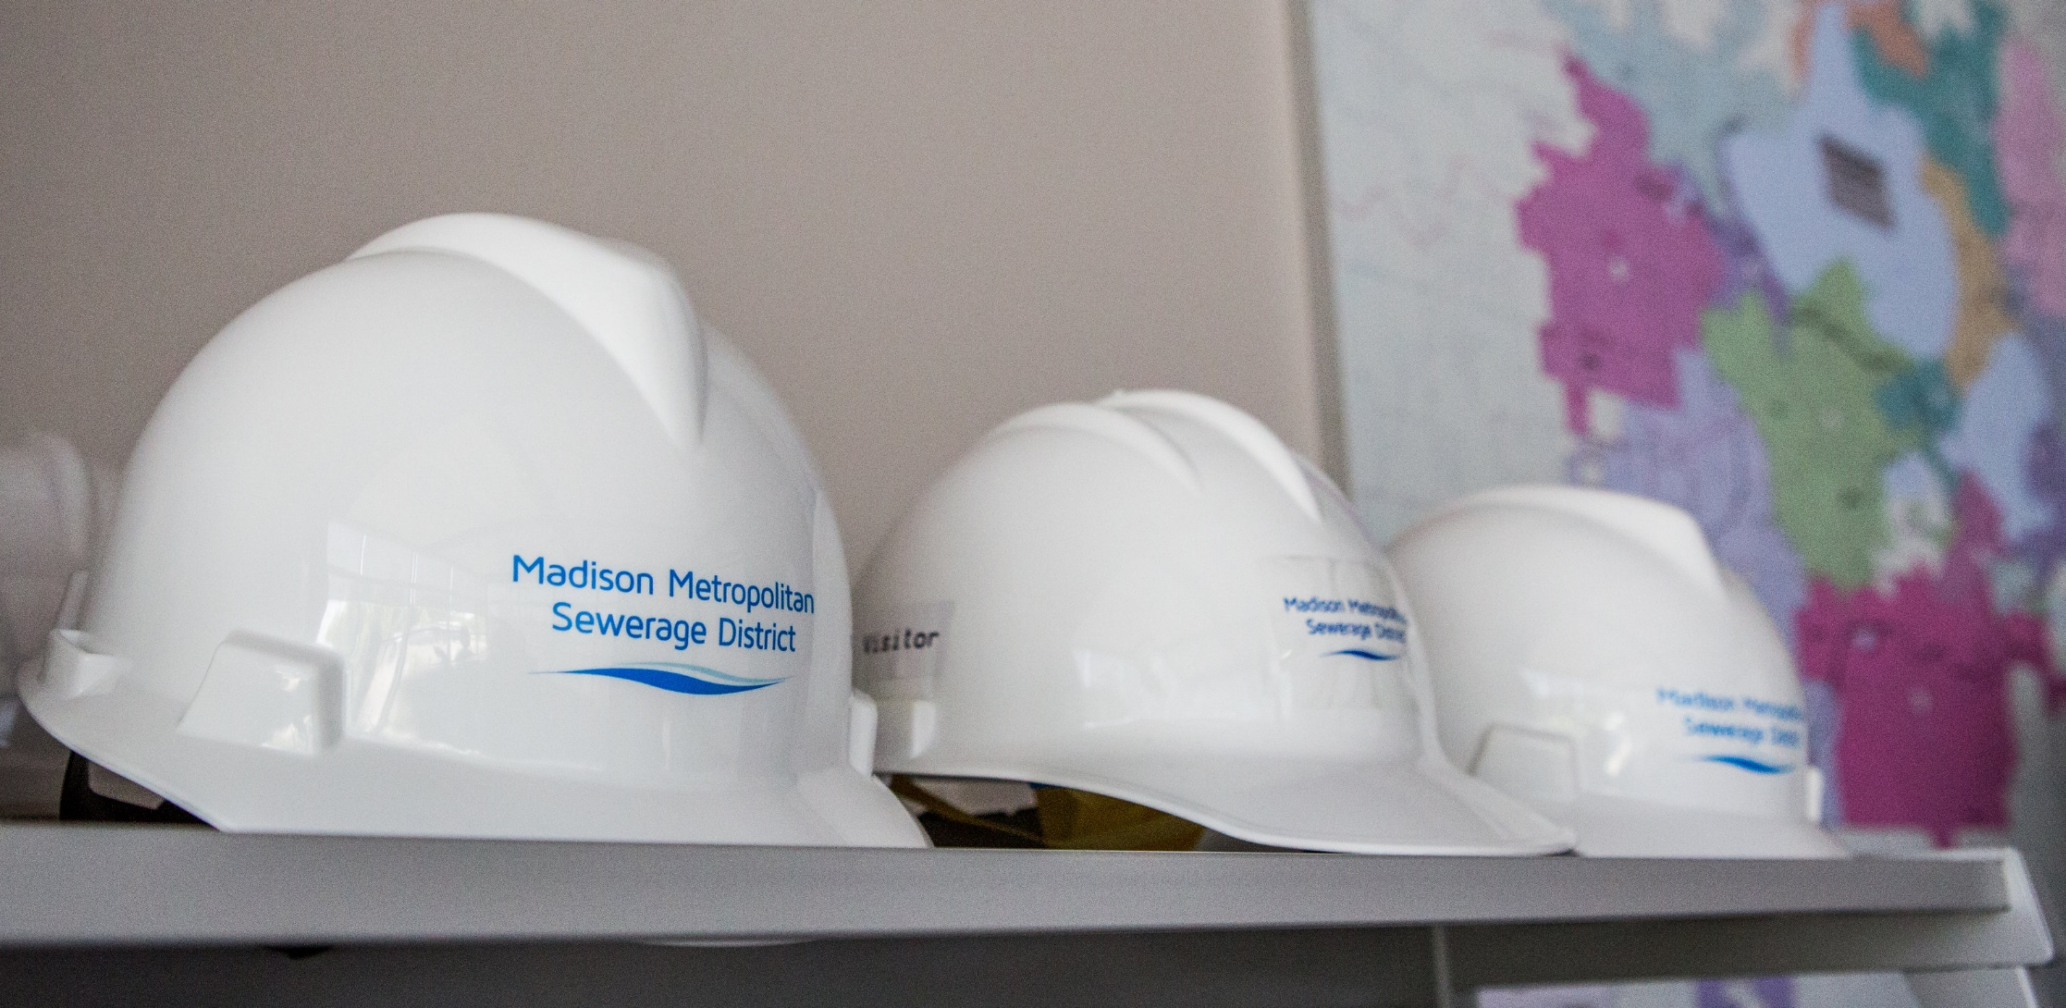
Questions?

