Slide 1
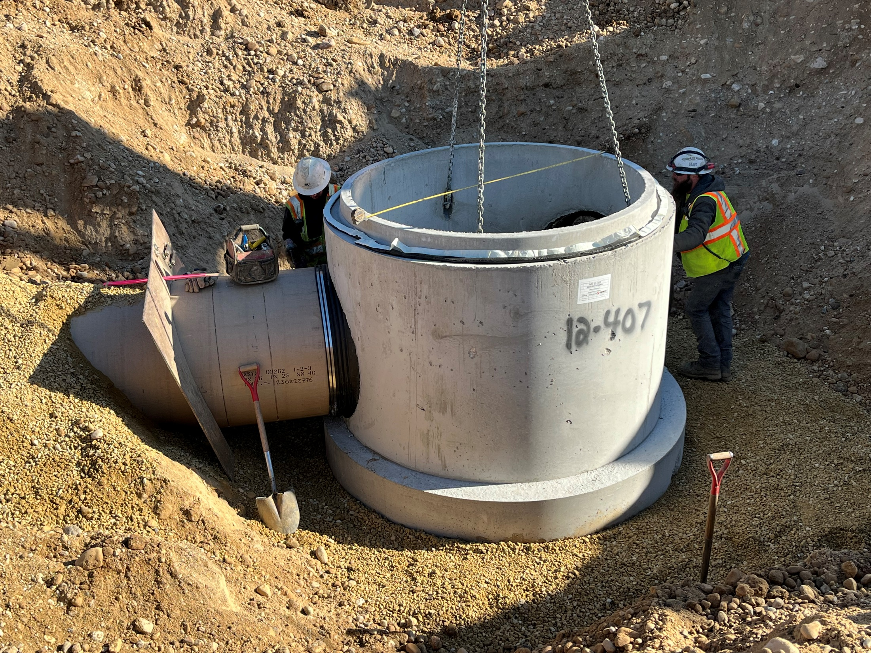

2023 Collection System Facilities Plan Update
May 30, 2024

Slide 2

Agenda
What is the collection system facilities plan?
Why do we prepare the plan?
What is included in the plan?

Slide 3

Capital Projects Planning
Master Planning
50 years
20 years
Capital Improvements Planning
Facilities Planning
< 6 years
Notes:
Three primary phases of capital planning, differentiated by planning horizon.
50-yr Master Plan was completed in 2009. Included a comprehensive analysis of collection system needs.
Facilities Plans for collection system were prepared in 2002 and 2011 – done entirely by District staff.
Planning period is 20 years, although the goals is to update them every 10-15 years to include the latest population forecasts and census data.

Slide 4

Facility Plan Requirement
The Facility Plan is a statutory requirement and must be submitted to the Wisconsin Department of Natural Resources (WDNR) for approval before project implementation.
All projects seeking a state Clear Water Fund (CWF) loan must be submitted for WDNR review and approval.
The basic purpose of facility planning is:
condition assessment
establish a need for improvement
evaluate options to address system needs
identify the cost-effective alternative
Notes:
Facilities plans are required for all projects requiring DNR approval.
Treatment plant additions and major projects often have separate and well-defined facility planning steps, while the level of effort for CS projects can vary depending on project scope and complexity.
Regardless, facility plans are required for all projects seeking funding by Clean Water Fund program.
In either case, a facility plan answers the four listed areas.
While facility planning is often done for CS projects just before project design, preparation of a long-range facility plan such as the District’s plan helps establish project need and to identify alternatives early in the process.

Slide 5
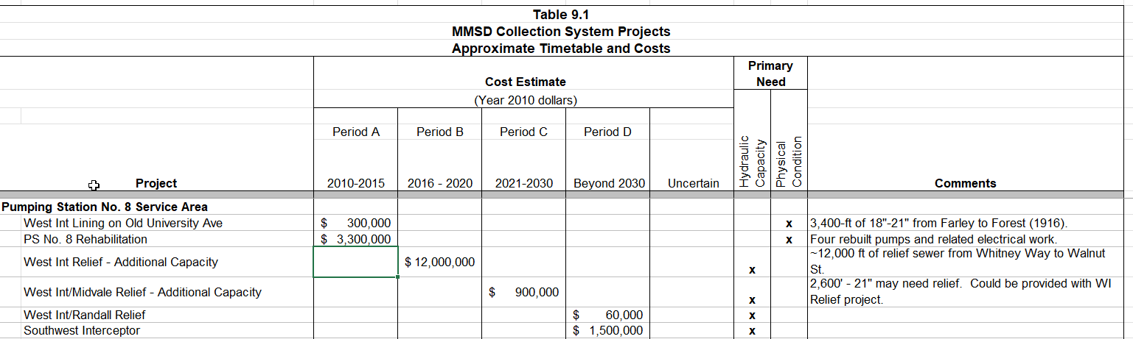
Capital Improvements Plan
Capital Projects (2010 to 2020)
 | No. of Projects | Expenditures (actual $)
Recommended in Plan | 36 | $112 million
Completed/Initiated | 29 | $98 million
Notes:
Excerpt is from 2011 Plan.
Recommended projects are listed by pump station service area and costs are estimated in different planning intervals.
Most of the projects in the Plan have been implemented in the ten years between 2010 and 2020.
Three more projects have started in the last three years.

Slide 6
Topics in Plan
CMOM
Capacity Assessment
Condition Assessment
Inflow and Infiltration
Emergency Power
System Resiliency
Force Main Condition Assessment
Collection System Maintenance (FOG, H2S, Access)
Energy Optimization
Lower Badger Mill Creek Basin
Recommended Projects
Notes:
The Plan contains a number of chapters, or topic areas.
Assessments of asset capacity and condition are the most prominent chapters.
Other topic areas which are highlighted in bold type will also be mentioned.

Slide 7
Age of Interceptor System
Notes:
Age of interceptor system is an important consideration for both asset condition and capacity.
As shown in the plot, over 70% of the system was installed prior to 1980.
Capacity of most facilities are designed for only 40-50 years.

Slide 8
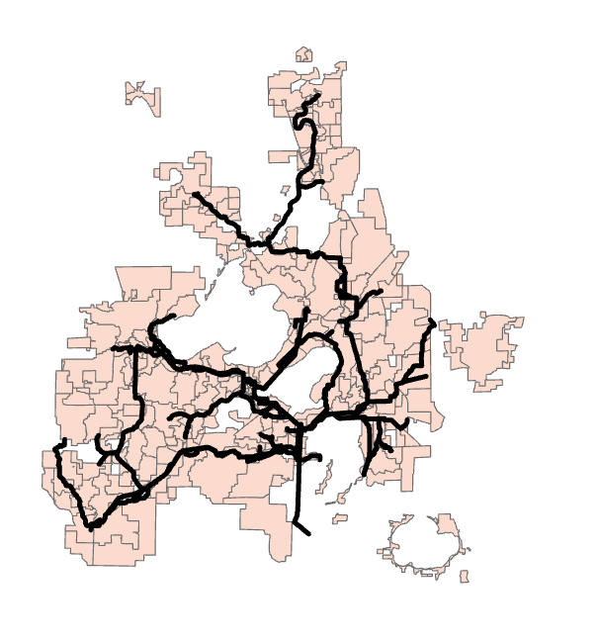
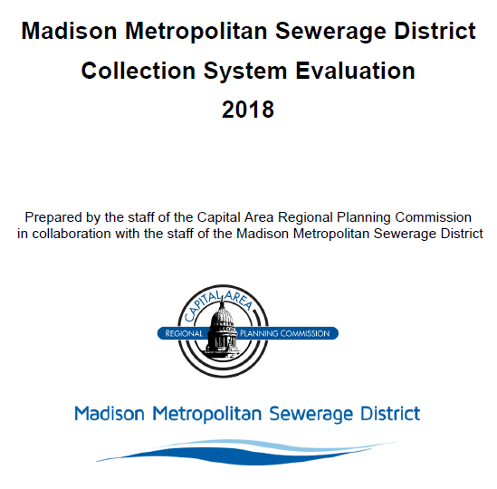
Collection System Evaluation
Notes:
CARPC assists in capacity assessment through preparation of District’s collection system evaluation.
In this comprehensive analysis wastewater flows are estimated in each of the subbasins shown on the screen based on U.S. census data and our customer’s comprehensive development plans.
The flows are then routed through the District’s infrastructure to assess capacity needs.

Slide 9
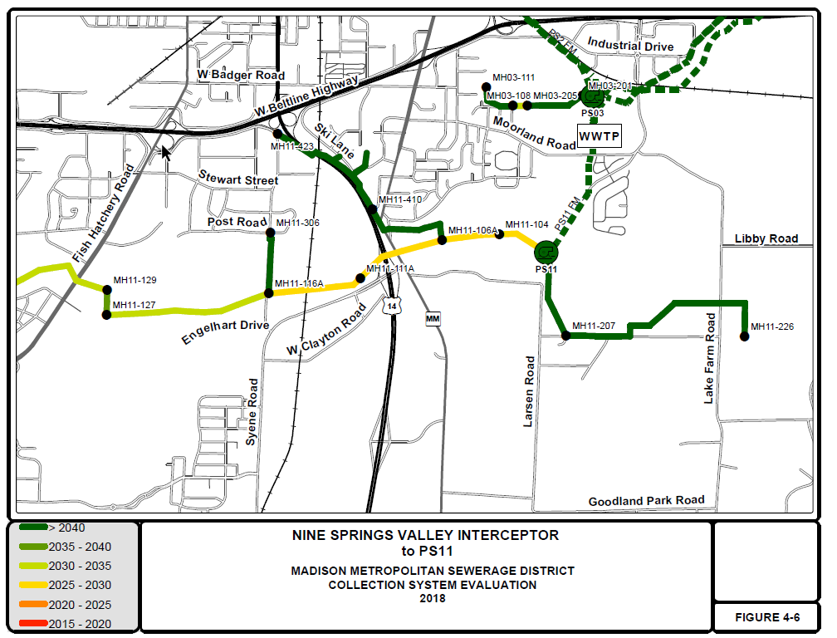
Collection System Evaluation
West Interceptor Relief
Northeast Interceptor – Waunakee Extension
Nine Springs Valley Interceptor
Notes:
Here is the output from a section of the District’s Nine Springs Valley Interceptor. Pipe segments are color coded according to the time period where capacity is expected to be reached.
In general, capacity is adequate in most areas of the collection system.
The most pressing needs are in the Nine Springs Valley Intercepting system.

Slide 10
Increased Density
Notes:
Transit-Oriented Development zoning introduced as a concept in City’s 2018 Comprehensive Plan.
CARPC’s 2018 evaluation did not account for this zoning change.

Slide 11
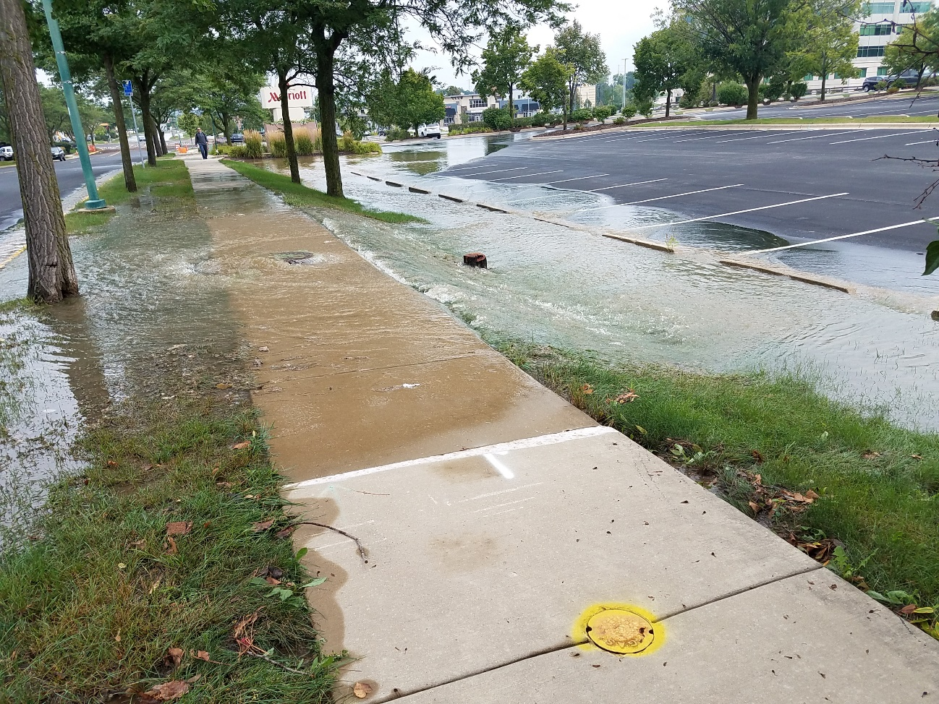
System Resiliency/Redundancy
Emergency power generation
Adapting to climate change
Notes:
Additional topics studies in the Plan include system resiliency and redundancy.
The picture at left shows a sewer overflow from the large storm in 2018 that delivered 10” of rain in a short time period to the west side of the collection system. Strand is modeling the effects of these larger storms on the District’s system.
The District is also developing a program to provide standby emergency power generation at all District pumping stations over the next ten years or so. Short-term installations are being incorporated into rehab projects.

Slide 12
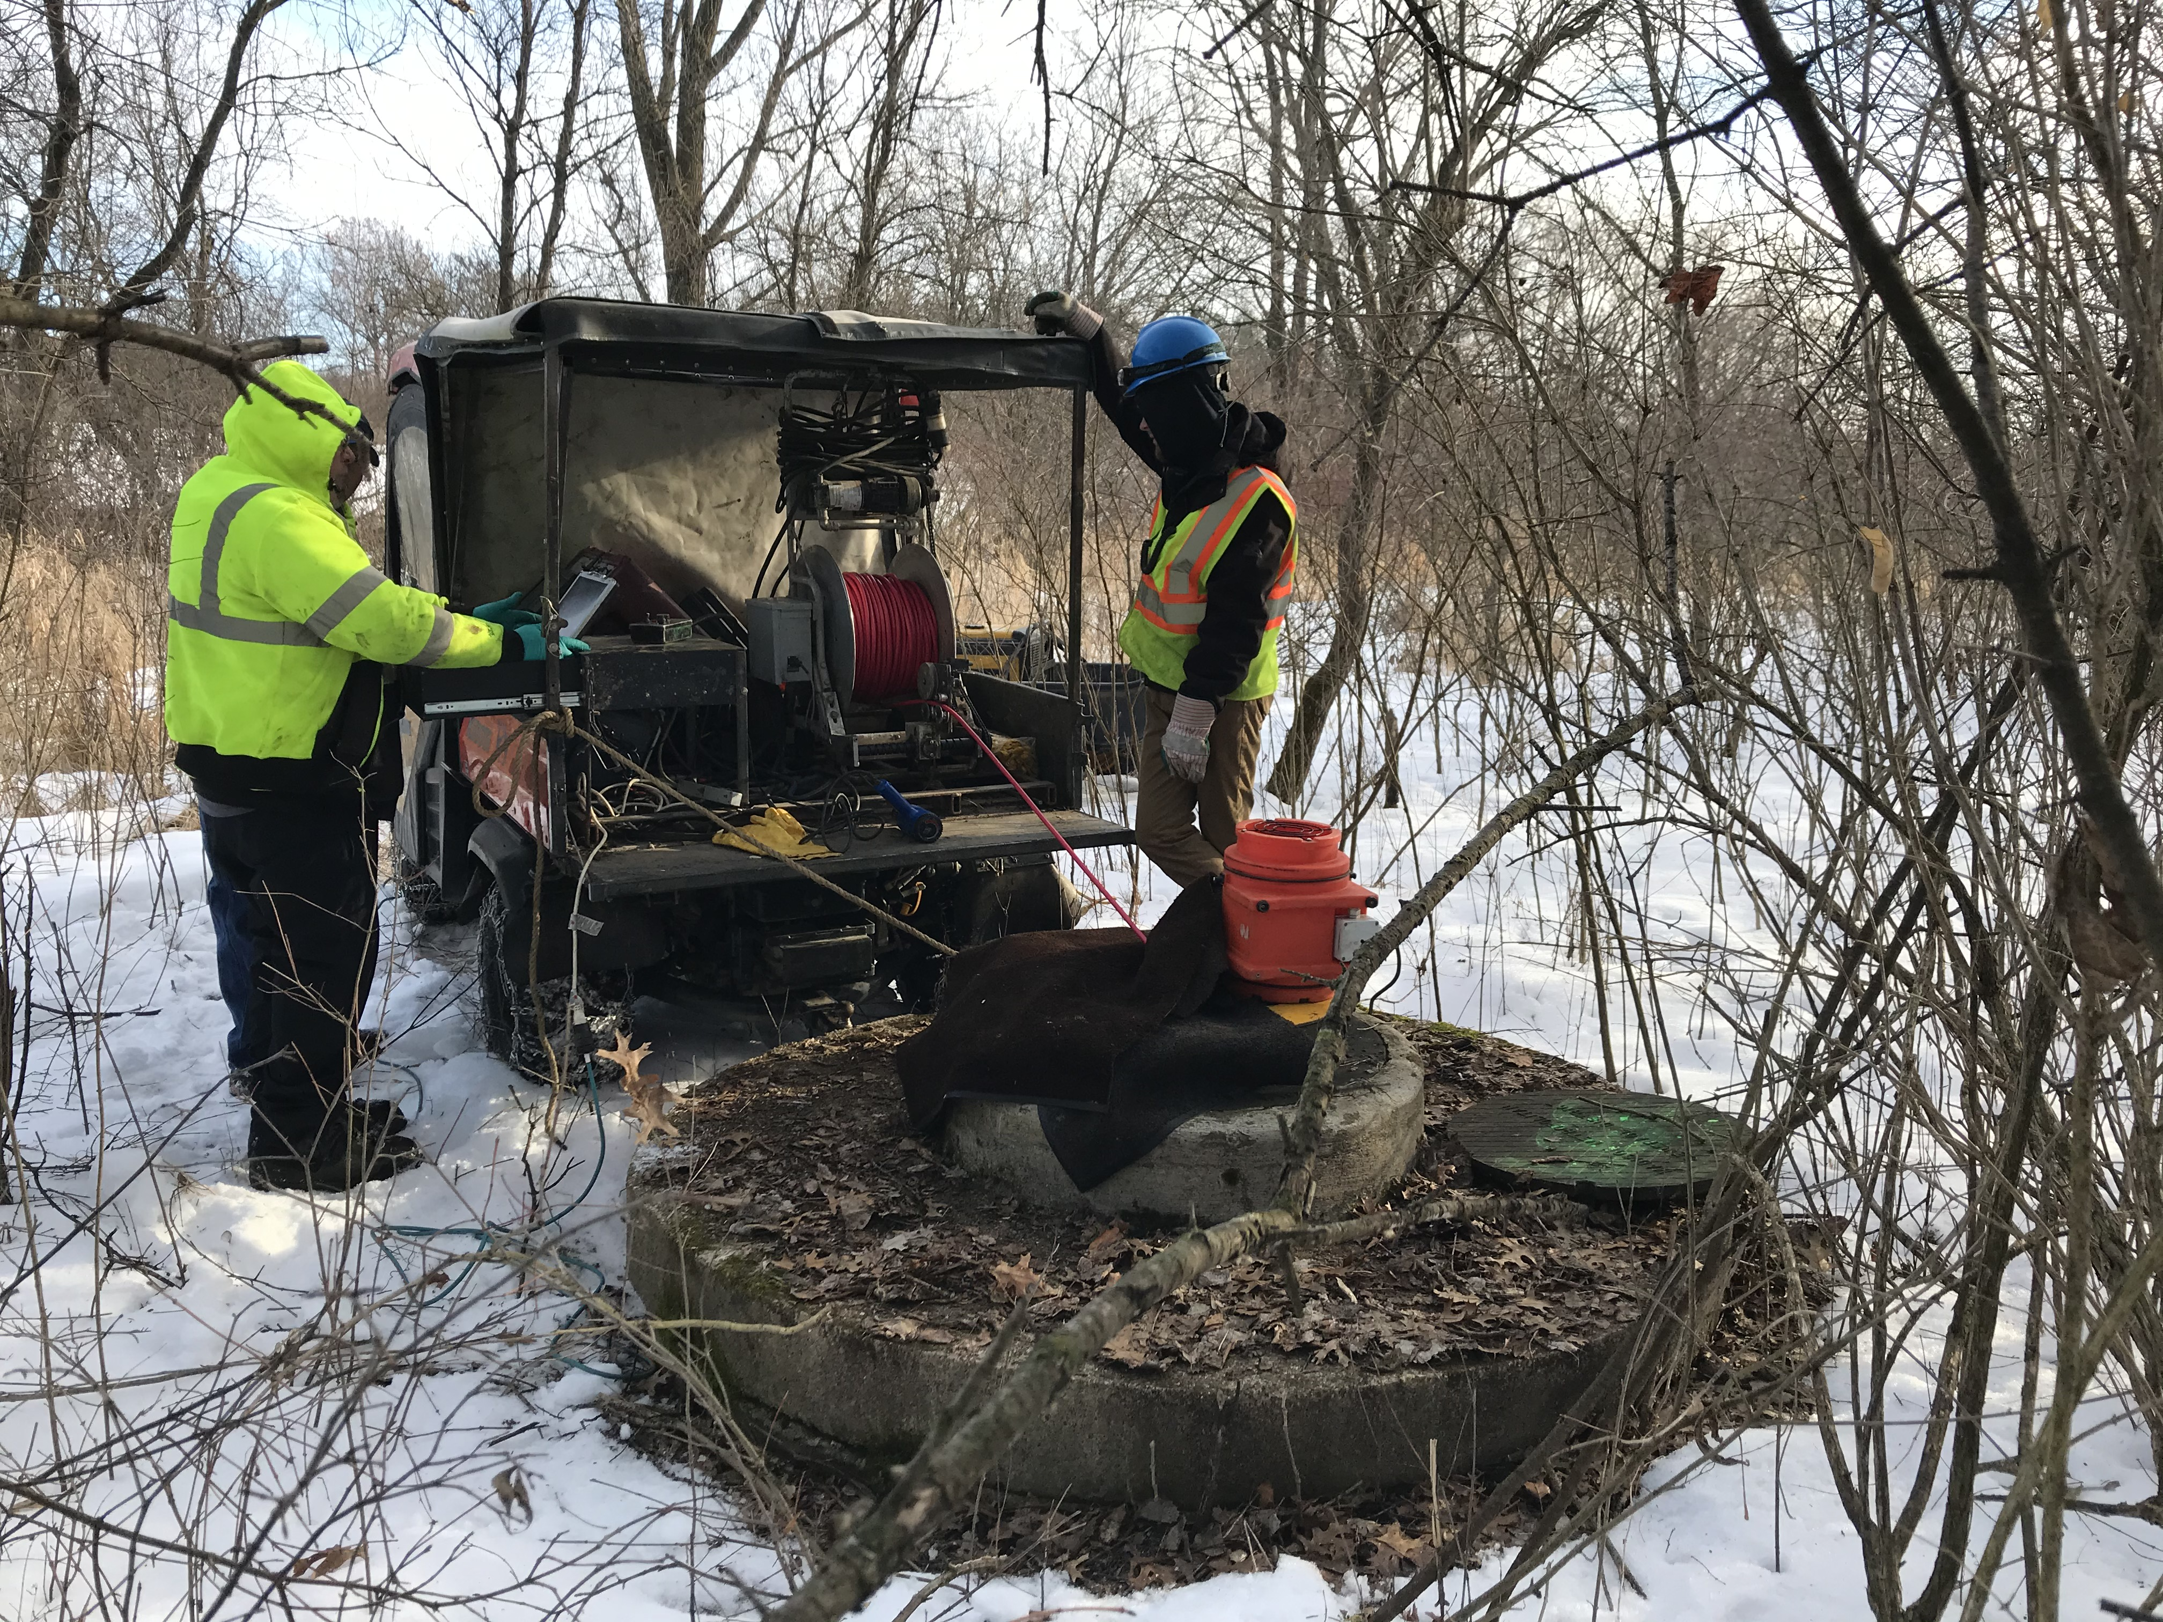
Condition Assessment - Interceptors
Likelihood of Failure - PACP
Consequence of Failure Categories
  Pipe size
  Location of pipe
  Proximity to environmentally sensitive features
  Service to customer of significant importance
  Access for maintenance or emergency repairs
Notes:
The district has 145 miles of sewer pipes. Gravity sewers (interceptors) = 98 miles.
Condition inspection of at least 10% of the gravity pipes is completed through the annual televising and cleaning contract. This picture is an example of televising using an all-terrain vehicle. The location does not allow getting cleaning equipment and the traditional televising truck to the manhole. This setup with the ATV allows us to televise and complete a condition inspection.
For the condition inspection, PACP. As of 2024, we are utilizing SewerAI AUTOCODE – or aritificial intelligence to complete the scoring. This provides consistency to compare across the system for prioritization. Each pipe has a condition score based on the most recent inspection.
For the facility plan update, we also determined a consequence of failure for each gravity pipe. The categories we used to calculate a score were:_______________.

Slide 13
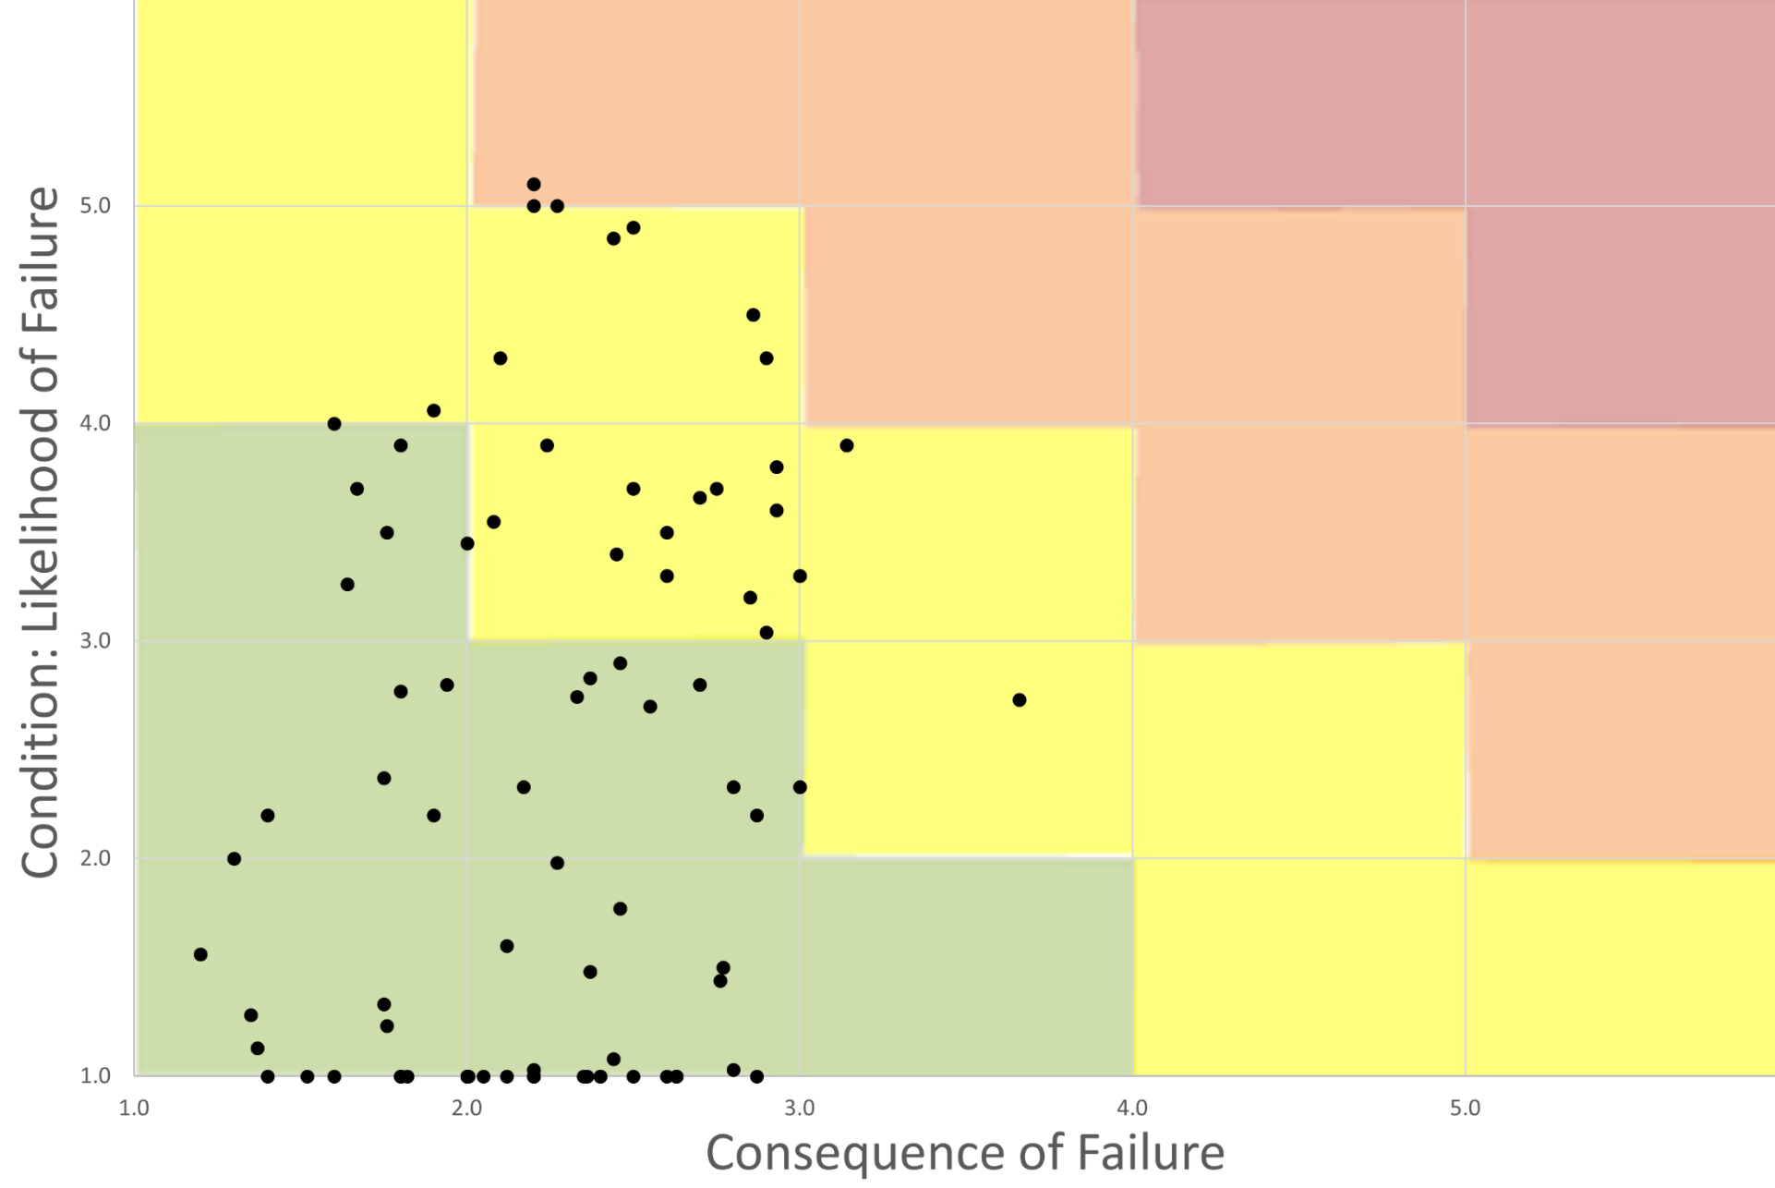
Risk Assessment for Gravity Interceptors
Notes:
Highlight this analysis is NEW and being used in the CIP.
The likehood of failure and consequence of failure scores range from 1 to 6. For the Facility Plan, pipes of similar diameter, age, and material were grouped into interceptor systems. This gives a smaller dataset to work with and identifies potential projects. The average condition score and the consequence of failure score is plotted on the risk matrix. Points in the red zones would be considered immediate needs with a very high risk of failure. The orange zone should be programmed in the CIP. Points in the yellow zone are those projects we recommend in the next within the facility planning window of 20 years.
Projects in the orange zone:
West Interceptor (Babcock to Dayton Street) LoF 5.0, CoF 2.2 – Cast Iron Pipe installed in 1916; included in the CIP; lining project planned for in 2026.
NEI – Waunakee Union HS Leg LoF 5.0, CoF 2.3 – Vitrified Clay 1971; included in the CIP, replacement/pipe bursting project planned for ?
* West Interceptor Relief MH02-547 to MH08-336 LoF 5.1, Cof 2.2 -- NOT in CIP this is one pipe segment that was not replaced during Shorewood Relief project.

Slide 14
Condition Assessment – Pumping Stations
Likelihood of Failure
Peak Flow Capacity
Firm Flow Capacity
Power System Redundancy
Mechanical Condition
Structural Integrity
HVAC Condition
Electrical Condition
Consequence of Failure
Average Daily Flow Volume
Normal Flow Allowable Downtime
Diversion Options
Notes:
Assets at the District’s pumping stations are scored based on work orders and observations made by District maintenance staff.
Mention Power System Redundancy is a separate chapter. We have onsite generators at 5 District Stations. Emergency Power Generation at District Pump Stations is
Highlight finishing up big rehabs
Expect smaller, more frequent projects especially for electrical controls projects. Equipment life differences.

Slide 15
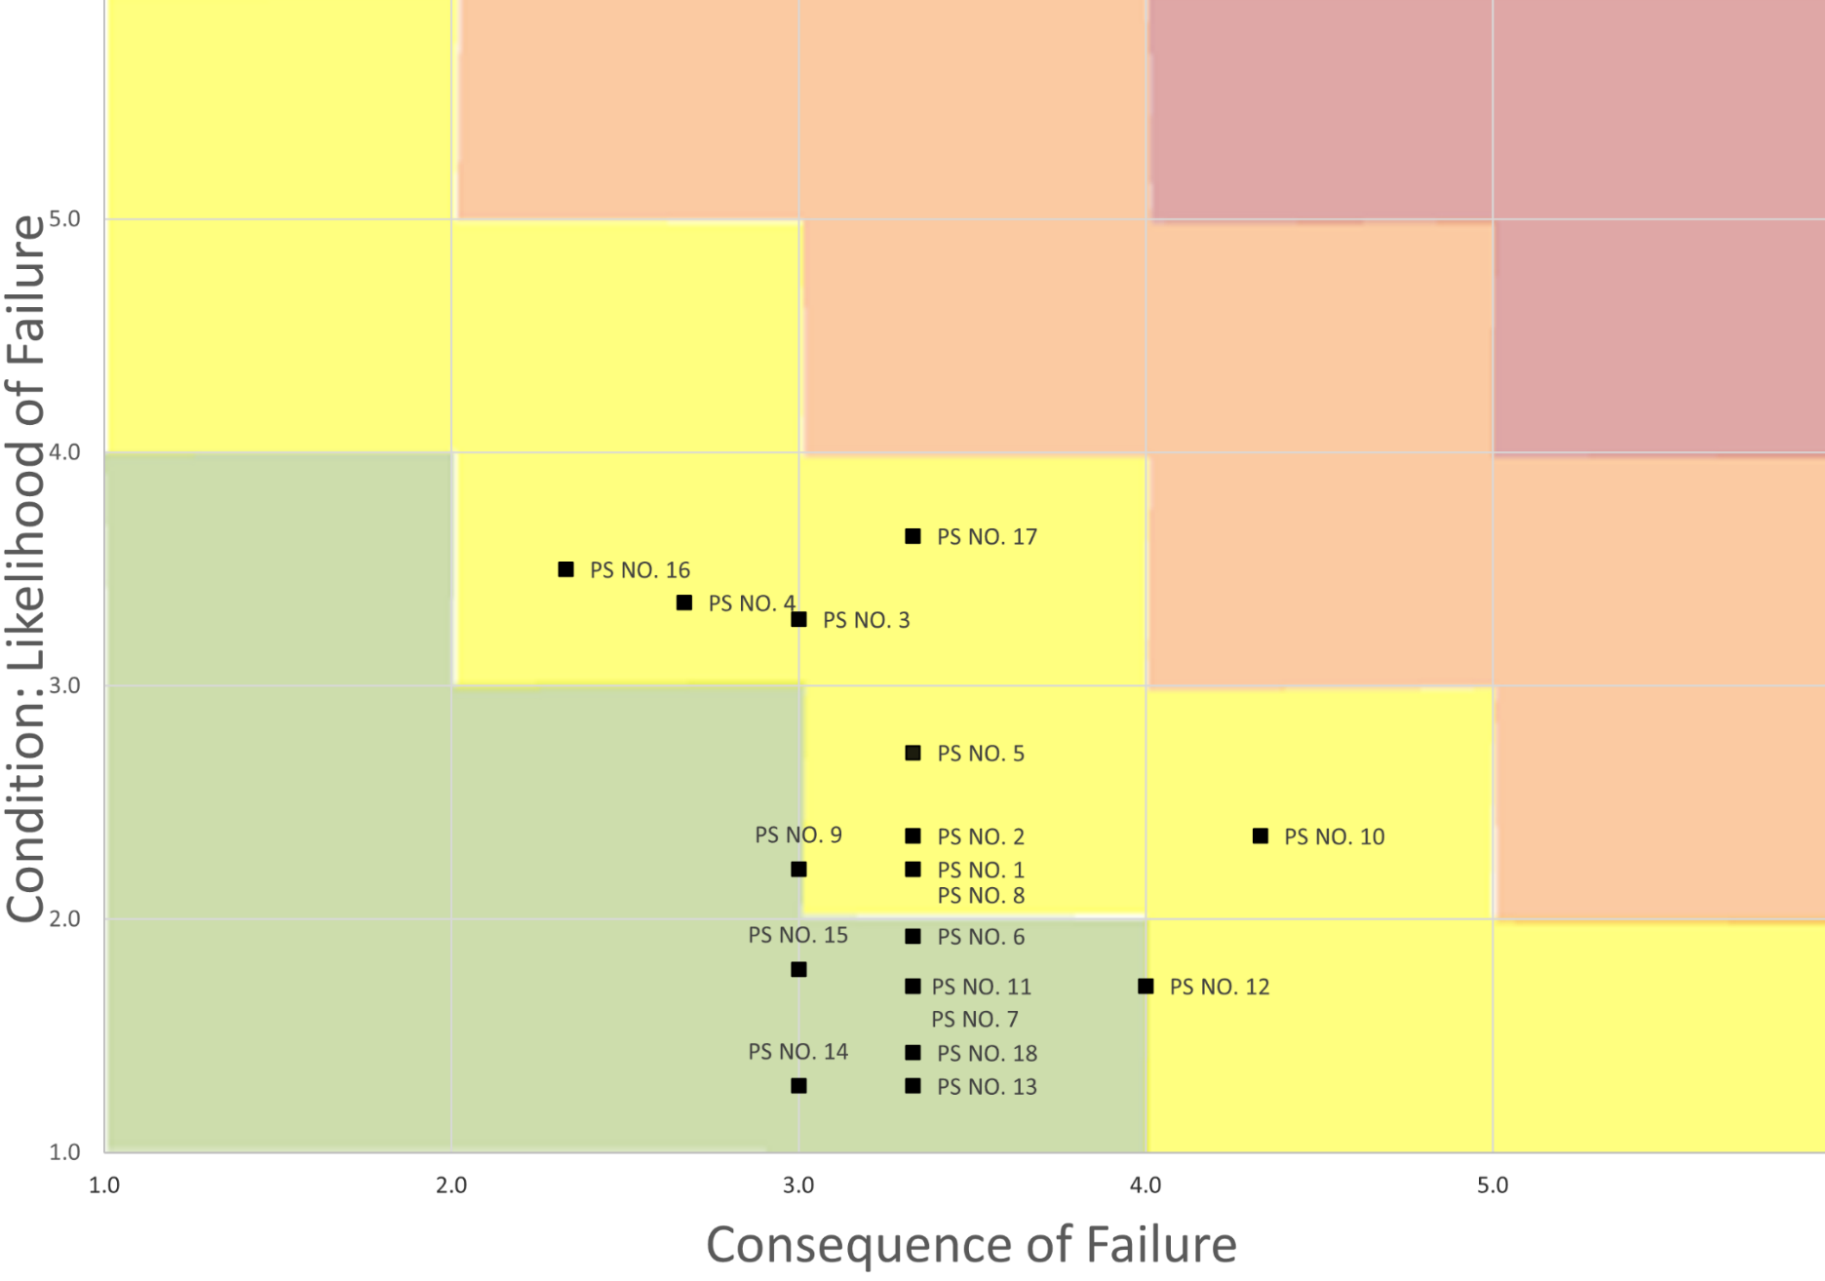
Risk Assessment for Pumping Stations
Notes:
Recommended rehabs: PS16, PS3, PS5 and PS9

Slide 16
Force Main Condition Assessment
High Priority List | Year Installed | Size & Material | Length (ft) | Average Daily Flow (MGD) | CIP Project Schedule
PS10 FM | 1964 | 36” PCCP | 11,100 | 8.2 | 2024-2025
PS15 FM | 1972 | 24” & 20” DI | 6,800 | 1.3 | 2025-2026
Notes:
Strand evaluated. The top priorities
PS10FM first. RFP Q4-2024, Assessment in first half of 2025.
Previous assessments:
* PS06, PS07 (both), and PS16
Medium Priority
PS05
PS16
PS15 Diversion
Low Priority
PS17
BMC Effluent FM
PS09
NOTES:
PS10FM – HDPE swage-lining of 1,900 downstream most gravity portion completed in 2018. High risk. No redundancy for this force main.
PS15FM – Break 10/6/2023. Air and likely corrosion issues. Critical portion before split.
Badfish Creek Effluent FM – Pressure restrictions drive the capacity of the FM. Add transient pressure monitoring to the recommended condition assessment technologies.
PS08FM – Air pockets likely present; multiple air release valves removed at high points.

Slide 17
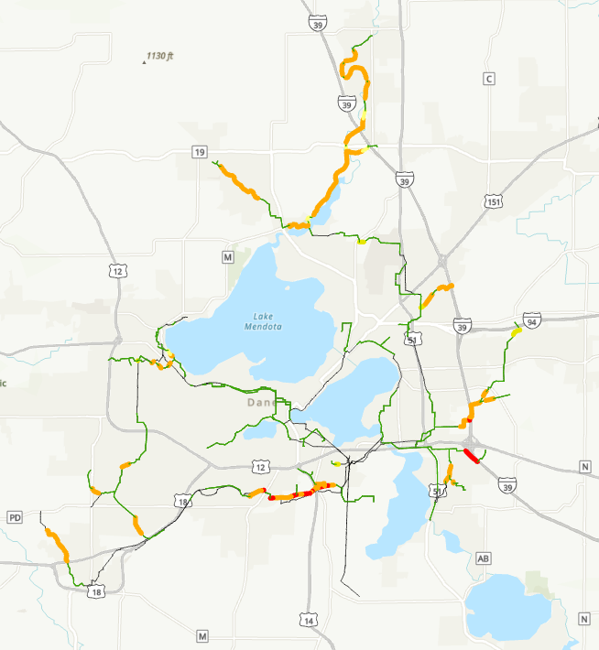
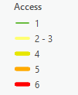
Maintenance Topic: Access to Facilities
21%
Of system is not accessible
  5 = 237 pipes; 96,300 LF (19%)
  6 = 18 pipes; 9,100 LF (1.8%)
Notes:
Topics being evaluated under the Collection System Maintenance chapter include: FOG, H2S, and Access to Facilities. Areas of concern are being noted and options for _________
Highlighting the access issue:
Definitions of the Access scores:
Good access. Able to get heavy equipment to clean pipe.
Can get a truck to televise, but not the heavy jetter truck
(skip)
Possible to access if conditions are dry enough.
Can only access by ATV.
No access.
Item is on the list for the EO.
Larger effort of rights under Chap 200 is being discussed.
In the meantime, planning for a project that has larger budget than annual TV and Clean for cleaning the difficult access interceptors. May need to hire consulting services to help with permitting and design of temporary access.

Slide 18
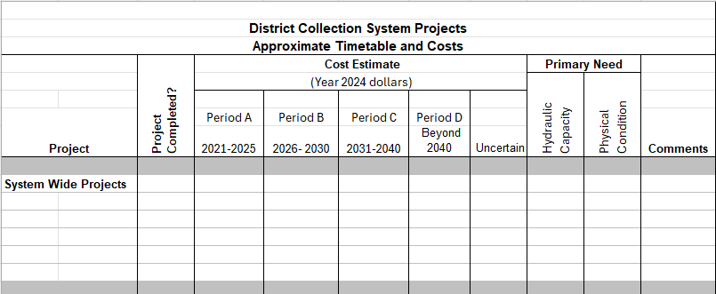
Outcome: Recommended Projects
Notes:
The District’s collection system facilities plan is used to identify needs in the conveyance system and to recommend projects to address those needs. The planning horizon of the Plan is twenty years, with projects recommended in roughly five-year intervals. Projects from the Plan are included in the capital improvements plan (CIP) during the District’s annual planning process as needed.
Next Steps:
A draft of the 2023 Plan is scheduled for completion at the end of 2024. Preparation of the final document and acquisition of the required approvals by WDNR and CARPC is expected in the first half of 2025.

Slide 19
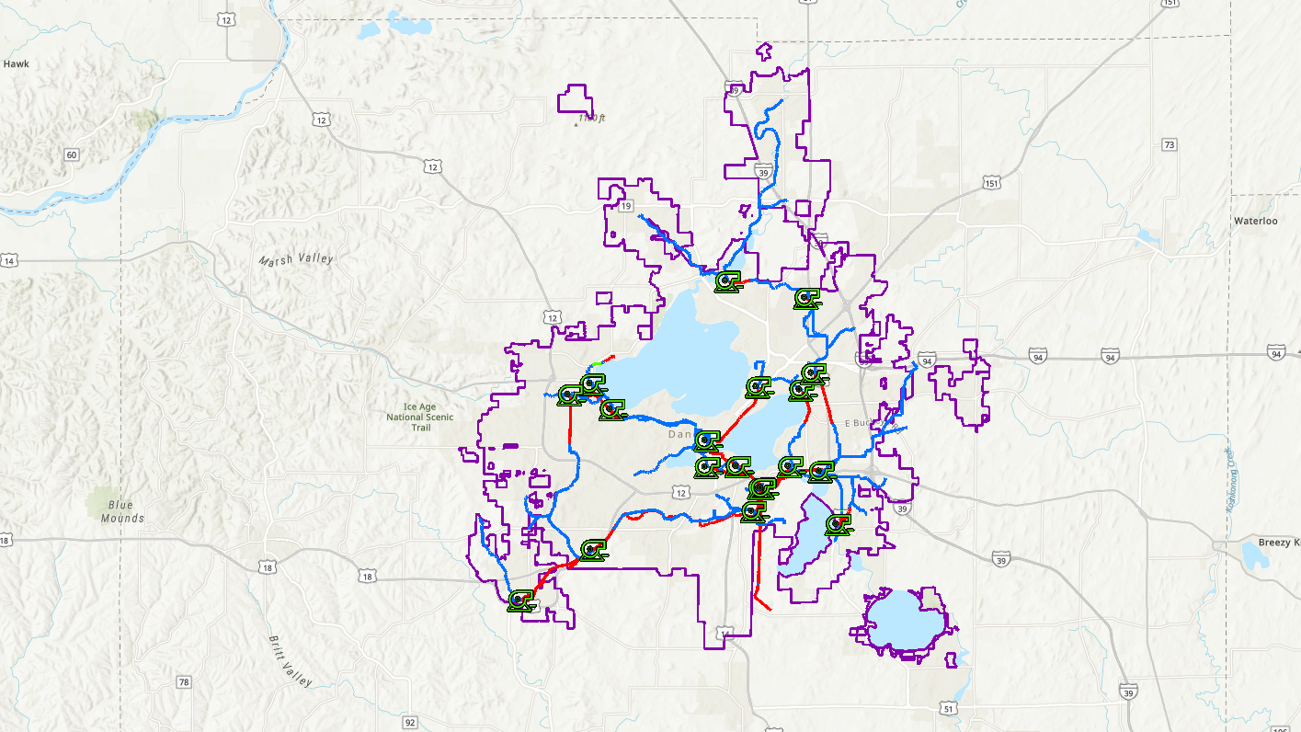
Questions?

