Slide 1
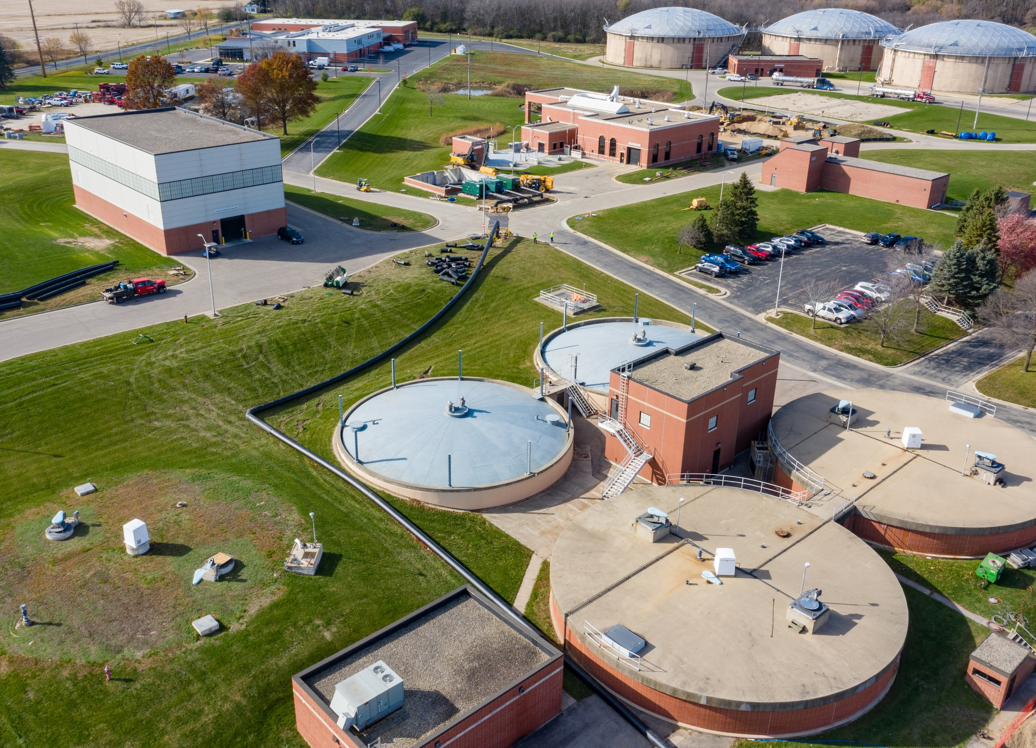

April Operations Report

Slide 2
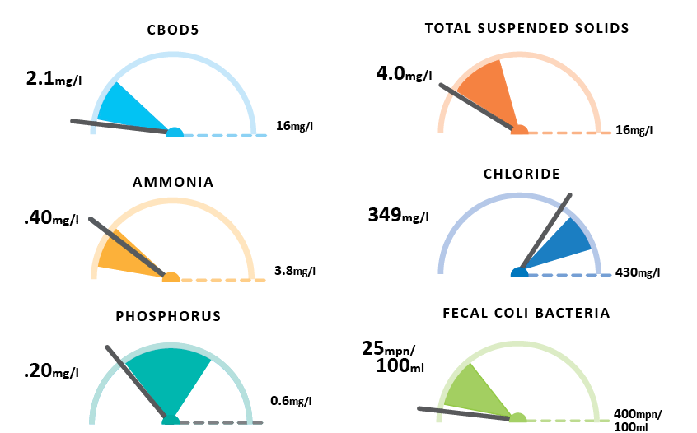
April Plant Performance

Slide 3

Thank you

