Slide 1
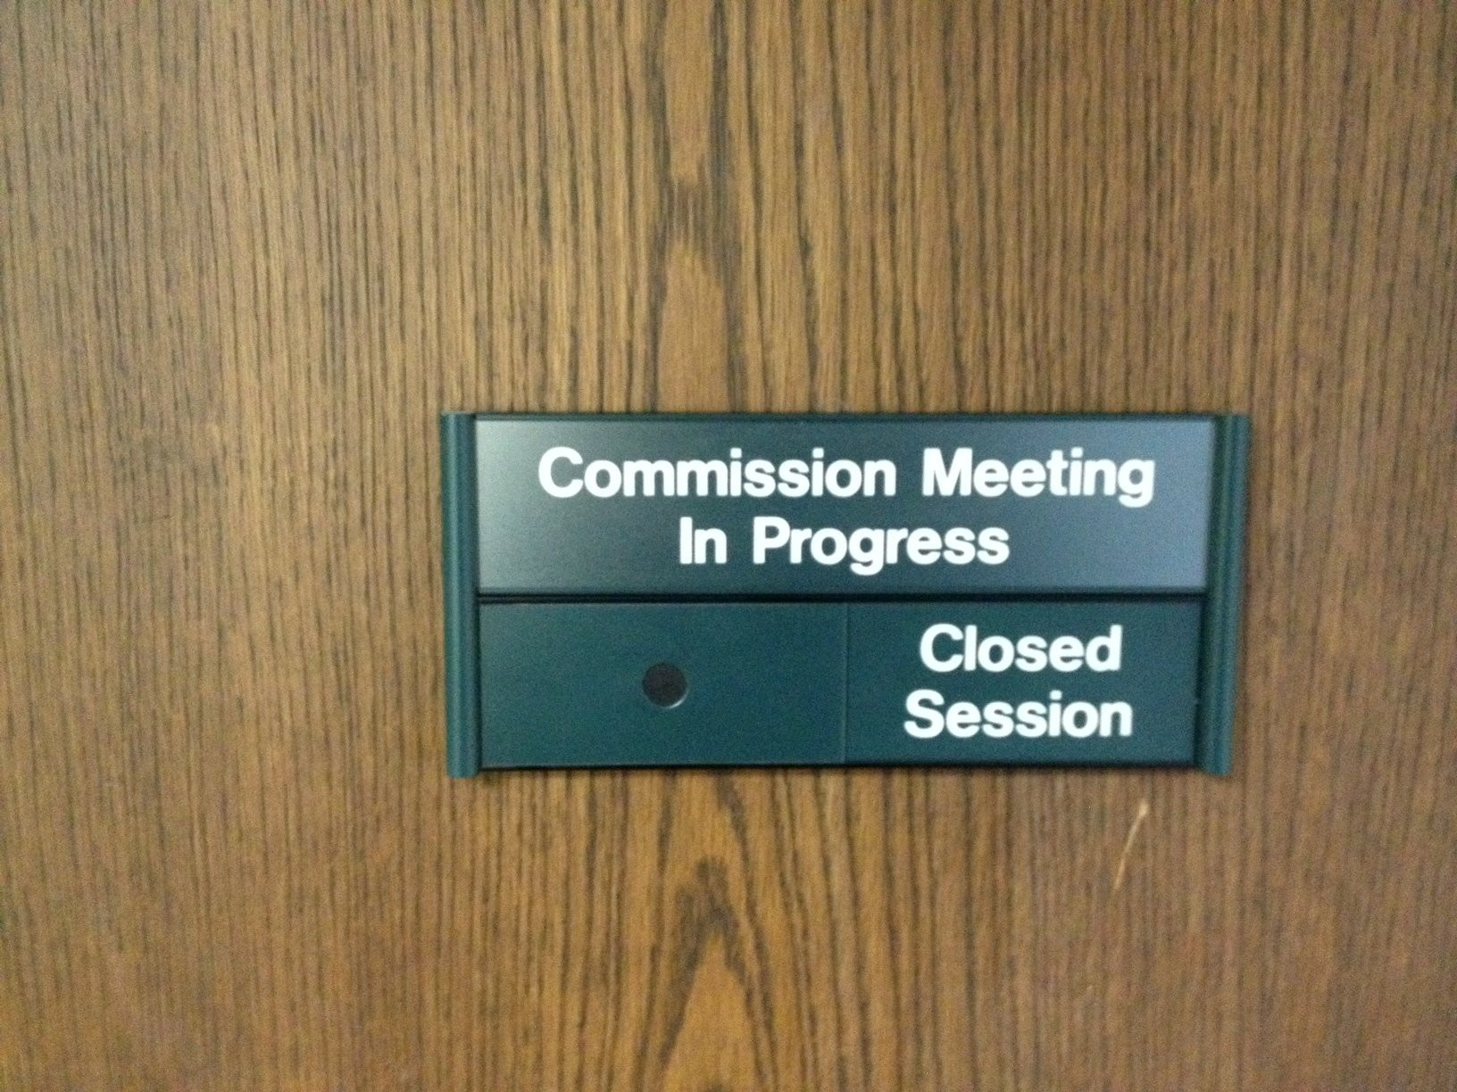
Closed Session Discussion

Slide 2
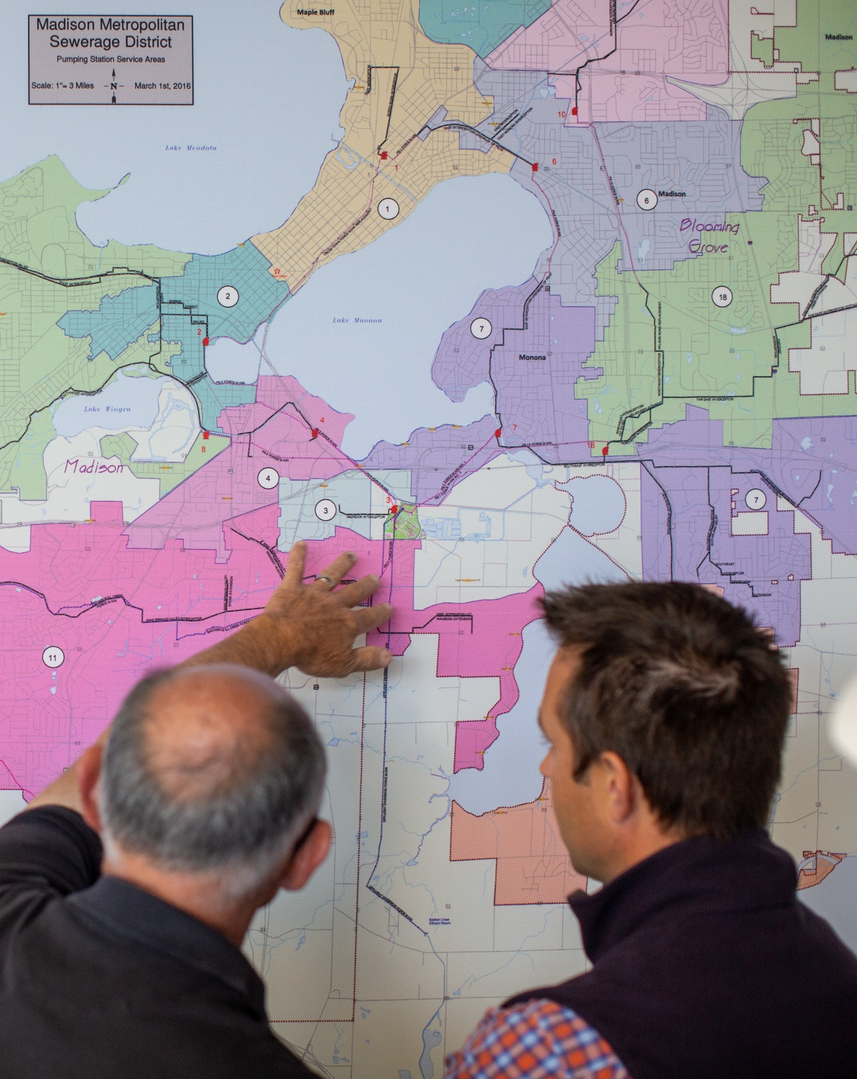
Agenda
Background
Discussion
Direction

Slide 3
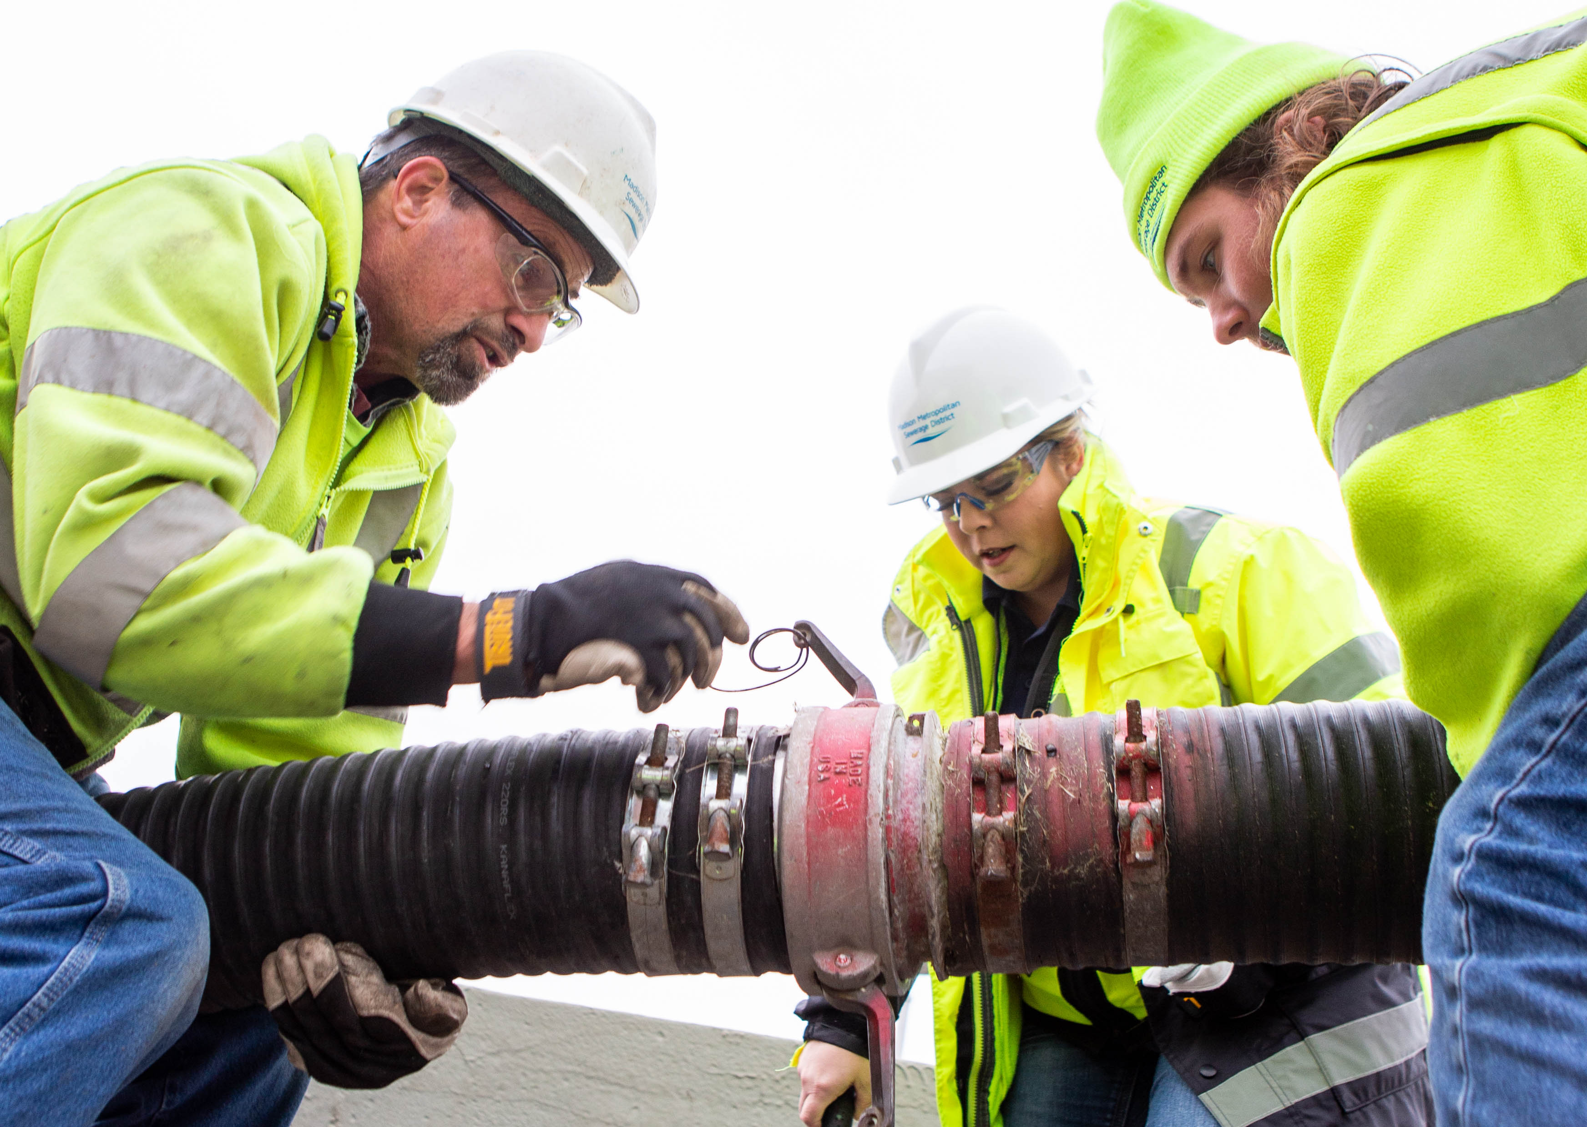
BACKGROUND
Commissions desire to review closed session policies
Purpose for open meetings law
Purpose for certain exceptions
Closed session procedures

Slide 4
DISCUSSION
Is the Commission comfortable with current practice?
Does the Commission wish to adopt further process steps?
Are there additional factors that should be considered?

Slide 5
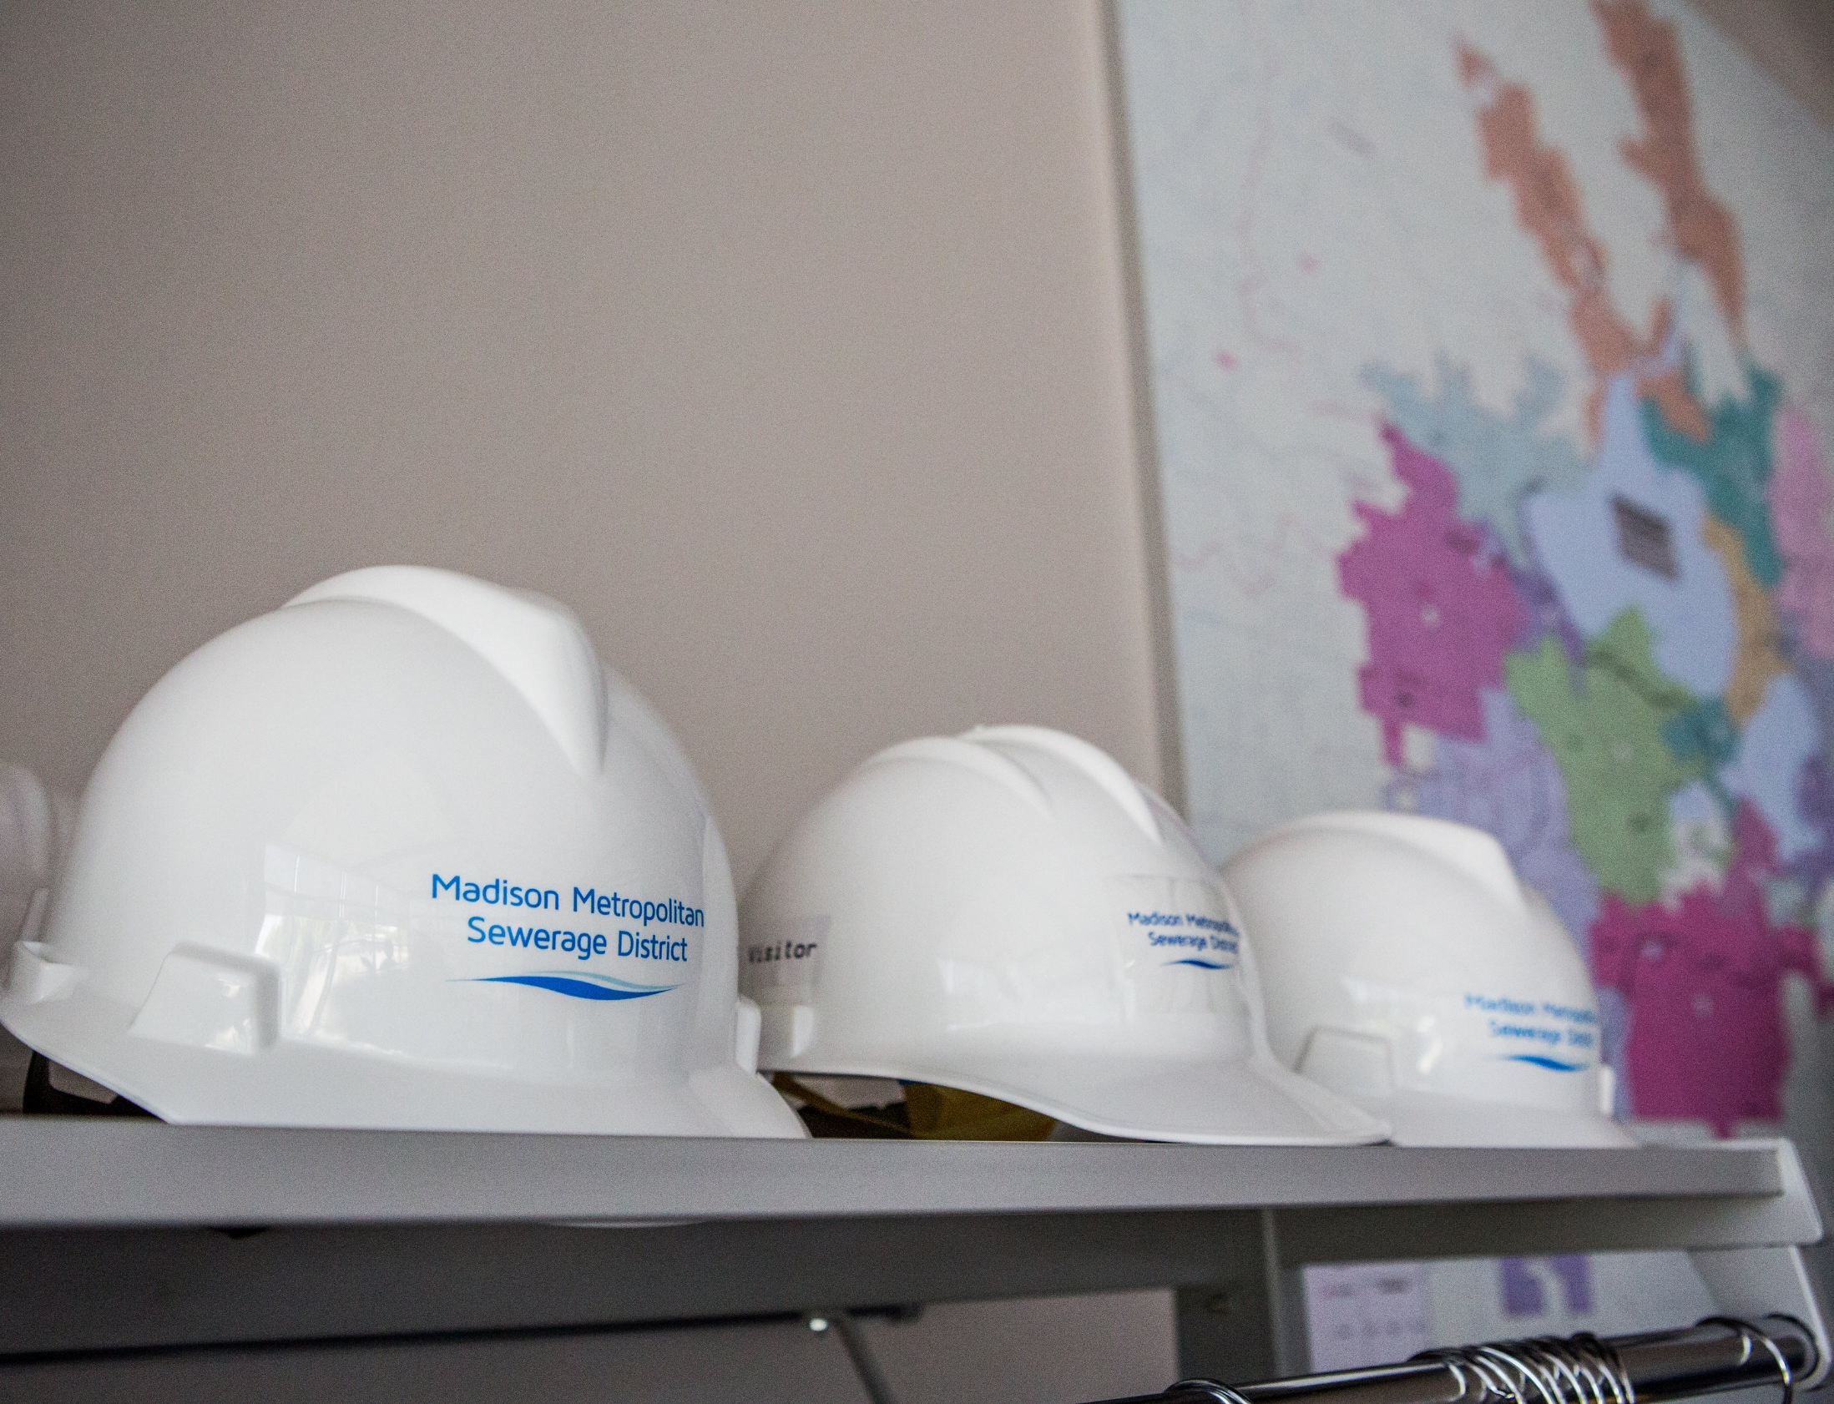
COMMISSION DIRECTION
Continue current practice
Provide staff with general guidance
Return with new policies and procedures

