Slide 1
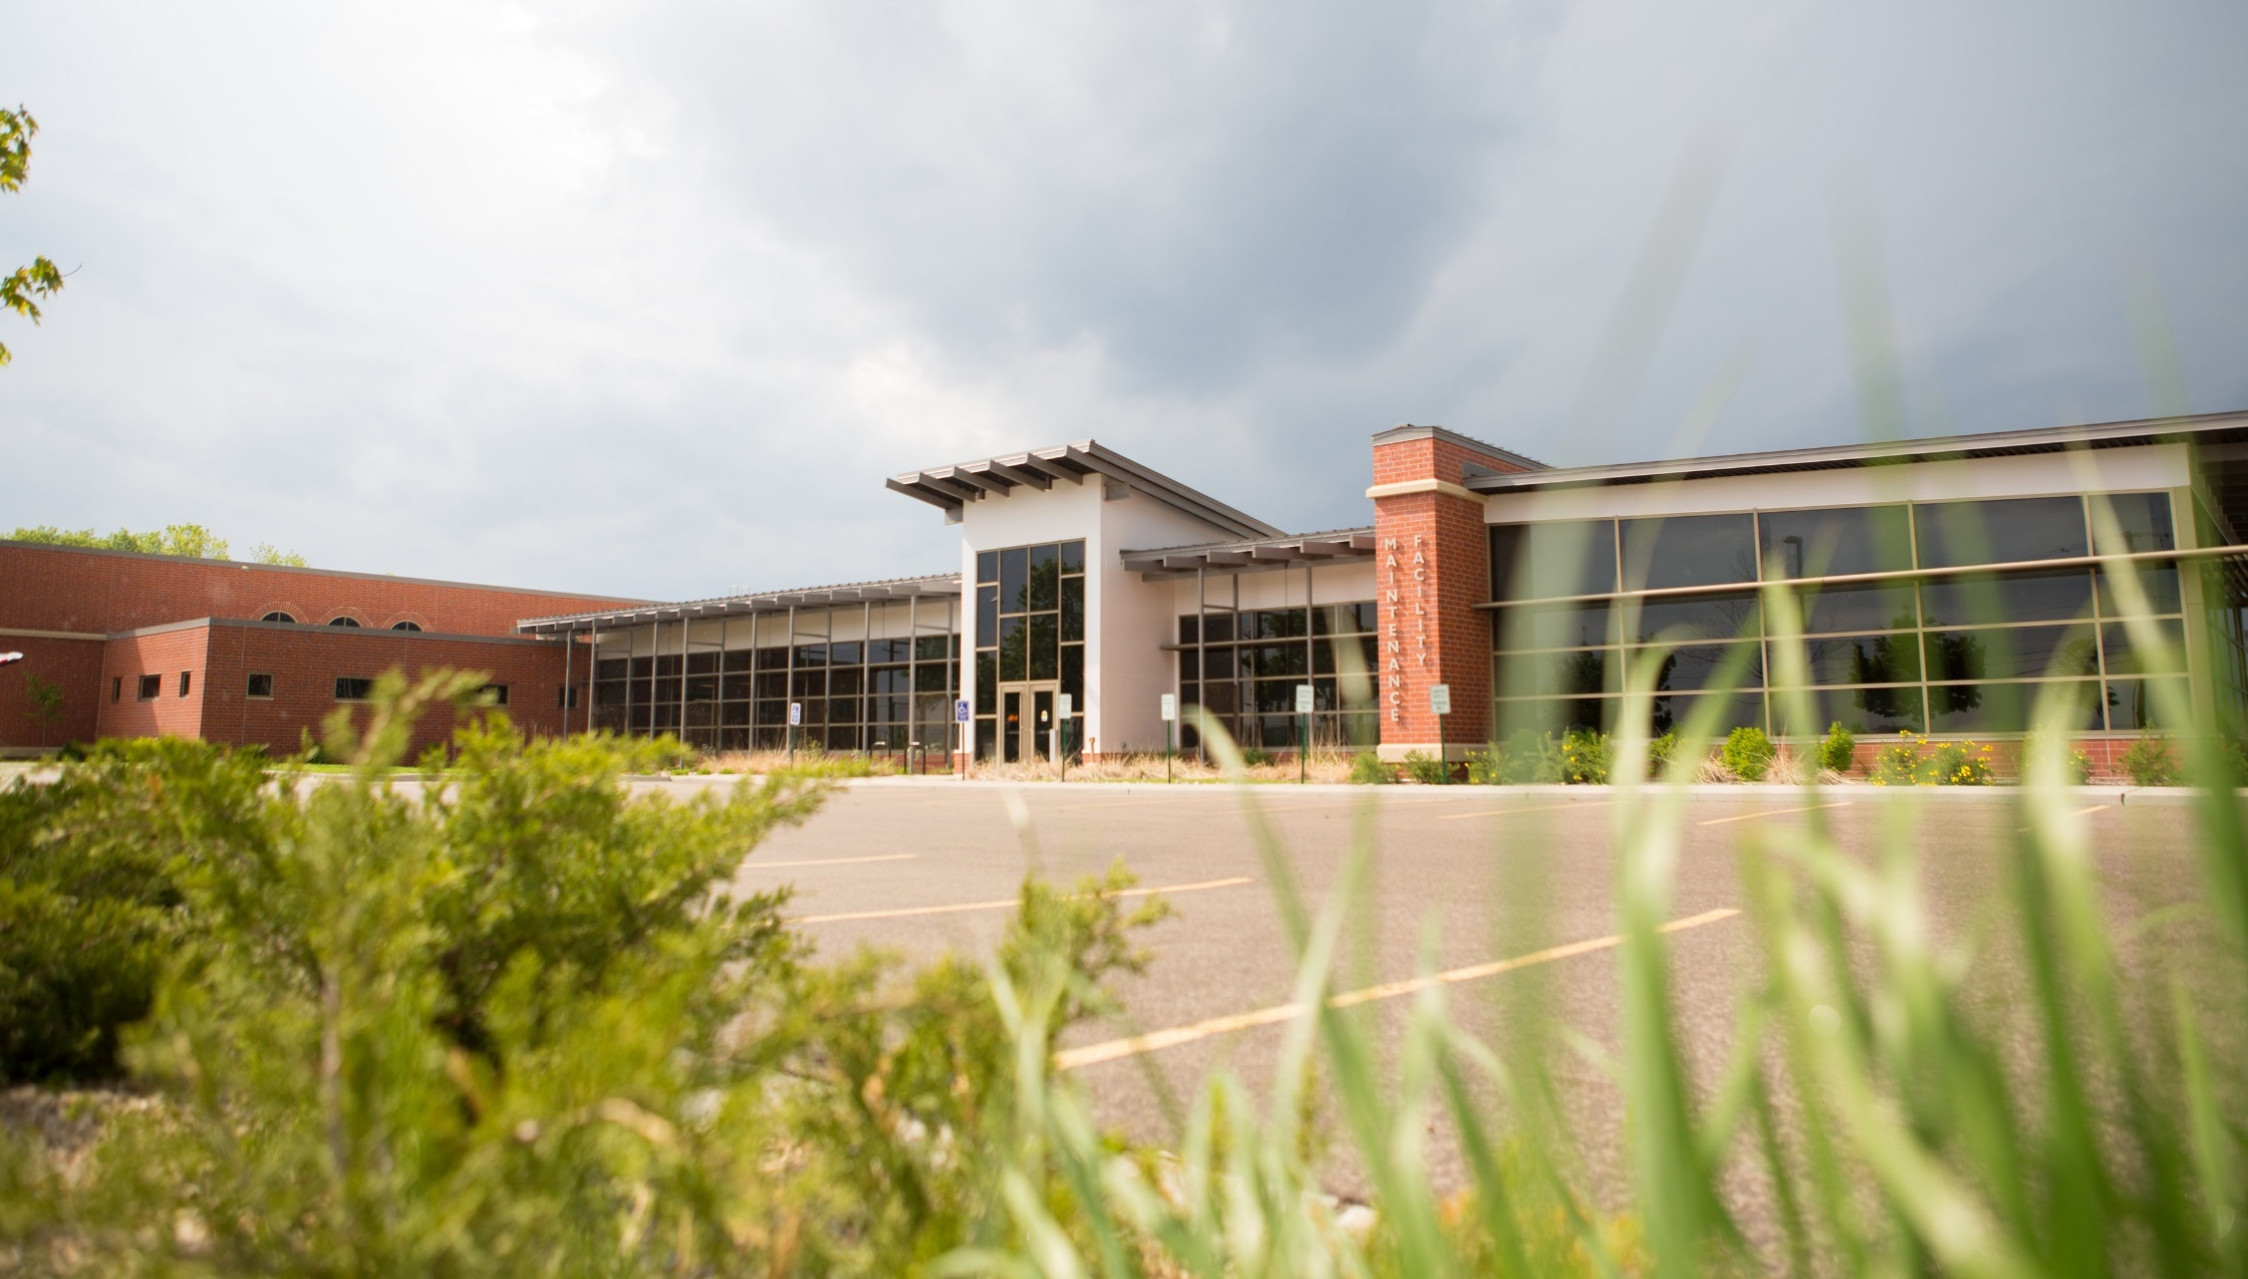
Operations & Maintenance Report August 27, 2020

Slide 2
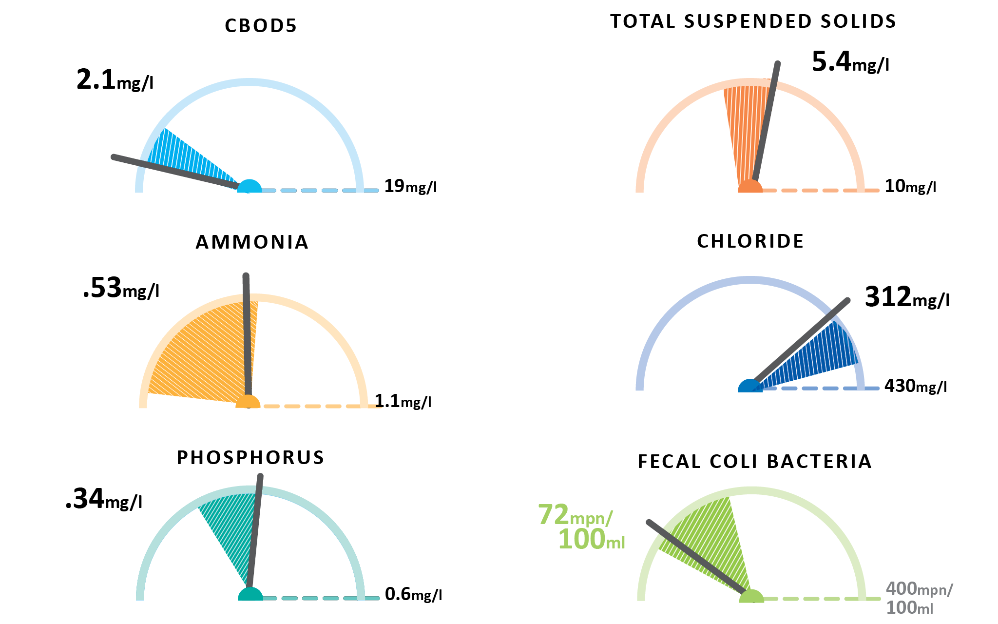
July Plant Performance

Slide 3
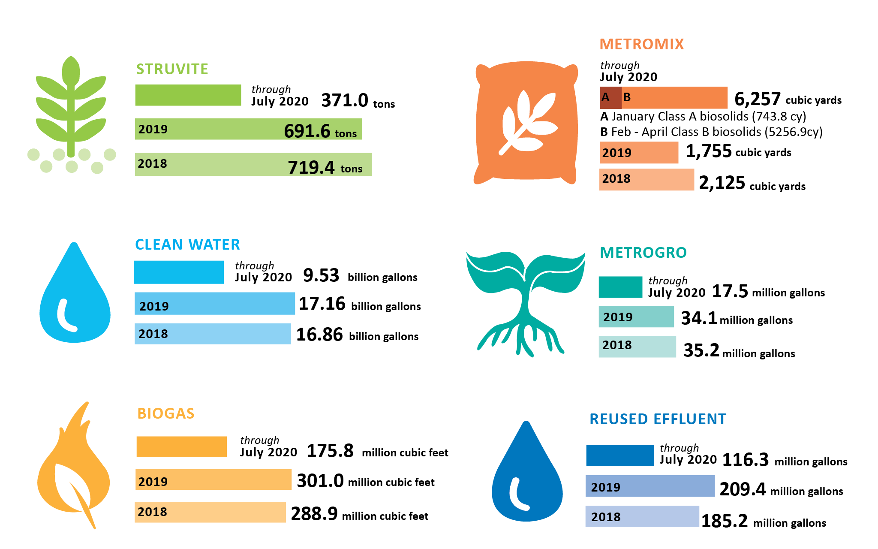
July Resource Recovery

Slide 4
What is this?
10,500,000,000,000,000,000
10.5 Quintillion! Number of microbes working for the district.

Slide 5
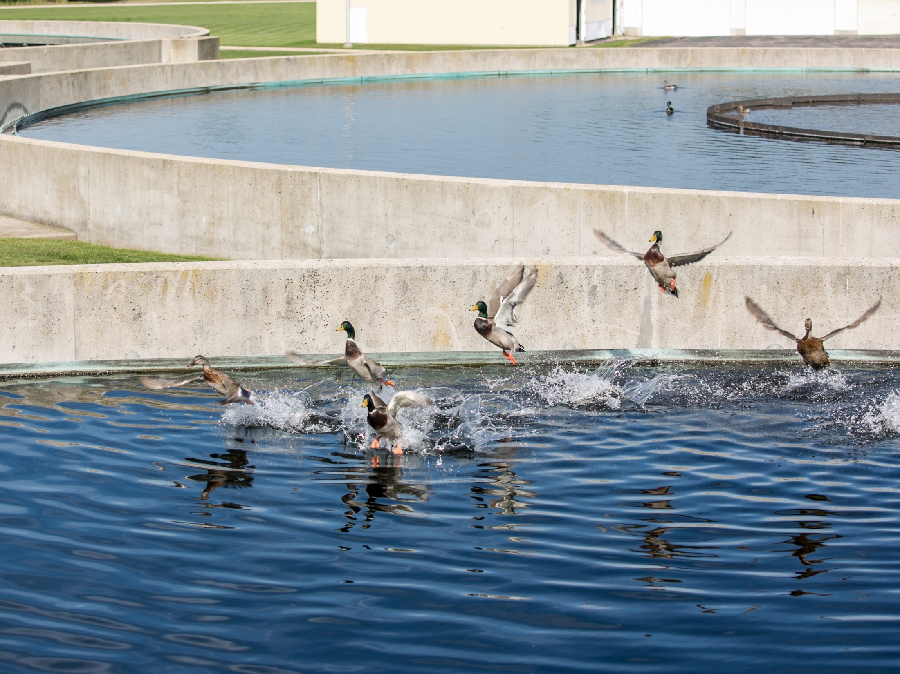
Thank you!

