Slide 1
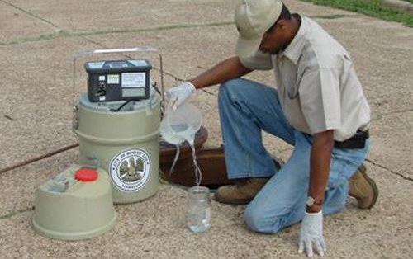
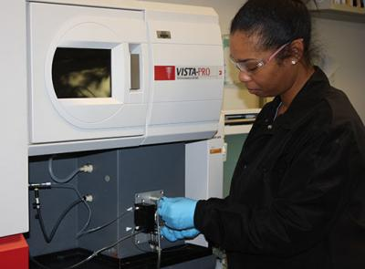
Industrial Users: PFAS
sewer use ordinance authority review
industrial permit review
pollution prevention and source reduction
Industrial Users: PFAS
industrial permit review
pollution prevention and source reduction

