Slide 1
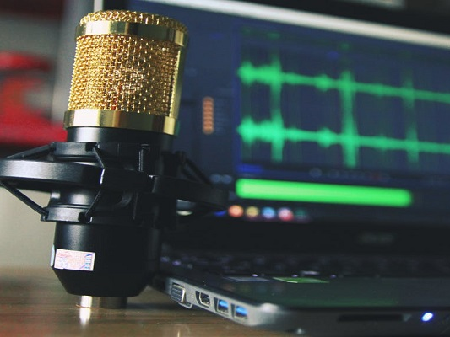
Update on Recording Commission Meetings

Slide 2
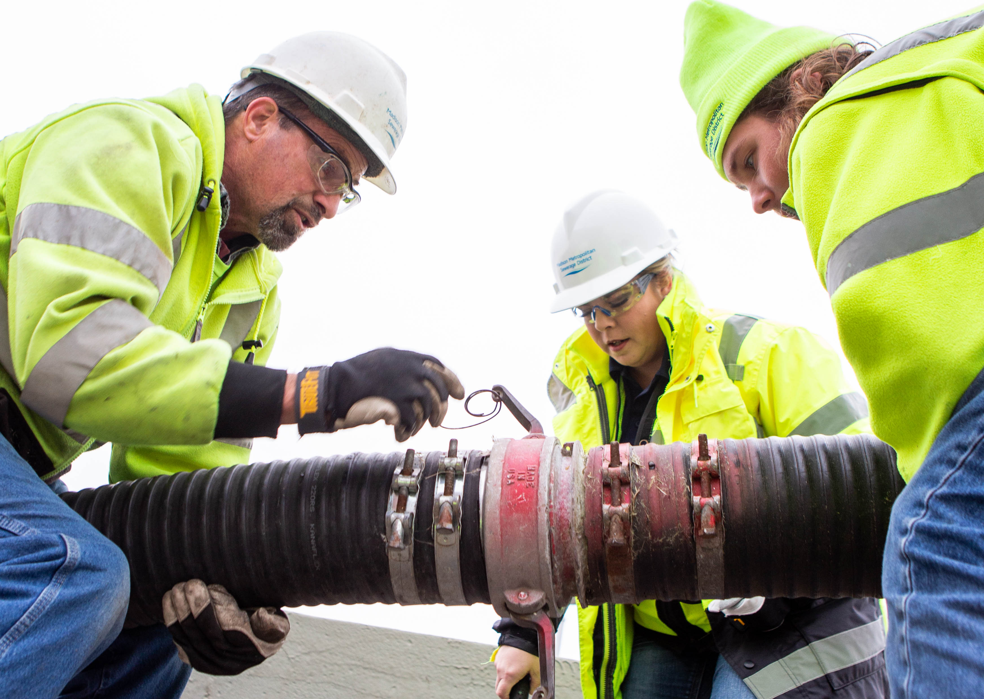
AND THE SURVEY SAYS…
Highest-ranking interests
Public access
Transparency
Inclusion/Accessibility
Recording format
Livestream?
AUDIO
VIDEO
POST LATER
LIVESTREAM

Slide 3
AND THE SURVEY ALSO SAYS…
Timing
NOW
AS SOON AS FEASIBLE
Investment
AS MUCH AS IT TAKES
BETWEEN $10,000 & $50,000
LESS THAN $10,000

Slide 4
Hold on in-person options
Record virtual Commission meetings
Switch platforms (from Zoom to GoToMeeting)
Live captioning service
Livestream on our YouTube channel
Launch September 10th (!?!?)
THE PLAN

Slide 5
Process changes
Security plan
Testing plan
Both internal & external testing
Live captioning service
80% accuracy (don’t expect perfection)
SOME NOTES

Slide 6
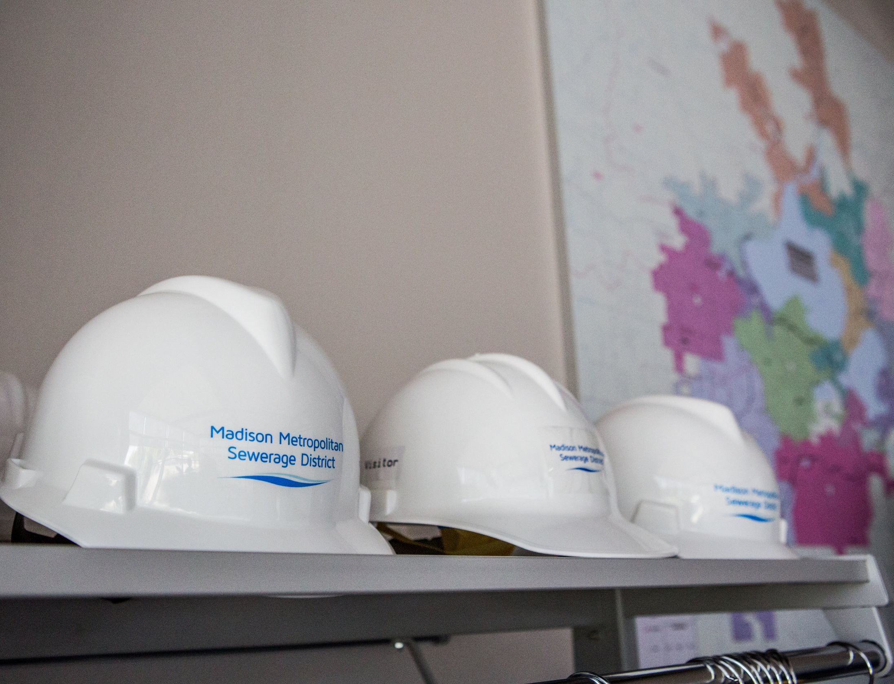
COMMISSION ACTION
Recommendation
Options

Slide 7
Thoughts?

