Slide 1
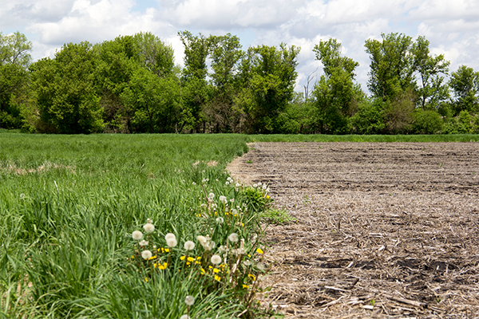
Yahara WINS Working For The Watershed

Slide 2
Reductions in phosphorus necessary
6 mg/L
Additional 70% reduction
$140 Million NPV

Slide 3
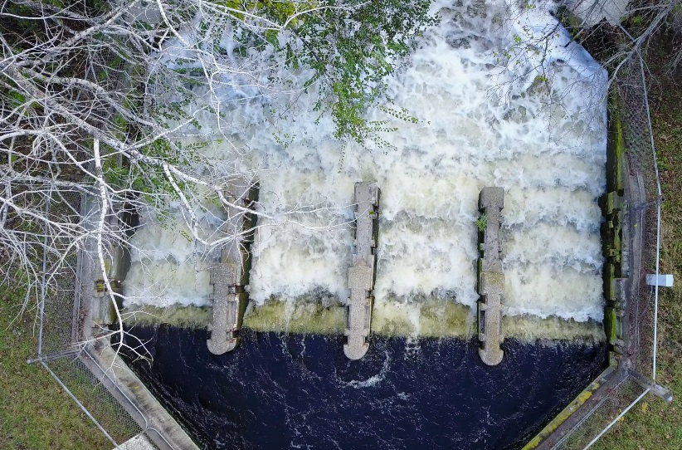
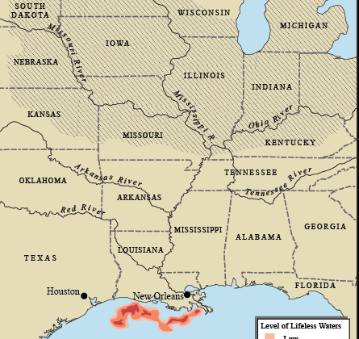
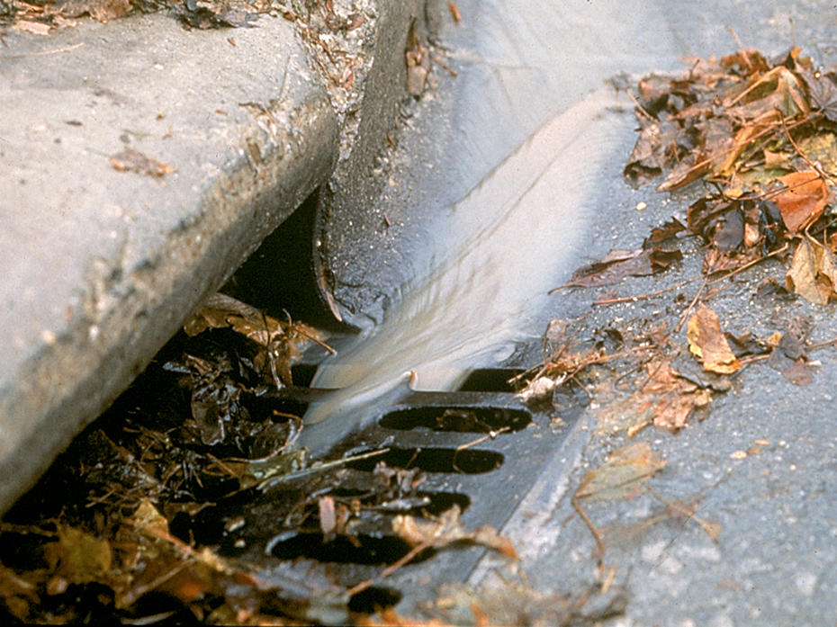
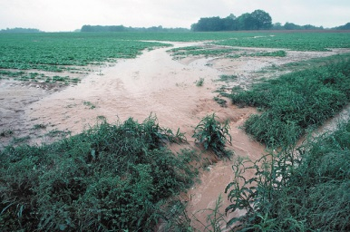
Phosphorus Sources
Notes:
Adaptive management reduces all phosphorus souces. Point sources like treatment plants; urban runoff, and agricultural runoff

Slide 4
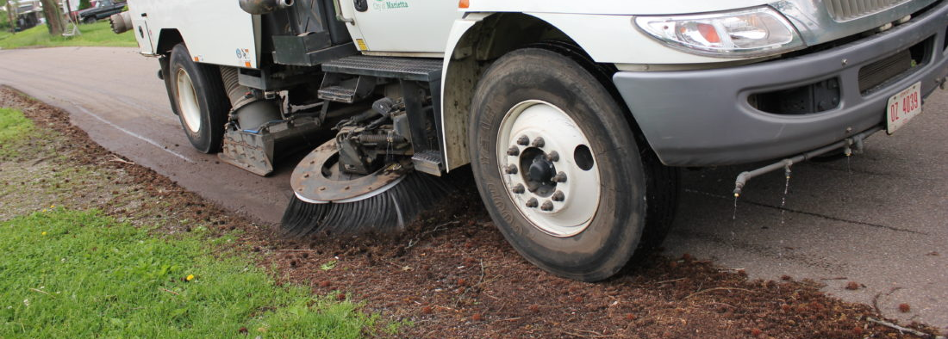
Urban Practices

Slide 5
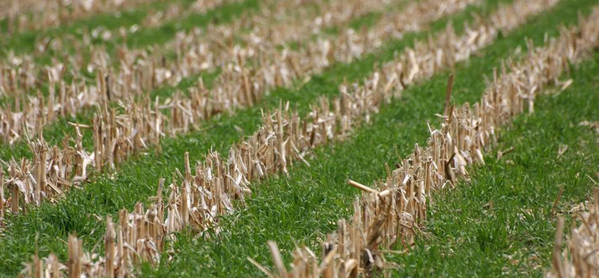
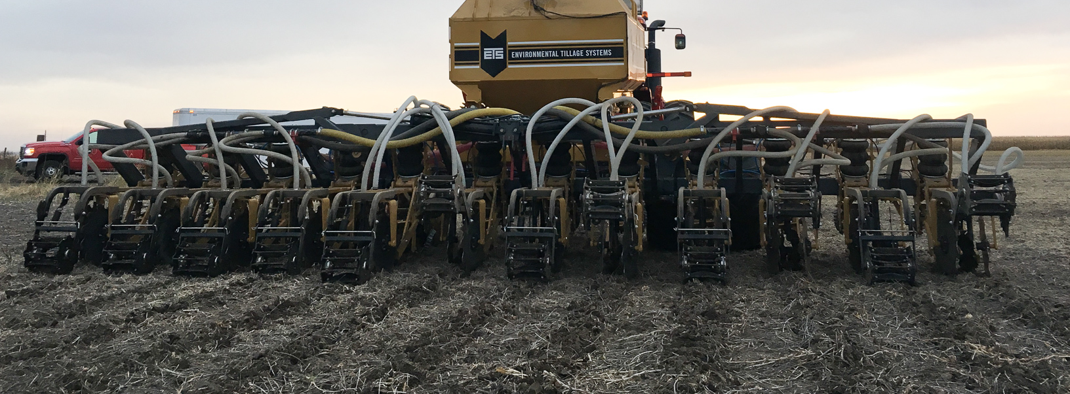
Agricultural Practices

Slide 6
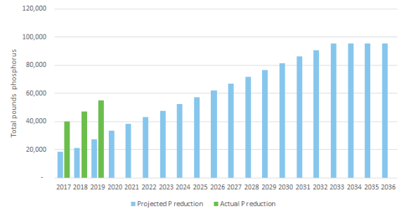
Phosphorus Reduction Success

Slide 7
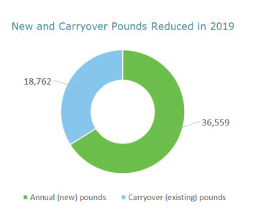
Phosphorus Reduction Success

Slide 8
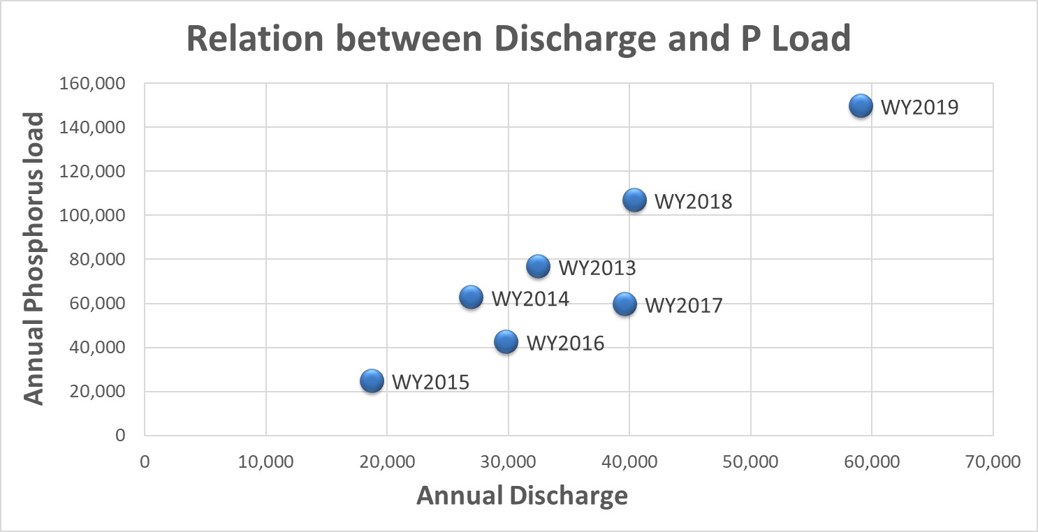
Phosphorus Reduction Challenges

Slide 9
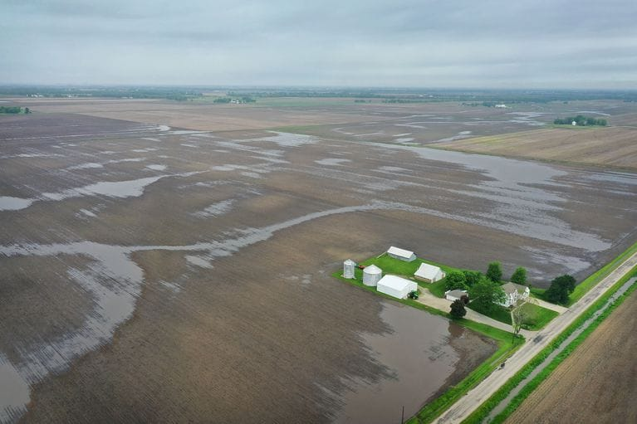
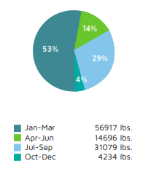
Phosphorus Reduction Challenges

Slide 10
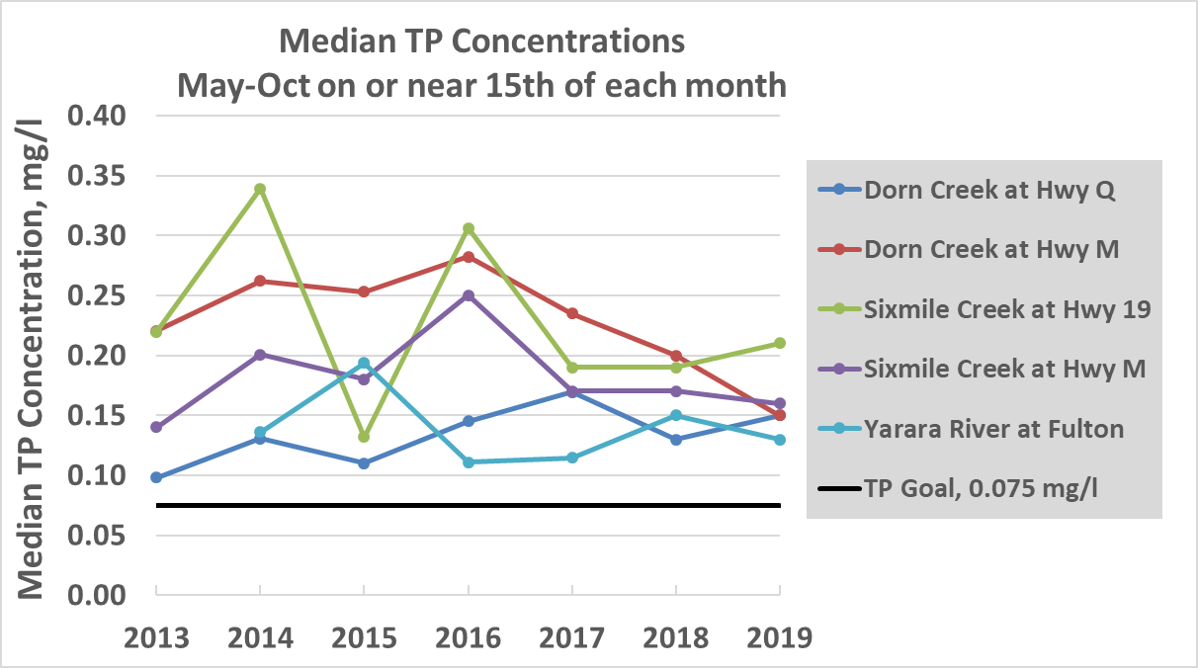
Instream Phosphorus

Slide 11
Phosphorus Reduction Challenges

Slide 12
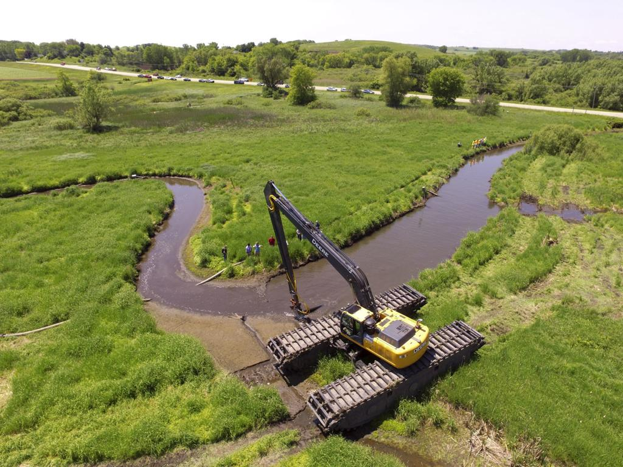
Creativity & Innovation

Slide 13
2020 Moving Forward
Reissued Permit
Additional Monitoring
Phosphorus Reduction Agreement with Yahara Pride Farms
Innovation Grant Program
New Service Agreement with District
ASCE 2020 #GameChanger recognition

Slide 14
Questions?

Slide 15
Questions?

Slide 16
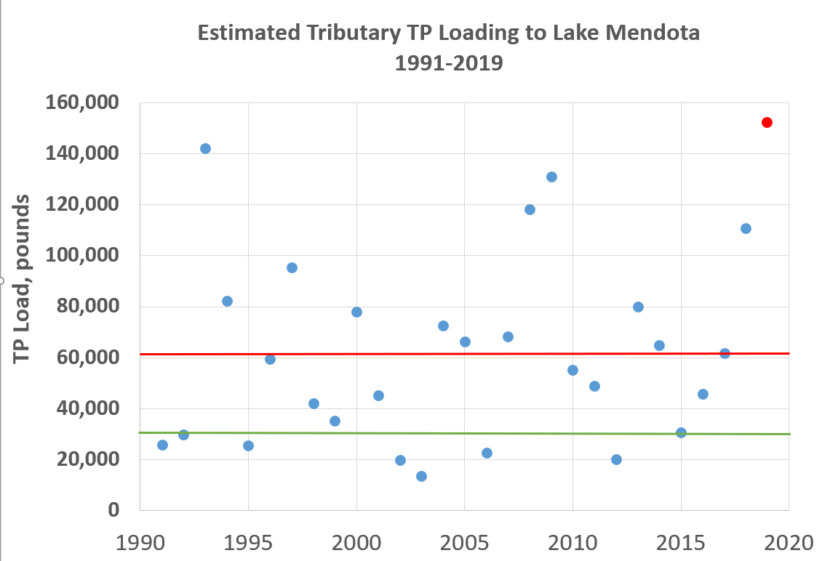
Phosphorus Reduction Challenges

