Slide 1
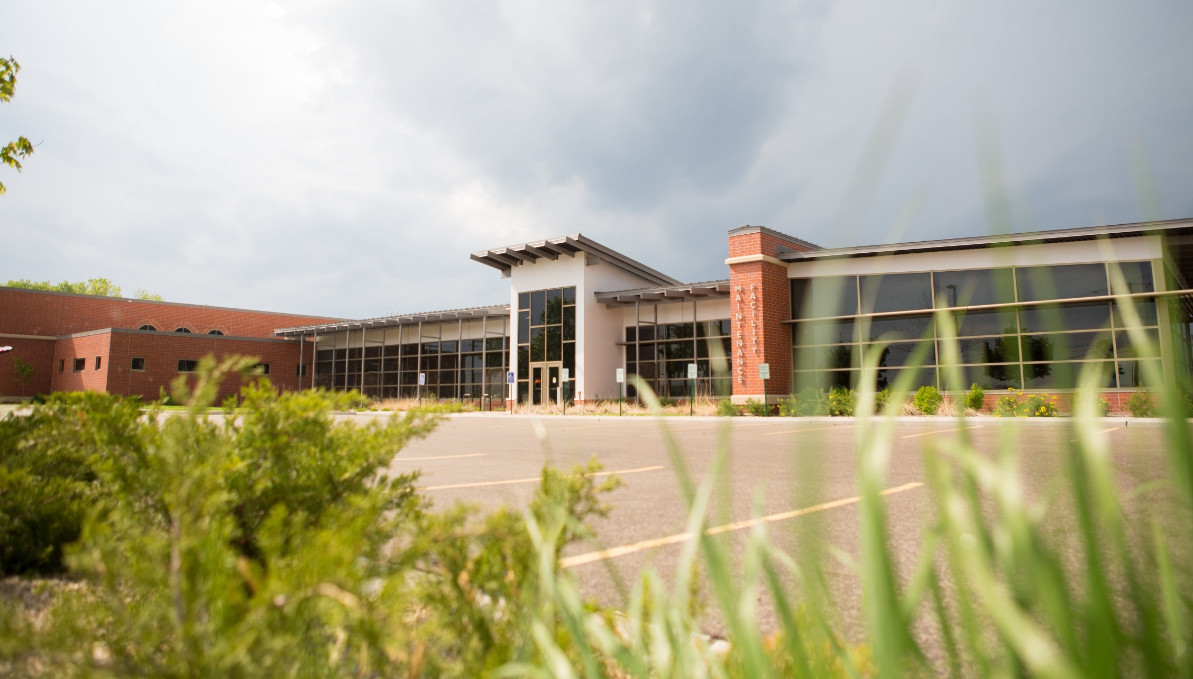
Operations & Maintenance Report – July 2020

Slide 2
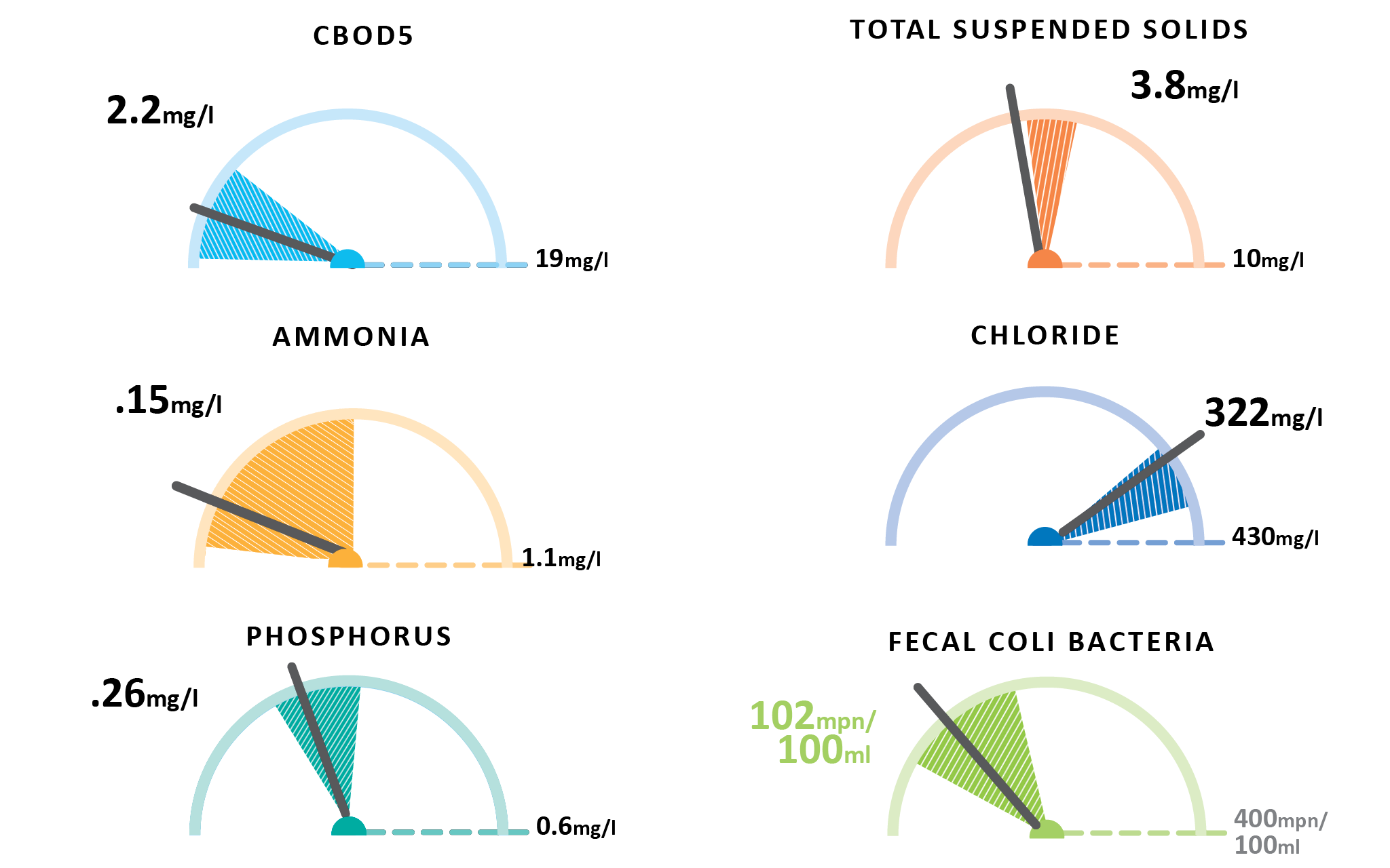
June Plant Performance

Slide 3
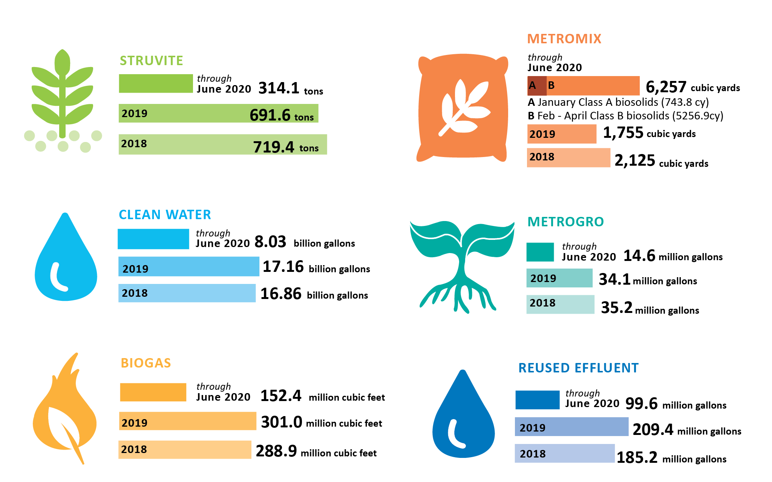
June Resource Recovery

Slide 4
What’s happened in
July
. . . so far.

Slide 5
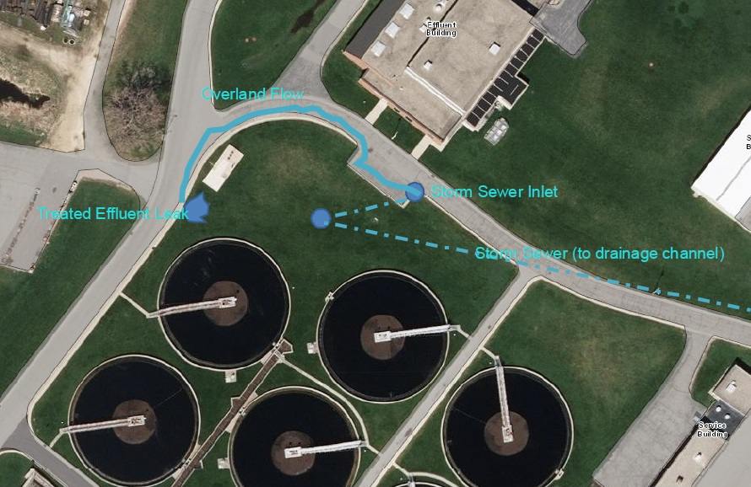
Badfish Creek Forcemain TFO Summary

Slide 6
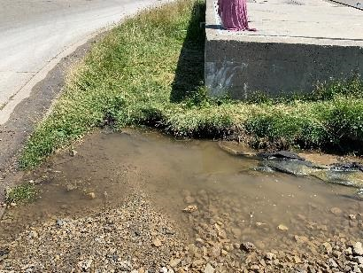
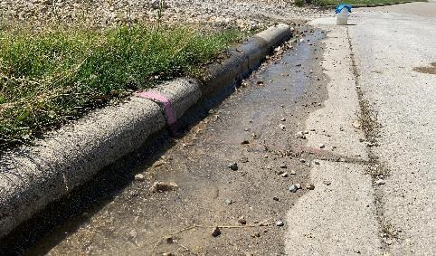
Badfish Creek FM TFO Summary
Leak discovered on the south side of the meter vault (concrete structure above)
Disinfected treated effluent flowed along curb into the storm water system

Slide 7
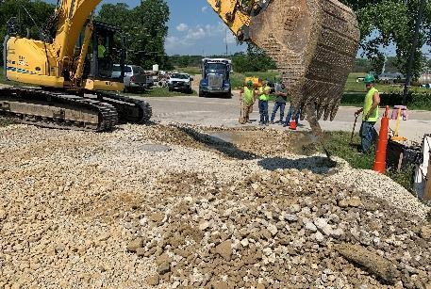
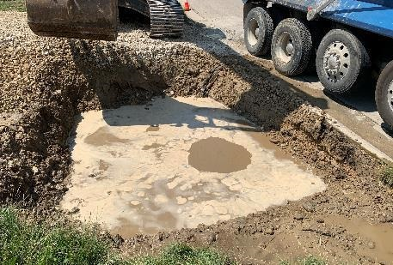
Badfish Creek FM TFO Summary
Contractor excavating where pooling water was found.
Dig site quickly filling with treated effluent.

Slide 8
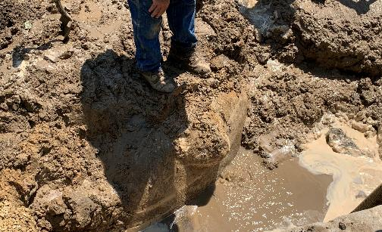
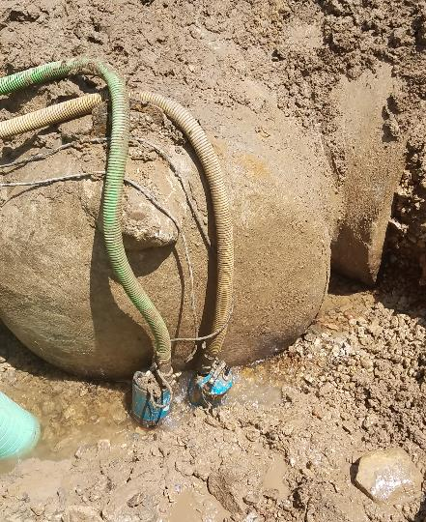
Badfish Creek FM TFO Summary
Excavation revealed leak was coming from the bottom of a capped wye section of forcemain.
Dewatering pumps needed for access to leaking pipe fitting.

Slide 9
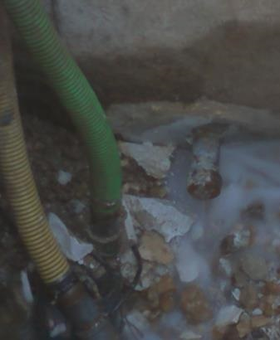
Badfish Creek FM TFO Summary
Closeup of leaking piping fitting at bottom of cap. Mortar encasing pipe has been removed.
Pipe fittings likely used for pressure testing during construction.

Slide 10
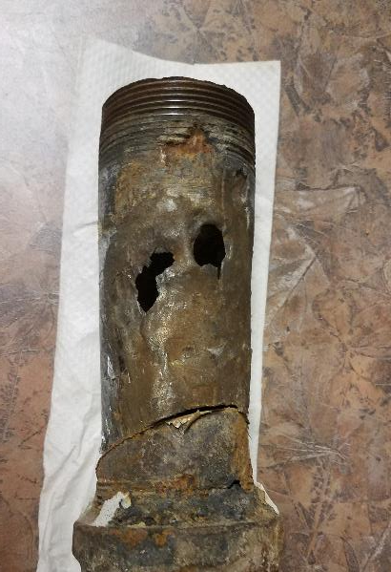
Badfish Creek FM TFO Summary
Closeup of corroded pipe fittings. Pipe is 6” long, 2” diameter

Slide 11
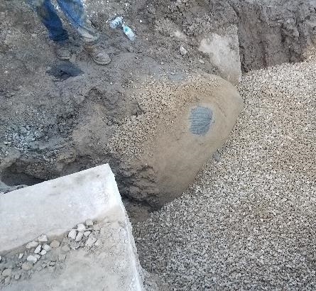
Badfish Creek FM TFO Summary
Contractor completed repairs. Mortar covered plug can be seen at top of cap.

Slide 12
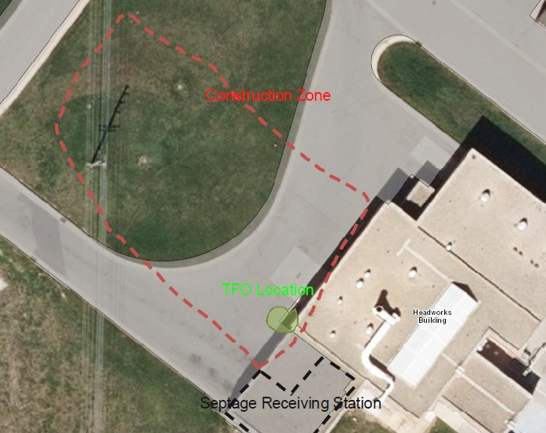
Septage Receiving TFO Summary

Slide 13
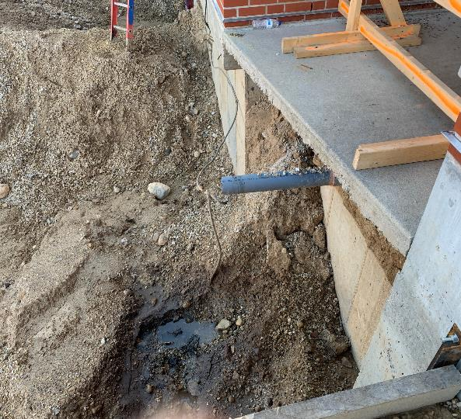
Septage Receiving TFO Summary
Source of the TFO. Drainage pipe had not been capped following disconnection.

Slide 14
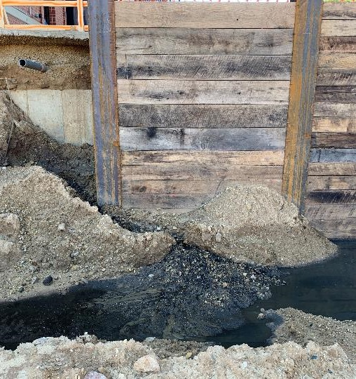
Septage Receiving TFO Summary
Spilled septage material accumulated in the contractor’s excavation site.

Slide 15
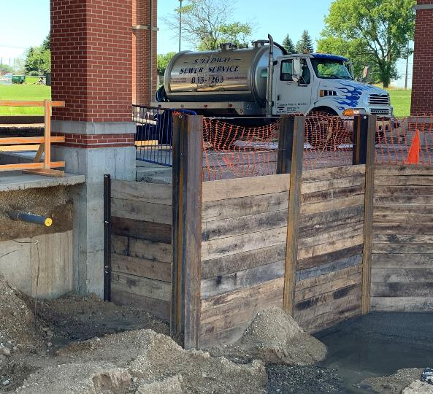
Septage Receiving TFO Summary
Line was capped to prevent further overflow.
Septage receiving station in background.

Slide 16
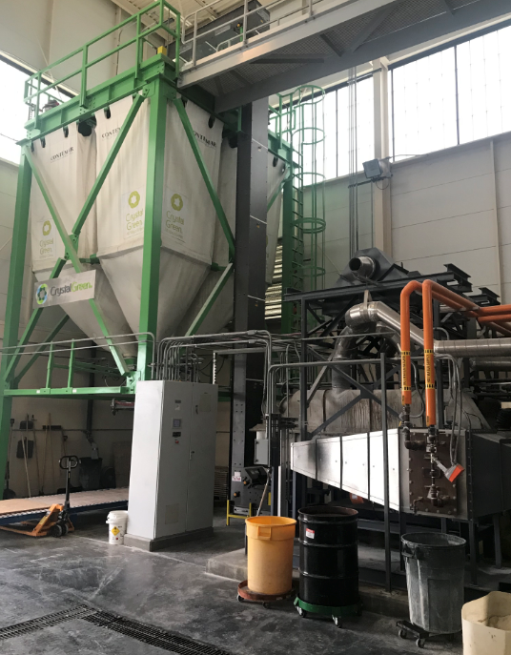
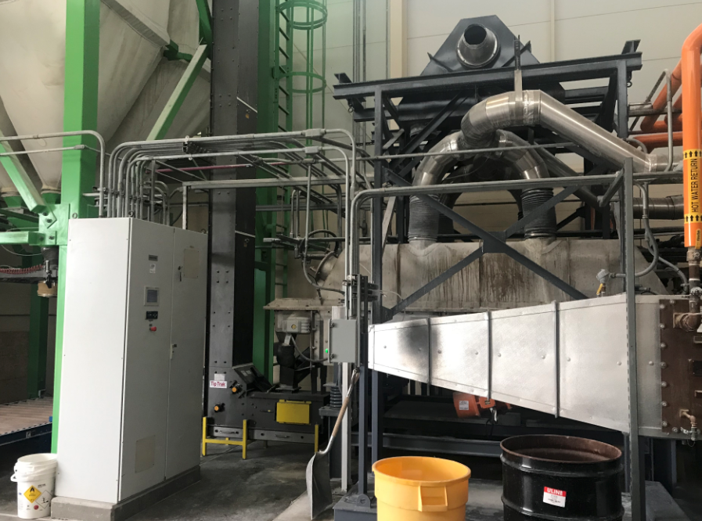
Struvite Harvesting
Conveyor

Slide 17
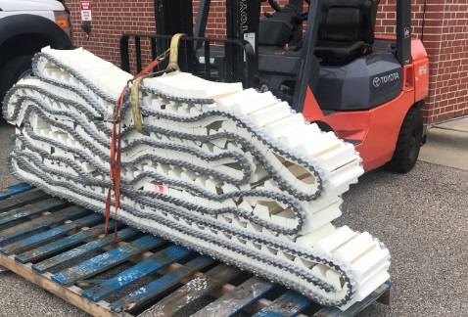
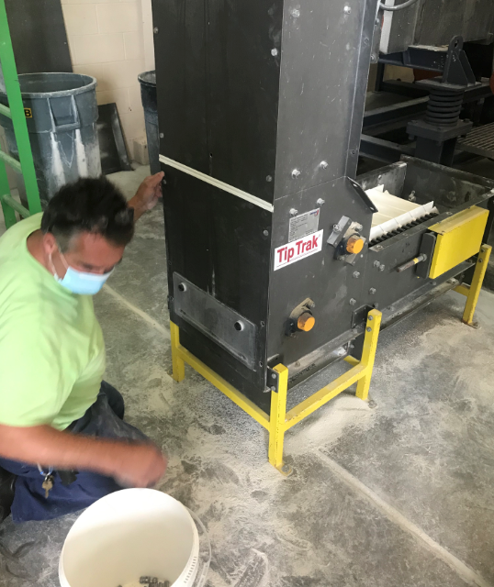
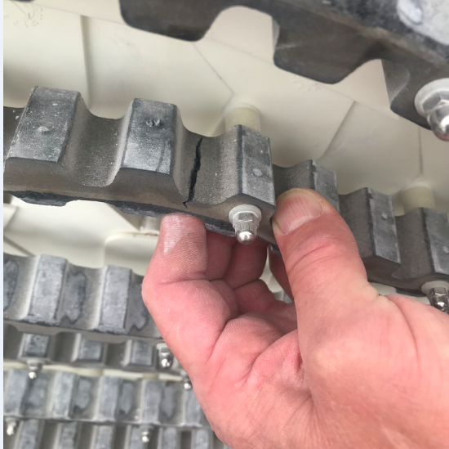
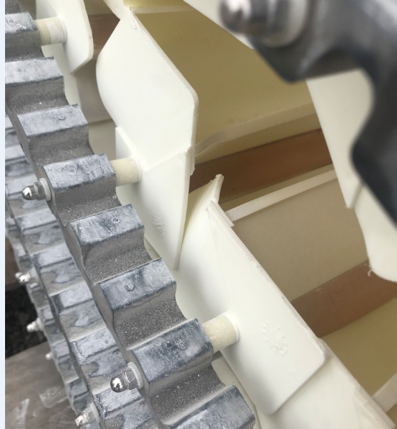
Struvite Harvesting
Conveyor

Slide 18
Operations & Maintenance
Did you know?
How many maintenance hours were dedicated to preventative maintenance in 2019?
22,815 hours
*Equivalent to approximately 13 workers 100% dedicated actual work hours.

Slide 19
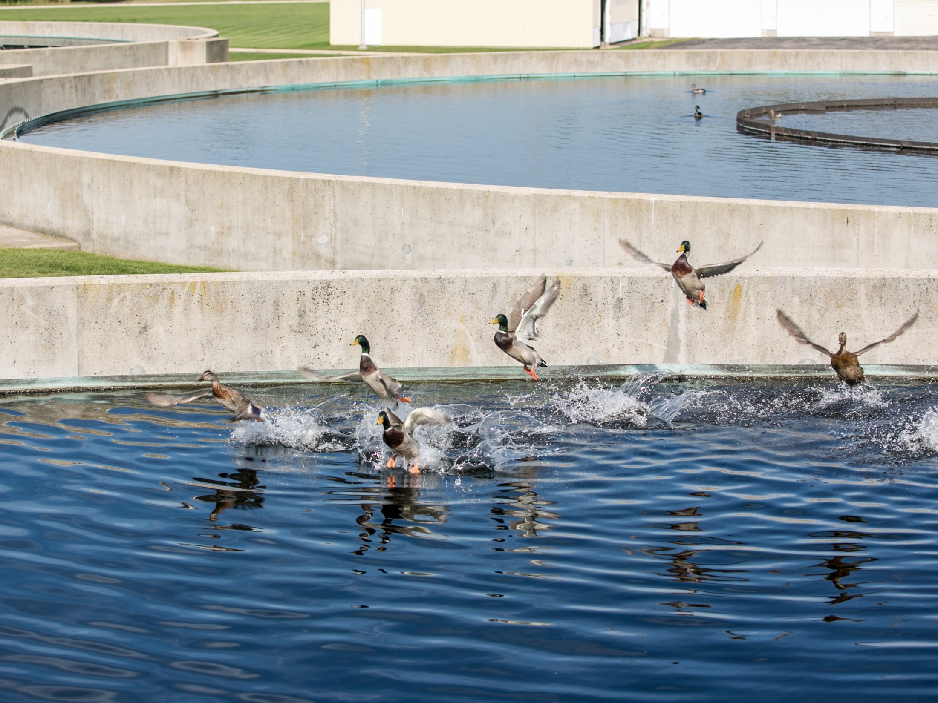
Thank you!

